Slide 1

What does AIC do for you?
Camden Murrell
cmurrell@indianacounties.org
Deputy Director of Government Affairs

Slide 2
Board of Directors
District Presidents (Elections late Spring at District Meetings)
District Vice Presidents (Elections late Spring at District Meetings)
Affiliate Presidents
Affiliate Past Presidents
Legislative Chairman (Appointed by President)
Past President of the Association
Executive Committee (President, Three Vice Presidents, Treasurer) Selected at AIC Conference from a Nominating Committee and voted on by the membership of the Board
Notes:
Distritct Presidents among the 6 dsitrcits and election happens at district meetings.

Slide 3
Offices in AIC
V=Voting Member NV Non-Voting Member
Auditor (Constitutional Term Limited) V
Clerk of Circuit Court (Constitutional Term Limited) V
Recorder (Constitutional Term Limited) V
Treasurer (Constitutional Term Limited) V
Coroner (Constitutional Term Limited) V
Surveyor (Constitutional) V
Commissioners (Statutory) V
Council (Statutory) V
Assessors (Statutory) V
Highway Engineers/Supervisors (Appointed/Advisory) NV
IT Directors and ADA Coordinators NV

Slide 4
AIC Staff
David Bottorff Executive Director
Elizabeth Mallers – Director of Communications
Jamie Bolser – Director of Governmental Affairs
Camden Murrell – Deputy Director of Governmental Affairs
Pam Coleman – Director of Finance and Corporate Affairs
Cameron Pannabecker– TRECS and Data Management
Jacque Clements – Director of Planning and Professional Development

Slide 5

How AIC Serves Indiana Counties
Education
Advocacy
Resources
Collaboration
Everything AIC does for Indiana Counties can be grouped into one of four pillars
Notes:
Advocacy
We give Indiana counties a voice at the Statehouse by representing county government before the Indiana General Assembly, state agencies, and other policymakers.
Education
We keep county officials informed through conferences, legislative updates, webinars, publications, and training opportunities
Resources
We provide members with trusted resources, research, publications, and practical tools to help them stay informed and serve their counties effectively.
Collaboration
We bring county officials together to share ideas, build relationships, and strengthen county government across all 92 Indiana counties through conferences and AIC committees.

Slide 6
Advocacy
Your voice at the State House
Represent County Government before the Indiana General Assembly.
Advance County legislative Priorities.
Protect counties from harmful legislation.
Keep members informed through legislative updates
Connect county officials with law makers.
Notes:
Advocacy is probably the part of AIC that most people are familiar with. A big part of our job is representing counties at the Statehouse and making sure county government has a voice in the legislative process.
Most of our time during the legislative session is spent talking with legislators, tracking bills through HannaIndiana, testifying in committee, and educating legislators on how proposed legislation is actually going to affect counties.
We are also there to advance county priorities. The issues that AIC works on do not come from AIC staff but instead they come from our members through the AIC legislative committee. You are the ones doing the work everyday so our legislative agenda starts with issues that county officials bring to us. And Those issues are vetted through the AIC legislative committee which includes representation from each of our affiliate groups.
While a large part of advocacy is advancing the county priorities and keeping law makers educated on issues, another large part is playing defense and preventing or improving harmful legislation towards counties. A bill may have good intentions, but there can be unintended consequences for counties, additional costs, or administrative issues that you all recognize but something legislators may have not realized until pointed out.
There are hundreds of bills moving during session that AIC is tracking across all of our affiliate groups. Obviously, you don't have time to follow every bill, amendment, or committee hearing.
Our job is to narrow that down and identify what actually matters to your office. For clerks, we compile those bills through Hannah IndianaNet and share them with your Legislative Committee so we can discuss them every week during session
And Finally, we try to connect you all with legislators throughout the process. I can always relay the position of the Clerks Association to a legislator and meet with them but sometimes it is much more effective when a legislator hears directly from you who administer at the local level. And I'll give you some real examples from this past session over the next couple of slides where members of your Legislative Committee were involved and made a difference.

Slide 7
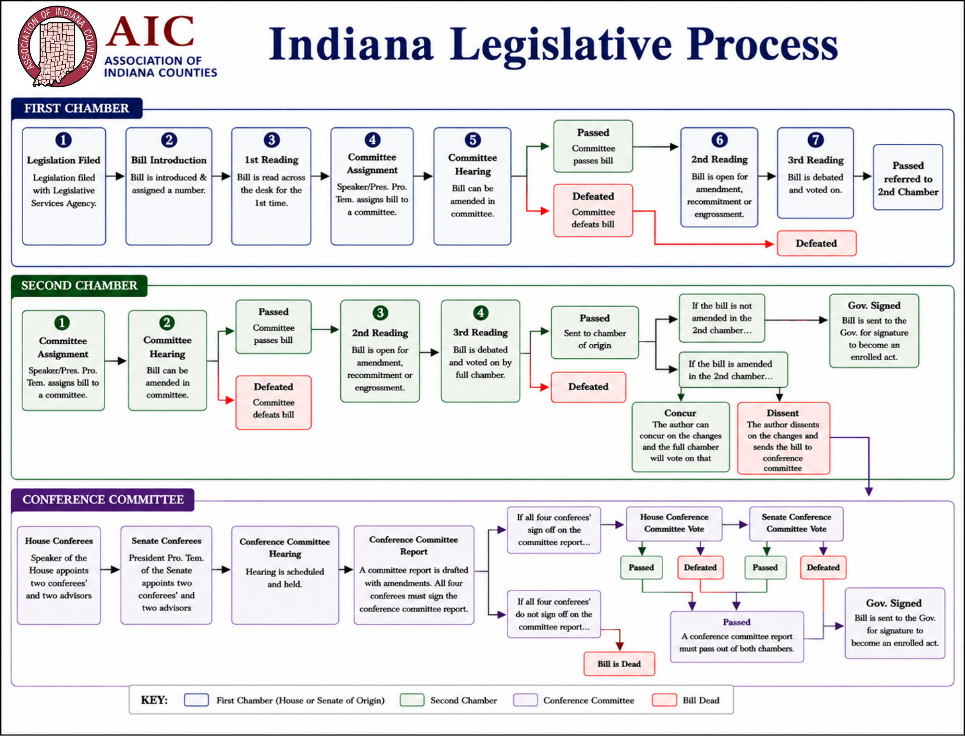
Notes:
So if we're going to talk about how clerks can be more effective advocates, it helps to understand where you can actually have an impact. We will walk through the legislative process, and as we go through it, I'll point out the places where your involvement can make the biggest difference.
This chart looks like a lot, but the basic process is pretty straightforward. A bill starts in one chamber, goes through committee, second reading and third reading, and if it passes, it goes over to the other chamber and essentially starts that process again.”
If the two chambers ultimately disagree on the language, you can end up in a conference committee before a bill reaches the Governor.
Rather than going through every single box, I want to focus on the points in this process where you as clerks can actually make an impact, because there are several.
BOX 1: The first opportunity actually happens before this chart even starts.
We talk a lot about advocacy during the legislative session, but some of the most important advocacy happens months before session begins.
Legislators don't show up in January and suddenly decide what bills they're going to file. Those conversations are happening throughout the summer and fall.
This is when we need clerks identifying problems early. If there's something in statute that isn't working, tell us what the problem is. Bring us examples. Bring us data. Explain the local impact, and ideally start thinking about what the solution might look like.
This is also a great time to start conversations with your local legislators. Build that relationship before you need something from them. If you have an issue you'd like addressed, talk with them early and see whether they're interested in carrying it.
Legislators also have limits on how many bills they can file, so getting an idea in front of them early matters. By the time session begins, many legislators already know what their bill package is going to look like
BOX 5: This is a really important point for clerk engagement. When there is a bill important to the Clerks Association, this is when we may be asking you to contact members of that committee. Even if your senator or representative isn't sitting on that particular committee, don't assume they can't help. They can still talk with their colleagues who are on the committee
AIC will testify and explain the Association's position, but there's a difference between me telling a committee that something is going to create a problem for clerks and an actual county clerk sitting in front of them saying, ‘Here's exactly how this is going to work in my office.
Bring real-world examples. Bring numbers if you have them. Explain the administrative impact. And be willing to answer technical questions.”
“You don't have to come in and give some elaborate speech. Sometimes the most valuable thing you can do is simply be the subject matter expert in the room
BOX 6: This is another important time to communicate with your local legislator.
Maybe the bill is generally good, but there's still one piece that needs fixed. Second reading may give us an opportunity to work on an amendment.
At this point, AIC may be working with the bill author or other legislators on amendment language, while clerks are helping reinforce why that change is necessary
BOX 7: Third reading is where the entire chamber votes on whether the bill moves forward.
This is still the prime time to be calling your legislator. Legislators hear from lobbyists all day long. Hearing from somebody back home can carry a different amount of weight.
BOX 1 (Second Chamber): Assuming the bill passes, it goes over to the second chamber. And for the most part, the process starts over with a new set of legislators.
The examples, data, and testimony you provided in the first chamber will still be extremely useful, but now we're taking that information to a completely different group of lawmakers.
BOX 3&4 (Second Chamber): Same thing here where second reading gives us another opportunity to address amendments. If the bill started in the House, now we're asking you to work your Senate relationships. If it started in the Senate, now we're working with your House members.
CONFERENCE COMMITTEE: Now, if the second chamber passes the exact same version, the bill can move toward the Governor. But if the second chamber changes the bill, the original author has a decision to make on whether they want to concur on the changes and send the bill to the governor's office or if they want to dissent on the changes and take the bill to conference committee. The conference committee makeup is four conferees total: two from the House and two from the Senate. The House and Senate may also appoint advisors, but those advisors are separate from the four conferees
This is where differences are settled and sometimes the disagreements are political or policy disagreements but sometimes they’re very technical which is what I’ve seen most. These committees are scheduled
However, there are instances where entire bills are shoved into another bill during conference committee. If one bill has passed either chamber, it is eligible language to be amended into another rule as long as it is germane. The germaness can be funky and something even legislators get frustrated about from my experience on senate staff. Germanness rules can be different between the house and senate as well. Generally, language can be germane to another bill if the statutes are similar or the subject matter is similar. An example of this that I have seen is the permit less carry bill in Indiana.
Once both chambers agree on language and pass out of conference committee, it will head to the governors desk for signature.
So the big takeaway from this chart is that there isn’t just one point where clerks can influence legislation. You can have an impact before a bill is filed, during committee, during amendments, before chamber votes, when the bill moves to the second chamber, during conference committee, and even after the bill becomes law

Slide 8
Education
Keeping County Officials Informed and Prepared
Prepare newly elected officials through NEO training.
Provide learning opportunities through conferences, workshops, and district meetings.
Offer continuing education through the Institute for Excellence.
Keep members informed through Indiana92, Enews, and legislative updates
Connect members with policymakers and subject matter experts through webinars and Conversations with Policymakers.
Notes:
Now I want to circle back to the other three pillars we talked about at the beginning, starting with education.
Education is another major part of what we provide to members, and it really starts from the time somebody first takes office.
NEO Training
That starts with our Newly Elected Officials Conference, or NEO. After an election year, we provide training specifically for officials who are preparing to take office for the first time.
For somebody who may be completely new to county government, there is a lot to learn very quickly. NEO gives newly elected officials a chance to better understand county government, learn about their responsibilities, meet other officials, and hear from people who have experience in these offices
Conferences, Workshops & District Meetings
“We also provide a lot of education through our conferences and meetings throughout the year.”
“That includes Annual Conference, Legislative Conference, district meetings, and other workshops. Depending on the event, that may include legislative updates, educational sessions, discussions with state agencies, or simply an opportunity to hear what other counties are doing.
Institute for Excellence
“Another program we offer is the Institute for Excellence, which gives county officials and employees an opportunity for continued professional development.”
“Those classes aren't necessarily specific to one county office. They cover broader subjects like budgeting and finance, leadership, human resources, and other skills that are useful in county government
the idea is that education doesn't stop once you know how to perform the statutory duties of your office. There's always an opportunity to continue developing professionally.
Classes: Budget & Finance, Property Taxes and Deductions, Leadership, Debt Management, Legan & Ethical, Internal Controls, Communications, ETC.
Indiana 92, eNews & Legislative Updates
We also know that not everybody can attend every conference or training, so a lot of our educational work is about getting information to members throughout the year in different formats as well.
Indiana 92, our eNews, legislative updates, and our “Conversations with policy makers” during session give us ways to communicate changes, highlight county issues, share upcoming opportunities, and keep members aware of what's happening.
QUICK REFERENCE:
NEO → foundation for newly elected
Conferences → Annual, Legislative, Districts, workshops
Institute → budget/finance, leadership, HR, development
Indiana 92 / eNews / legislative updates → year-round information
Webinars / Conversations with Policymakers → direct access to experts
Starts when elected → continues throughout career

Slide 9
Resources
Information and tools for County Officials
Provide reference publications including the Factbook, County Officials Directory, and Guide to County Government.
Keep members updated through the Indiana 92 magazine and AIC eNews.
Share timely policy information through “Conversations with Policy Makers”
Provide legislative update material from district meetings and legislative conferences.
Connect Counties with additional programs, information, and resources through NACo.
Notes:
The next pillar is Resources. There is obviously some overlap between education and resources, but when I think about resources, I think more about the actual information, publications, tools, and materials that AIC makes available to members.
Factbook, Directory & Guide to County Government
One of our biggest reference resources is the AIC Factbook. We collect information from counties across the state with the help of your county auditors and compile it into one publication.
That includes things like salaries, tax rates, road and bridge information, and a lot of other county statistics
For counties that participate in providing the information, we provide three copies, generally for the commissioner, council, and auditor. Additional copies can also be purchased
We also maintain the Directory of County Officials, which gives you a quick way to find contact information for officials across all 92 counties.
Another resource is our Guide to County Government. Newly elected officials receive that as part of NEO, and copies are also available separately. It gives a broader overview of how county government works and the different offices and responsibilities involved
eNews, IN92 & Conversations with Policymakers
eNews is our electronic newsletter for subscribers. That's where we can quickly share important updates, upcoming events, opportunities, or other information that members should be aware of.
We even have other agencies or groups we work with that will sometimes ask if we can share something in our eNews that counties should be aware of.
IN92 is our physical magazine that goes out every other month. That gives us more room to take a deeper look at current issues affecting counties.
Conversations with Policymakers is another resource we've been using during session. Those are short, usually two-minute videos with legislators, state agency heads, or other policymakers talking about something happening at the Statehouse or an update that county officials should know about.
Legislative Update Materials
We also provide legislative resources throughout and after the session.
At Legislative Conference, which happens around the halfway point of session, we give members an update on the major bills that are still alive and affecting county government.
After session, we do another comprehensive update through our district meetings that walks through the new laws that passed and explains what changed for counties.
AIC Website
Our website also has a lot of resources that members can access at any time.
We have information related to opioid settlement funds, a grants page, and an Online Buyers Guide where counties can find vendors and see what services they provide.
We also have the Doodle videos that explain what different county offices do and why those offices exist. Those can be useful not only for county officials, but also when you're trying to explain county government to the public.
AIC also connects Indiana counties with resources available nationally through NACo, the National Association of Counties.
That gives members access to national research, programs, best practices, and information about what counties across the country are doing.
Communications / Press Releases
Another resource we can provide is communication support as our communications director works on press releases around significant county events, accomplishments, or other things worth highlighlighting.
Closing
But sometimes the most valuable resource isn't a publication, a website, or a program. Sometimes it's another county official who has already dealt with the exact same issue you're facing. And that brings us to our final pillar: Collaboration

Slide 10
Collaboration
Connecting County Officials Across Indiana
Bring County officials together to share ideas, experiences, and best practices.
Support affiliate associations, committees, and working groups.
Connect members with peers who have faced similar issues.
Build relationships between county officials, state agencies, and policy makers.
Create opportunities for counties to work together.
Notes:
The last pillar is collaboration, and this is probably the one that is hardest to put into a publication or program because a lot of it is about the relationships AIC helps create.
We represent 92 counties, and one of the advantages of that is that there is a tremendous amount of experience across the state. If one county is dealing with a problem, there is a pretty good chance somebody else has dealt with something similar.
Sharing ideas and best practices
A big part of collaboration is simply getting county officials together and giving you opportunities to learn from each other.
Sometimes the best answer to a question isn't coming from AIC staff or a state agency. It may be another clerk who dealt with the exact same situation six months ago
Affiliate associations, committees and working groups
AIC also provides a place for our affiliate groups to work together. For clerks, you have your association, executive board, legislative committee, and other opportunities to discuss issues that are affecting clerks statewide
Those groups help us identify common problems and determine whether something is unique to one county or whether it is an issue we need to address statewide
Your Legislative Committee is a perfect example. Individual clerks bring issues forward, the group discusses them, and that collaboration can eventually turn into an AIC legislative priority.
State agencies and policymakers
Collaboration also extends outside county government. AIC works regularly with state agencies, legislators, other associations, and subject matter experts\
Part of our role is helping bring those groups together with county officials so there is communication in both directions.
An example that comes to mind is the opportunity you all have at the AIC legislative conference during session when we parter with state office holders (SOS, AG, comptroller) to visit with them in their offices.
For clerks, obviously IED is a good example. There are issues where AIC, the Clerks Association, IED, legislators, and individual clerks may all need to be part of the same conversation
Common challenges and priorities
One county raising an issue is important. But when we start hearing the same concern from clerks in ten, twenty, or thirty counties, that tells us we may have a larger issue that needs to be addressed
Closing
So when we talk about collaboration, the biggest takeaway is that you don't have to operate in a vacuum. You have 91 other counties, your affiliate association, AIC staff, state agencies, and a much larger network of people you can lean on.

Slide 11
AIC Committees
Legislative Committee
Training Committee
Awards Committee
Nominating Committee
Ad hoc
  By-Laws Review
  Factbook Review

Slide 12
AIC Legislative Committee
Who serves?
One representative from each Affiliate Member organization
Five at-large elected county officials
President appoints the Chair
What does it do?
Reviews legislation affecting county government
Develops recommendations for AIC positions
Helps develop AIC’s legislative program
Sends recommendations to the AIC Board of Directors
Notes:
AIC’s advocacy doesn’t happen in a vacuum. Our Legislative Committee includes representatives from each of our affiliate organizations, so the Clerks have a seat at the table. The committee reviews legislation affecting counties, makes recommendations, and helps shape the legislative program that ultimately goes to our Board.”
The AIC President appoints five at large elected county officials while considering the general makeupt of the committee and that includes the legislative committee chair as one of the 5 appointments.

Slide 13
Duties of the Executive Committee
Exercise power on behalf of the Board
Responsible for the assets and affairs of the association
Recommend, support and evaluate Executive Director
Recommend policy and report to the Board

Slide 14
AIC Legislative Committee
Who serves?
One representative from each Affiliate Member organization
Five at-large elected county officials
President appoints the Chair
What does it do?
Reviews legislation affecting county government
Develops recommendations for AIC positions
Helps develop AIC’s legislative program
Sends recommendations to the AIC Board of Directors
Notes:
AIC’s advocacy doesn’t happen in a vacuum. Our Legislative Committee includes representatives from each of our affiliate organizations, so the Clerks have a seat at the table. The committee reviews legislation affecting counties, makes recommendations, and helps shape the legislative program that ultimately goes to our Board.”

Slide 15
Follow AIC
Supporting County Officials so they can Better Serve Taxpayers
www.indianacounties.org
Follow us Facebook, Twitter and YouTube
Contact: cmurrell@indianacounties.org
317-340-2357 (cell)

