Slide 1
2026 Fall Clerk’s Conference
Holly Davis, Katie Smith and Jennifer Utter, Clerk Field Consultants

Slide 2
Agenda
  Points of Contact
  Field Consultants
  Help Desk
  Background Checks
  Fingerprinting
  CJIS Training
Notes:
During this training, we’ll cover these topics: We’ll give you some background of the IV-D program and how it came about as well as background of our computer tracking system, ISETS, what it is and why we have it. We’ll provide you with the child support duties that Indiana’s Clerk’s Offices are responsible for performing. Of course, we’ll talk about IV-D claims for reimbursement of IV-D related expenses and also how Indiana’s incentive funds for performance are distributed and can be used. We’ll also tell you about confidentiality and security duties, including performing employee background checks, which is overseen in each office by a County Systems Administrator.

Slide 3
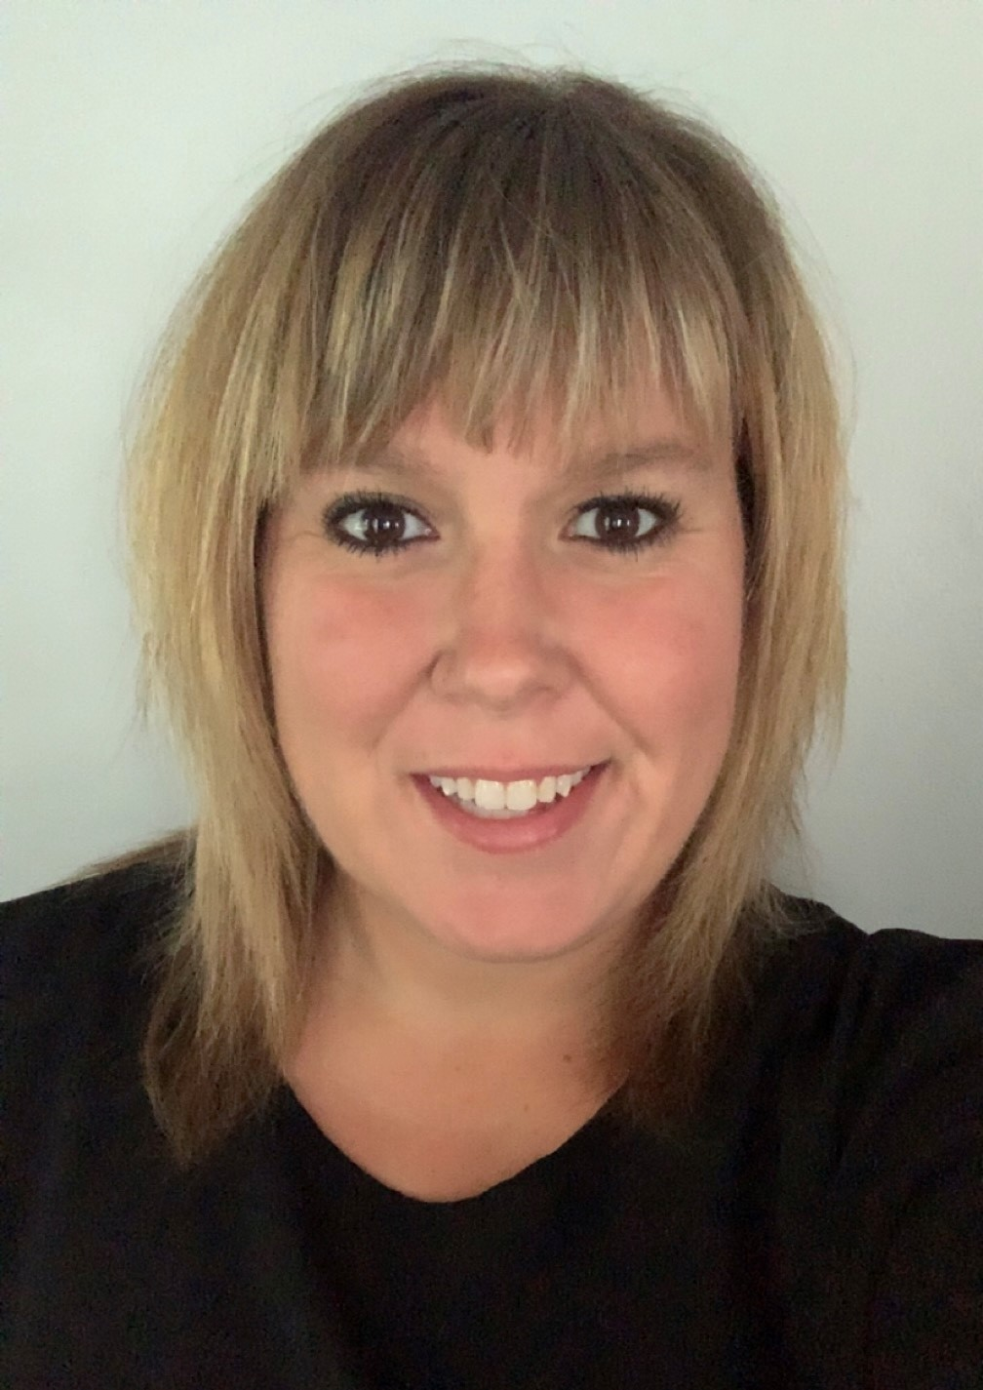
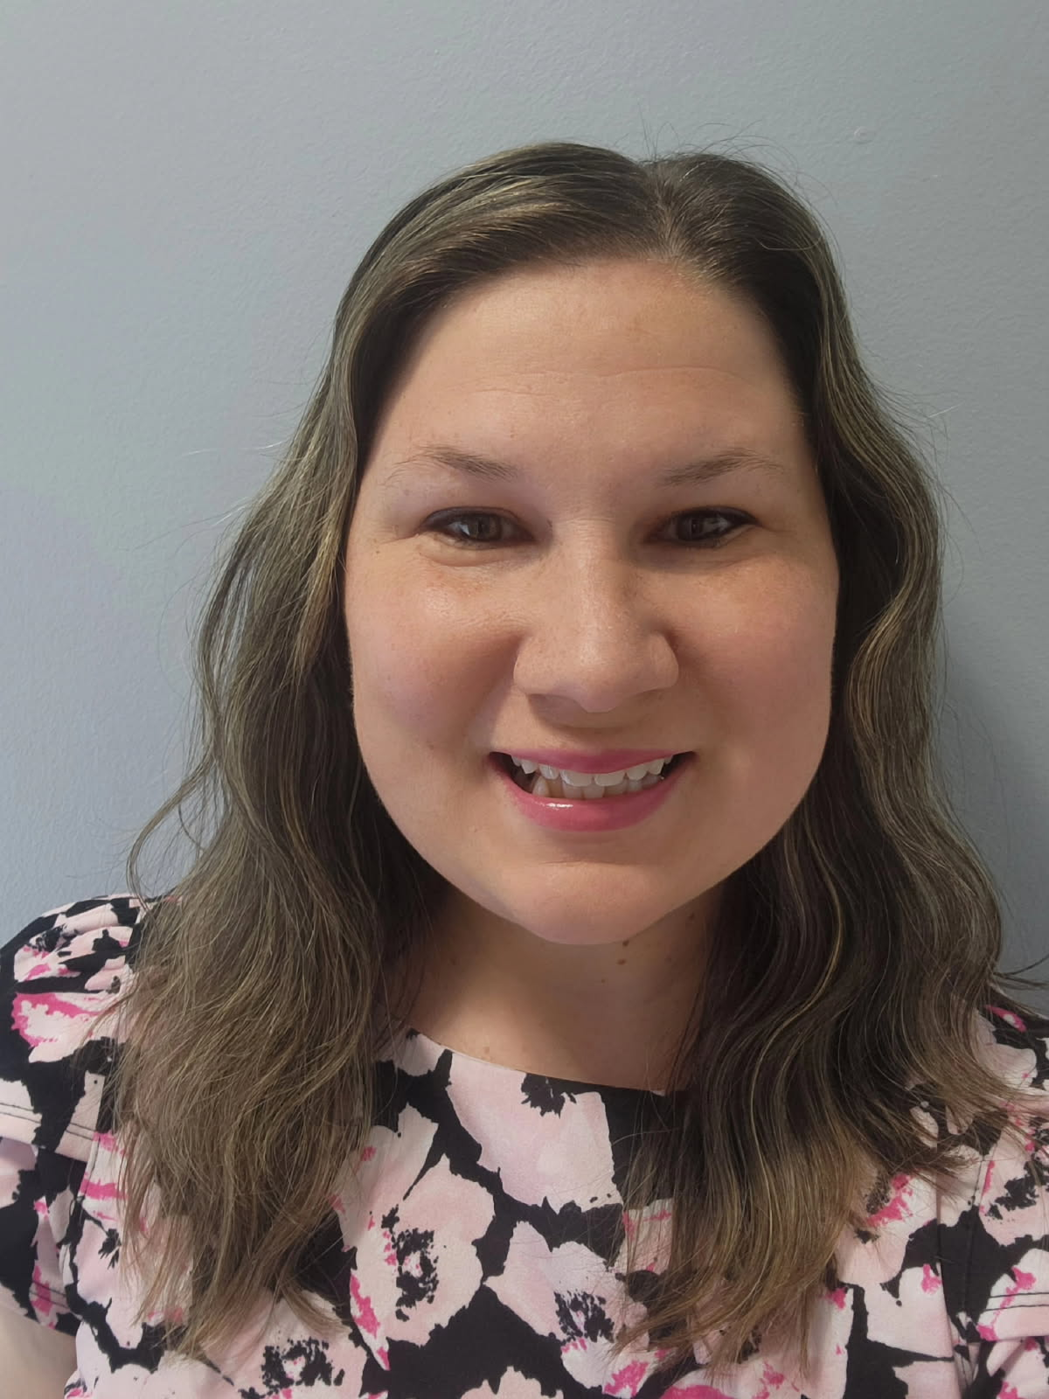
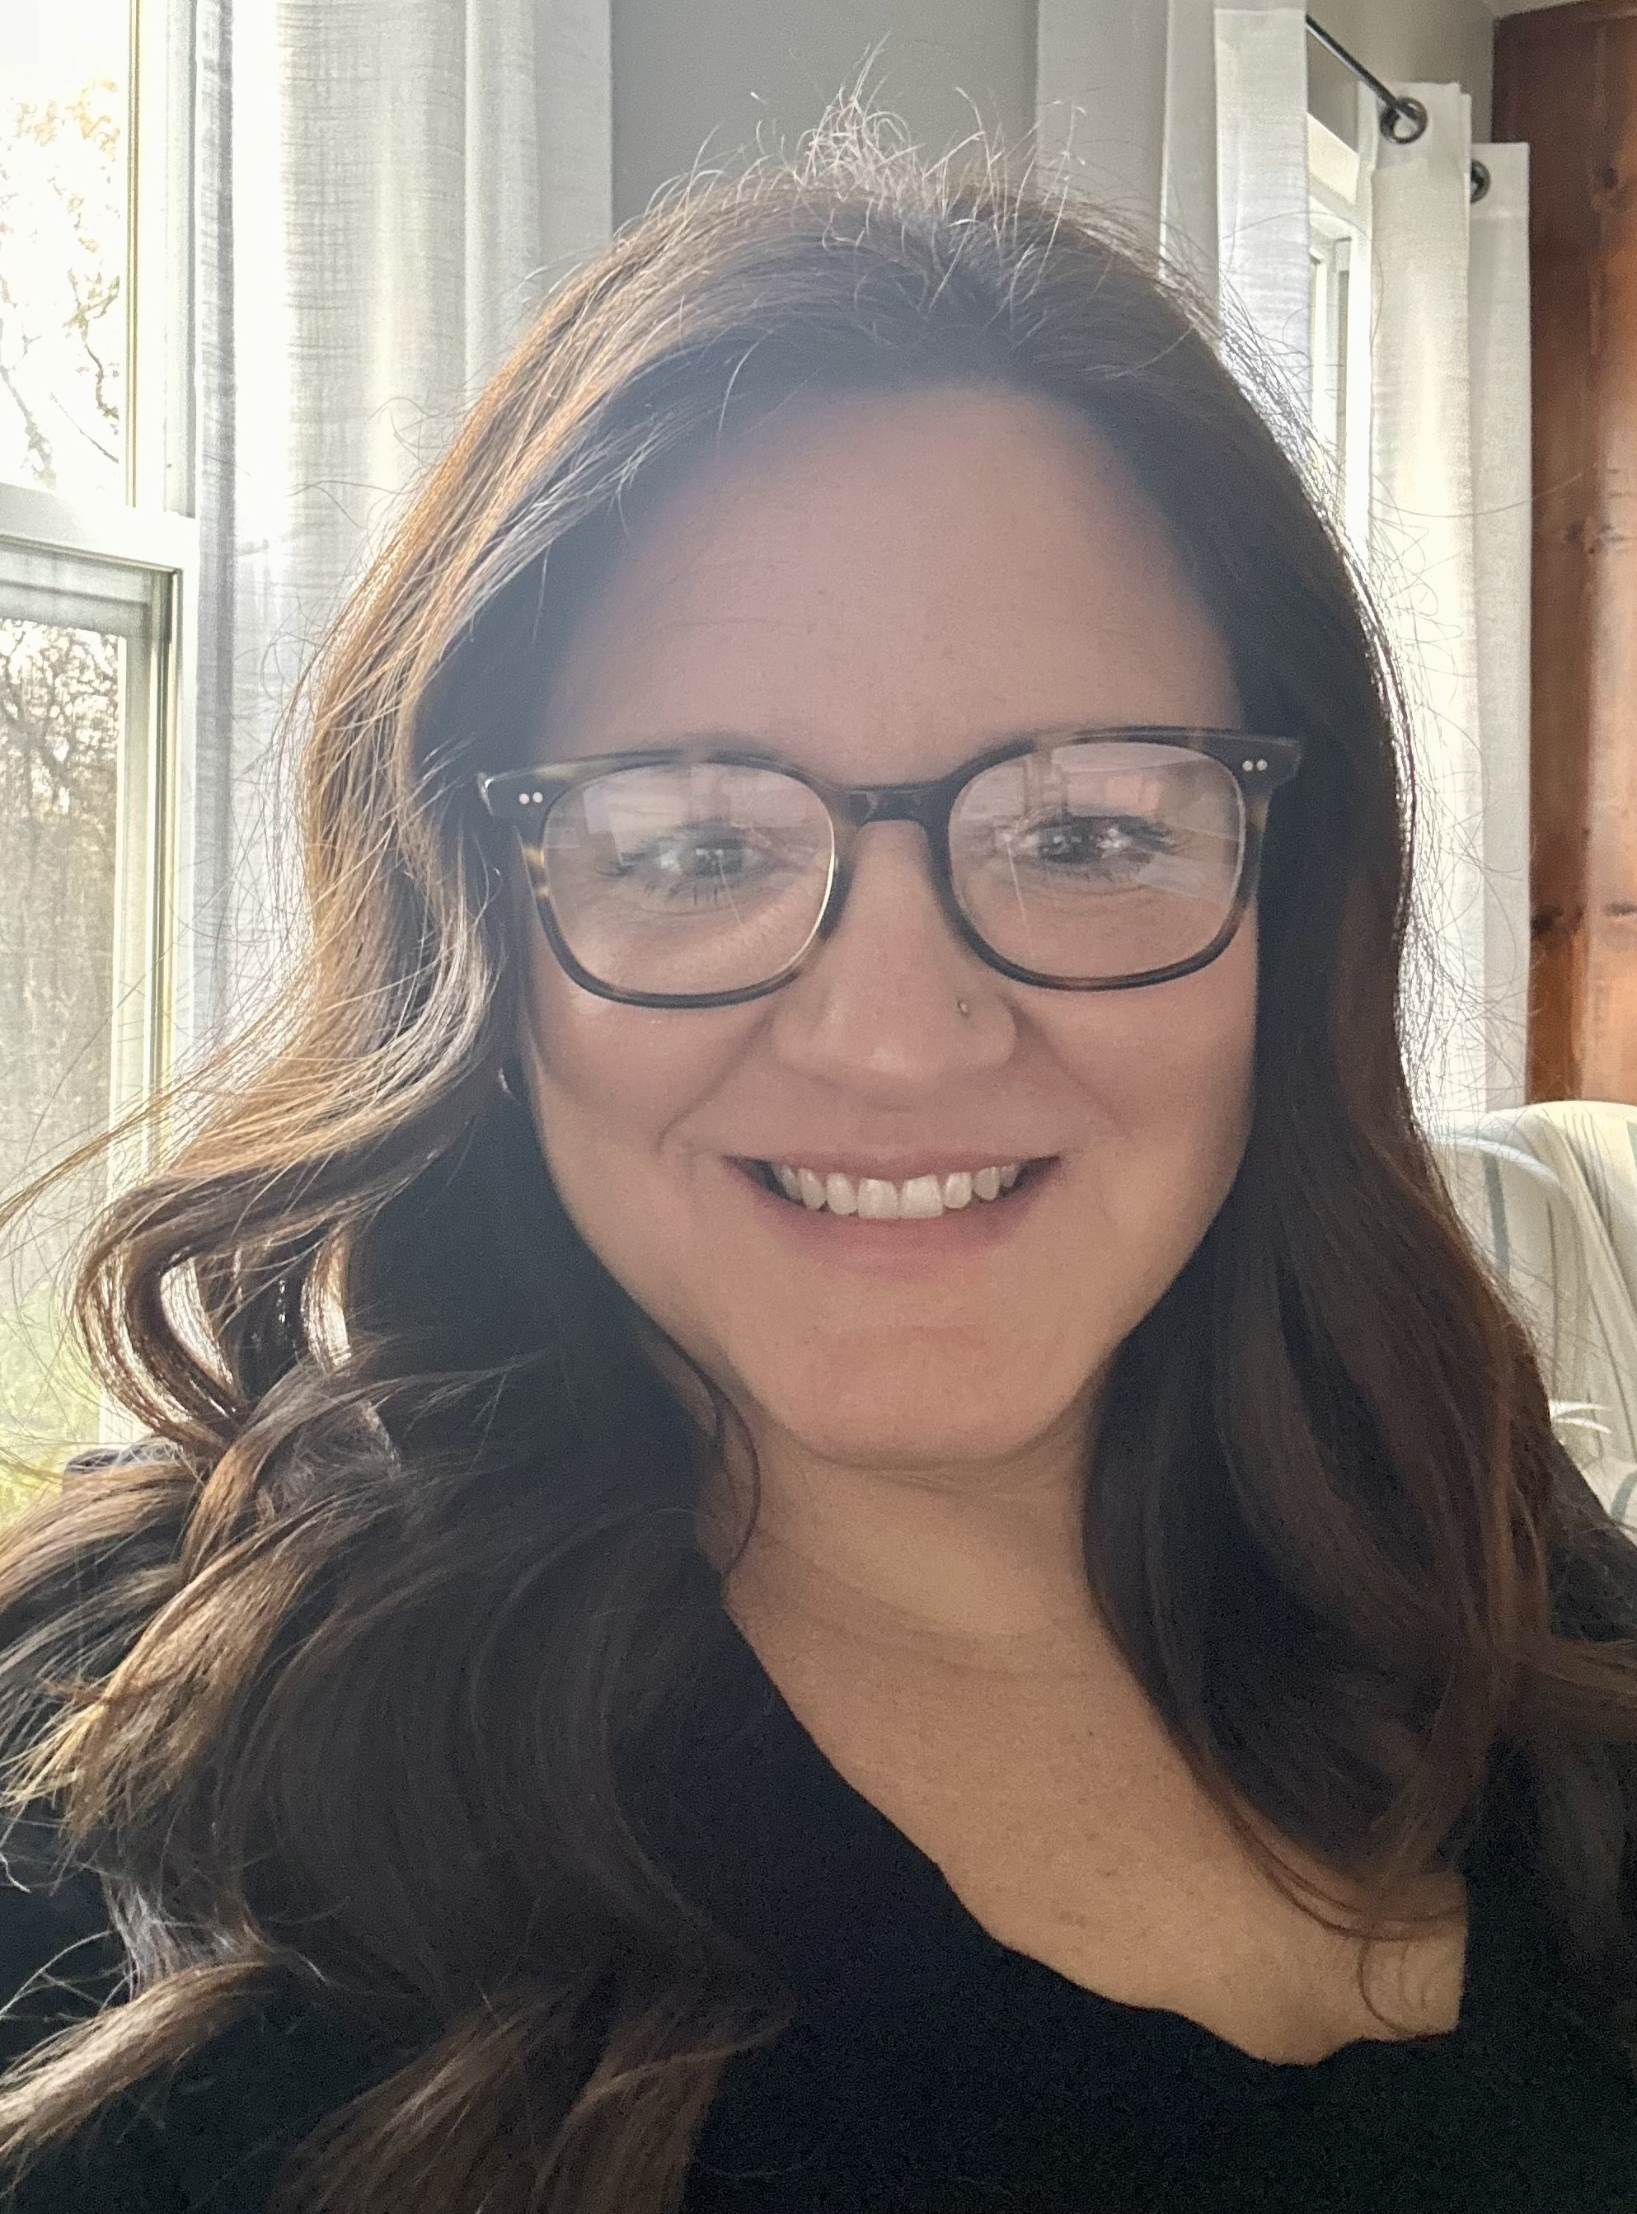
Your Field Consultants
Jennifer Utter - Region 1
Jennifer.Utter@dcs.in.gov
317-518-0976
Holly Davis - Region 2
Holly.Davis@dcs.in.gov
317-447-5634
Katie Smith - Region 3
Kathryn.Smith@dcs.in.gov
317-417-5256

Slide 4
ISETS Help Desk
Phone #: 1-800-876-4515
Email: ISETSHelpDesk@dcs.in.gov
ISETS HELP DESK HELPS WITH:
Bank Reconciliation
Software Issues
County Owned Fund Manual Adjustments
Password Resets
Multi-Factor Authentication Assistance

Slide 5
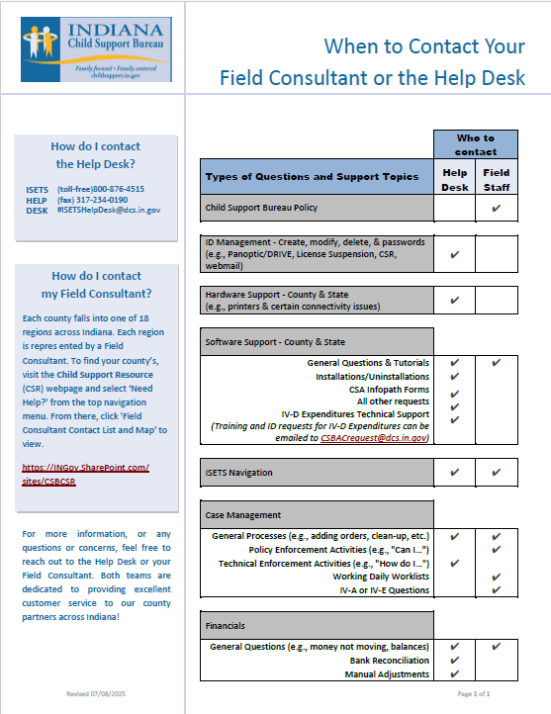

Slide 6
Background Checks
DCS IT Security Team
  Email: itsecurity@dcs.in.gov
Barada Associates
  www.baradainc.com
  customerservice@baradainc.com
  (800) 616-5917 8:00 a.m. to 5:00 p.m. EST

Slide 7
Fingerprinting
  INkless
    ISETSHelpDesk@dcs.in.gov
  IDEMIA Billing Questions
    ue2_cares_in@ps-idemia.com

Slide 8
CJIS Training
  Required Annually
  Basic Users – Level 1 CJIS
  Fingerprint Reviewer – Level 2 CJIS
  IT Support Staff- Level 4 CJIS
  CJIS Contact:
    Jason McIntyre (Indiana State Police) jmcintyre@isp.in.gov

Slide 9
THANK YOU!
Thank you for all you do for all 92 counties!
Field Consultant Contact Info:
Jennifer Utter - Region 1
Jennifer.Utter@dcs.in.gov
317-518-0976
Holly Davis - Region 2
Holly.Davis@dcs.in.gov
317-447-5634
Katie Smith - Region 3
Kathryn.Smith@dcs.in.gov
317-417-5256
Notes:
Tell what exactly the Cooperative Agreement is.

