Slide 1
Marriage License

Slide 2
Clerks are encouraged to speak with the county attorney about specific situations.
Information in this presentation is based on statutes, Office of Court Services, Department of Health and Department of Correction responses.

Slide 3

Annual Marriage Licenses Returned:
2026 – 23,734 *
2025 – 43,152
2024 – 42,930
2023 – 40,437
2022 – 41,741

Slide 4
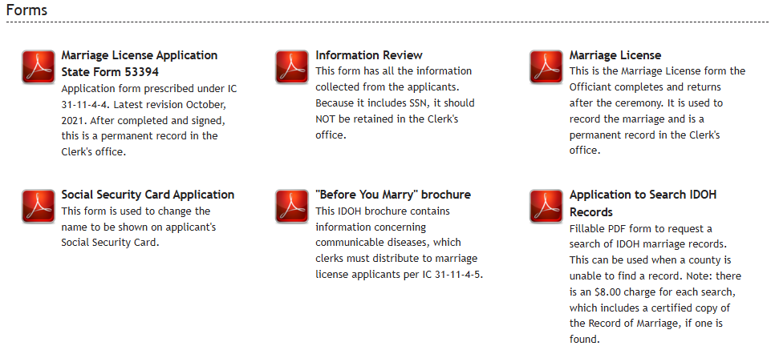
INcite > Documents > Marriage License

Slide 5
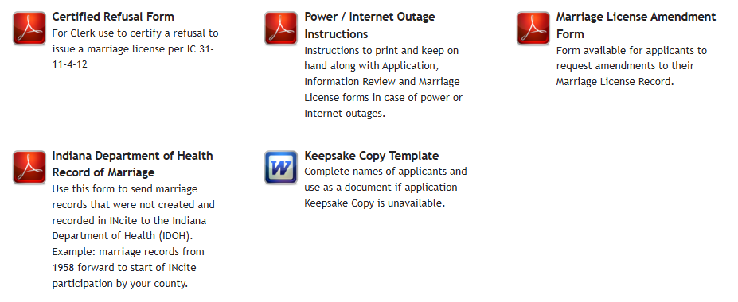
INcite > Documents > Marriage License

Slide 6

Marriage License Amendment Form:
Opens as a fillable .pdf or can be printed for completion
Can be used to make data entry errors such as:
If available, both parties should sign
The amendment form should be kept with the original license records
It can also be uploaded to INcite if desired ( )
NOTE: Scanning to INcite does not remove requirement to maintain marriage license records **

Slide 7
Can information on an issued license be corrected or is a new license required?
If the license is not expired, you can correct the information and provide an updated license.
Use the same process to make a correction as the amendment form.
Once finished, you can provide the corrected license.
There is no way to void a license.

Slide 8
Name Change After Marriage:
IOCT maintains these records for the Department of Health. Their guidance is that because licenses are permanent records, it is not recommended the record be amended unless the information was incorrect when it was created and an amendment form is completed.
  For example, if the name was ABC when the license was issued, changed to XYZ by court order, that does not change the legal name of the applicant at the time the license was issued. A court order for name change is proof of legal changes; it can be used to trace the party name together with the license.
NOTE: The exception to this would be if the court order specifically directs the marriage license record be amended; the clerk would need to determine the steps to comply. If a change is made to the license record, the documentation should be retained with the original application/license.

Slide 9
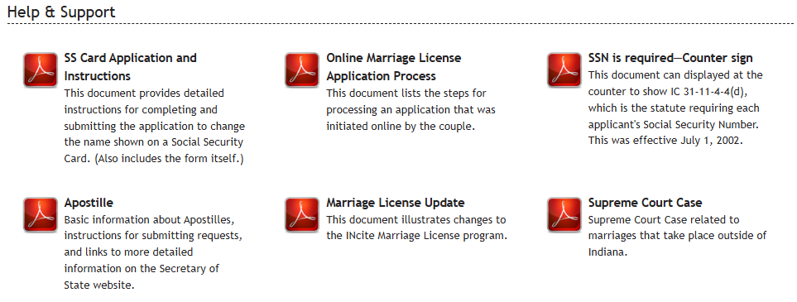
INcite > Documents > Marriage License

Slide 10
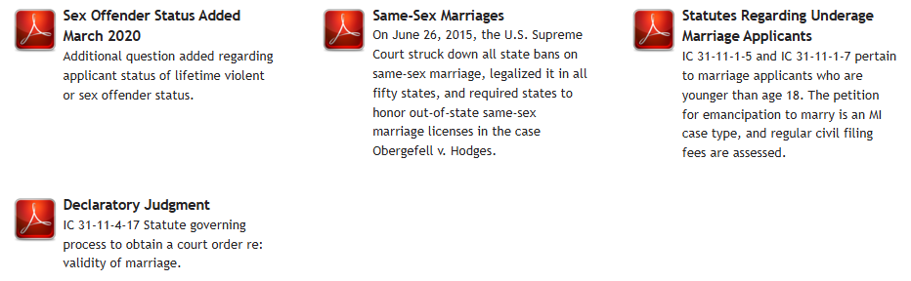
INcite > Documents > Marriage License

Slide 11
Is the Clerk Required to Verify the Provided Address?
Some Clerk offices have local policies regarding address verification to ensure applicants apply in the correct county and assessed the correct fee.
IC 31-11-4-3 County of residence or solemnization; place to obtain license
Sec. 3. Individuals who intend to marry must obtain a marriage license from the clerk of the circuit court of the county of residence of either of the individuals. If neither of the individuals who intends to marry is a resident of Indiana, the individuals must obtain the marriage license from the clerk of the circuit court of the county in which the marriage is to be solemnized.

Slide 12
Issuing a marriage license when one party is unable to apply in person (hospitalized):
There is no statutory provision in IC 31-11 that power of attorney or guardianship may be used to apply for the marriage license on behalf of another person.
Some counties have made accommodation that the parties complete the biographical information online, then the Clerk sends an authorized staff member to the facility with a paper application to complete and obtain signatures and the marriage license. The information can be added to the INcite record; the completed INcite and signed applications should both be retained.
NOTE: A concern is always that medication an applicant may be consuming would be an issue with the “under the influence” question.

Slide 13
Can a power of attorney be used to stop the issuance of a marriage license?
The authority of the power of attorney depends on the language of the document. The specific conditions when a Clerk may not issue a marriage license are:
IC 31-11-4-11 Conditions precluding issuance of marriage license
Sec. 11. A clerk of a circuit court may not issue a marriage license if either of the individuals who applies for the license:
(1) has been adjudged to be mentally incompetent unless the clerk finds that the adjudication is no longer in effect;
(2) is under the influence of an alcoholic beverage or a narcotic drug; or
(3) is a lifetime sex or violent offender, unless the individual submits an affidavit stating under the penalties of perjury that the individual has provided written notice of the person's:
(A) intent to marry; and
(B) intended married name;
to the local law enforcement authority in the county of conviction and in the person's county of residence.

Slide 14
Officiants Authorized in IC 31-11-6-1:
1) Can an out-of-state ordained minister perform a ceremony in Indiana?
Yes. There are no restrictions on the geography for the officiant as long as qualified in statute.
2) Does the officiant have to show proof of qualifications?
No. There is no requirement to ‘register’ or provide documentation.
3) Can an applicant also serve as officiant?
Yes. We’ve had this raised recently. The response from IOCS: If the applicant is legally authorized to conduct a wedding, the statutes do not prohibit him/her from officiating his/her own wedding ceremony.

Slide 15
Marriage License Information for Public Search:
Marriage License Public Lookup from public.courts.IN.gov
  https://publicaccess.courts.in.gov
Department of Health – Vital Records / Marriages
  https://www.in.gov/health/vital-records/marriages
Indiana State Library > Online Resources > Indiana marriages (date ranges)
  https://www.in.gov/library
  https://digital.statelib.lib.in.us/legacy/search.aspx?index=2

Slide 16
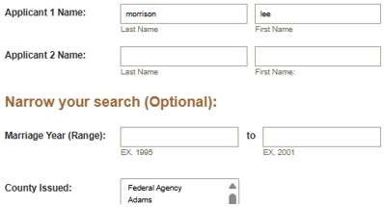

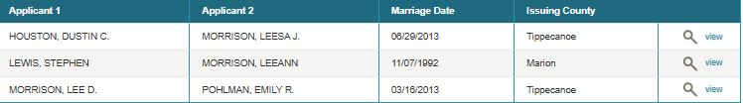
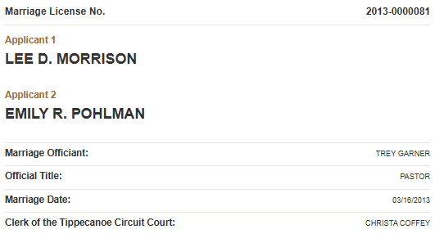
Marriage Licenses Are a Public Record:
public.courts.IN.gov

Slide 17
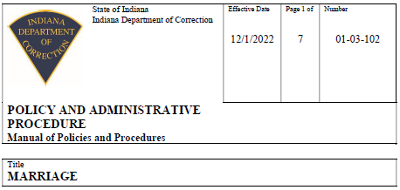
Department of Correction: Marriage Policy:
Manual of Policy and Administrative Procedure:
https://www.in.gov/idoc/files/policy-and-procedure/policies/01-03-102-Marriage-12-1-2022.pdf
Includes information for coordinating requests and the IDOC review process
“However, the incarcerated individual and the intended spouse shall be advised that the County Clerk may have certain rules regarding both parties being present to obtain the Marriage License that must be followed and that the Department has no authority over either the County Clerk or the Clerk’s rules.”

Slide 18
Record of No Marriage:
The Indiana Department of Health can issue a certified “Record of No Marriage” after performing a search, and that tends to meet this requirement. These are the instructions to request a Record of No Marriage:
Use State Form 54764 to request a search (https://www.in.gov/health/files/Marriage-Application-10.2018.docx and the form is also attached).
Include the full name on the Applicant 1 line.
On the next line, mark out Applicant 2 and type or write “Record of No Marriage” in that space.
Use “N/A” for the Date of Marriage, County of Marriage and City of Marriage.
Complete the remaining fields (signature, mailing address, daytime telephone number and today’s date).
Mail the completed form and a check or money order for $8.00 payable to the Indiana Department of Health to this address:
Vital Records
Indiana Department of Health
2 North Meridian Street
Indianapolis, IN 46204

Slide 19
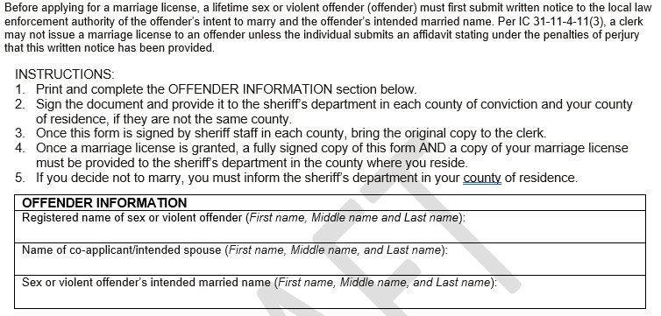
Coming Soon! Affidavit for Lifetime Offender:
Part 1:

Slide 20
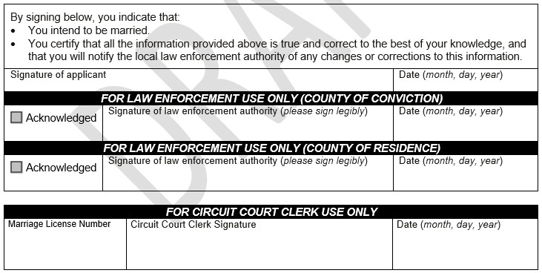
Coming Soon! Affidavit for Lifetime Offender:
Part 2:

Slide 21

Thank you!
Christa Coffey
christa.coffey@courts.in.gov
317-233-7640
helpdesk@courts.in.gov
888-275-5822
317-234-2588

