Slide 1


ACCCIND Website Forum
Anjan Kashyab
An Island, LLC

Slide 2
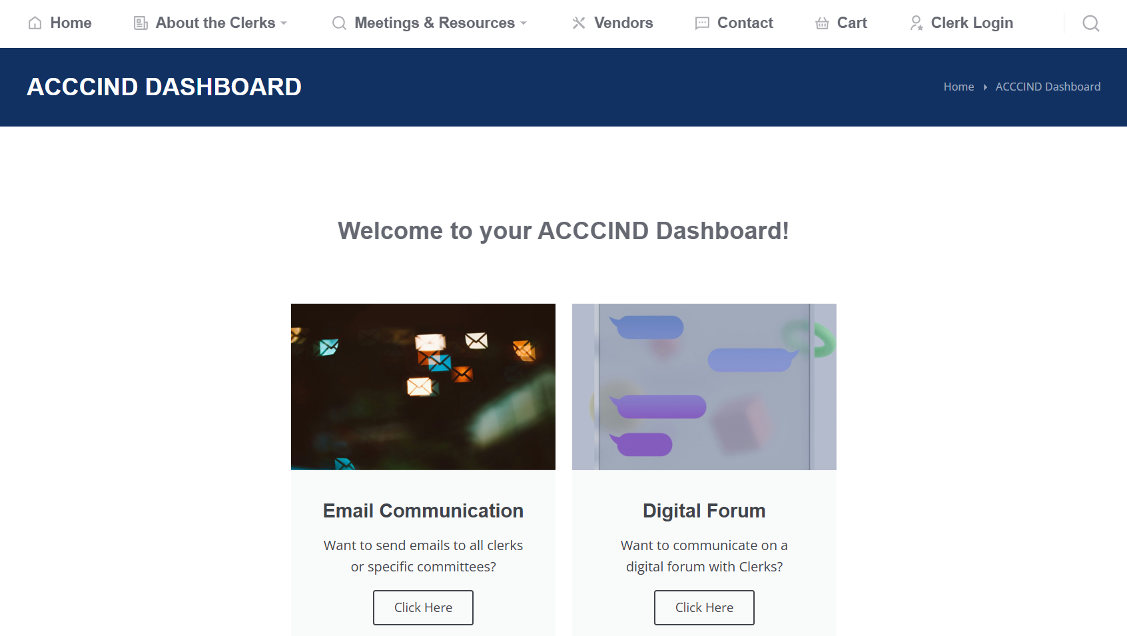
What is the Website Forum?

Slide 3
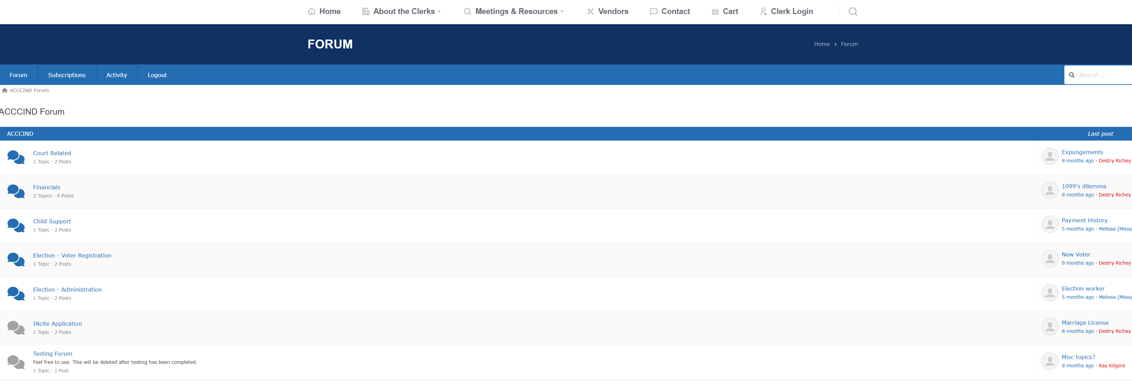
Why is the Website Forum needed?

Slide 4
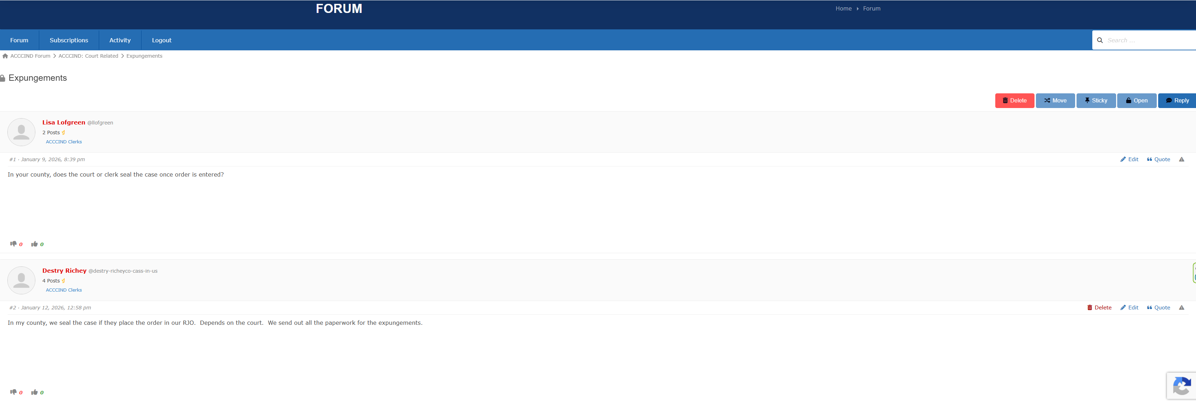
How do you use the Website Forum?

Slide 5
List of Main Features
Forum Category
Forum Sub-Category/Topic
Communicate in Forum/Thread
Create Polls in Forum/Thread
Subscribe to Forum/Thread for Updates via Email

