Slide 1

Unclaimed Property
Presented by: Patience Senter, Reporting Supervisor
Amy Hendrix, Unclaimed Property Director
Sam Sites, Deputy Attorney General
6/10/2026

Slide 2

Welcome
Since taking office in 2021, Attorney General Rokita has taken strong actions to protect liberty and the rule of law. Employing nearly 400 staff members, the Office of the Indiana Attorney General serves with a servant’s heart to ensure Hoosiers’ voices are heard and protected.
Our Services to Hoosiers
  As attorney for the State of Indiana, we represent state agencies and officeholders. With nearly 20,000 active cases at any given time, our office defends laws passed by the legislature and challenges federal overreach harmful to Hoosiers.
  We protect consumers from illicit business practices, cybersecurity and data privacy violations, and ID Theft. We have obtained nearly $1.1 billion in settlements for Hoosiers - including hundreds of thousands from annoying and illegal robocallers.
  We return over $1 million in Unclaimed Property to Hoosiers every week – achieving a record $88 million returned in 2025.
  Since taking office, we have recovered $97 million from entities allegedly engaged in Medicaid fraud.
  Our Appeals Division handles over 2,000 criminal and civil cases each year, including those that uphold convictions and sentences for child abusers, murderers, and rapists.

Slide 3

Agenda
Unclaimed Property Law – Sam Sites
General Unclaimed Property Information – Amy Hendrix
How to Report – Patience Senter

Slide 4
Unclaimed Property Laws - Background
Many unclaimed property laws have been around since the 1950s. It’s one of the original consumer protection plans.
Each state has a department that deals with unclaimed property as well as its own law.
In most states, unclaimed property divisions are usually part of the Treasurer’s Department or the Secretary of State.
In Indiana, our Unclaimed Property Division (UPD) is a division of the Attorney General’s Office.

Slide 5
Purpose of Unclaimed Property Law
Protect the interests and property rights of owners.
Relieve holders from the expenses and liabilities associated with the property.
Ensure that any economic windfalls benefit the public, not an individual holder.

Slide 6
Holder Obligations
Unclaimed property laws require businesses (holders) to review their records each year to determine whether they hold any funds, securities, or other property that has been unclaimed. Ind. Code § 32-34-1.5-19
These businesses make annual reports and transfer the property to the appropriate states.
The holder does not have to be incorporated in Indiana, or even conduct business in the state, to have reportable property for Indiana. The only requirement is that the business records show that the owner's last known address was in Indiana. I.C. § 32-34-1.5-14(b)

Slide 7
State Obligations
States are obligated to maintain the unclaimed funds until the rightful owner claims them.
All states make a diligent effort to locate and return these funds to the rightful owner, at no cost to the owner.

Slide 8
Unclaimed Property in Indiana
Indiana Code
§§32-34-1.5
The only Unclaimed Property office in the nation under the administration of the Attorney General’s Office
"Revised Uniform Unclaimed Property Act" (RUUPA)
Remittance due with annual report.
I.C. § 32-34-1.5-29
The Attorney General’s Office protects consumers/claimants/owners by attempting to locate the rightful owner or their heirs for 25 years. During this time, individuals who are legally entitled may file a claim for the property with the Unclaimed Property Division.

Slide 9
Courts' Unclaimed Properties
Presumption of Abandonment | I.C. § 32-34-1.5-4(9)
"(9) For property held by a court, including property received as proceeds of a class action, three (3) years after the property becomes distributable."

Slide 10
Outreach Efforts
The Attorney General attends the Indiana State Fair and other large events to inform attendees about unclaimed property and our FREE public services
The Unclaimed Property Division has full-time staff members who work to proactively locate owners
If the money goes unclaimed for 25 years, it is permanently escheated into the General Fund and can no longer be claimed
Social media, celebrity spokespeople (Jeff Saturday, Sammy Terry), and a 24/7 searchable website are utilized to reunite owners with their property

Slide 11
Clerk’s Process for Reporting Unclaimed Property

Slide 12
Property Types –
Government Agencies/Courts
Court Deposits
Restitution Awards
Bail Bonds Deposits
Support Payments
Escrow Accounts
Condemnation Awards
Wages / Payroll
Accounts Payable
Accounts Receivable
Tax Refunds

Slide 13

The State’s Responsibility
Release and indemnify the holder from liability
Secure the funds in a custodial capacity
Make efforts to locate the owners
Pay claims

Slide 14
Clerk’s Obligations
PROTECT funds until reported and transferred to the state
PERFORM due diligence
FILE a report
REMIT the property
MAINTAIN copies of all reports and supporting documentation
REPORT MUST contain the last known address, if known. Reporting this information is critical to the claiming process and reduces the chances that the owner will need to contact you to request documentation to support their claim.

Slide 15

Indiana requires holders to attempt to contact the owner of the property in advance of reporting it. This is known as due diligence.
All holders are legally bound to perform due diligence.
Indiana statute IC 32-34-1.5-23 requires that due diligence be performed on all unclaimed property of $50 or more.
Due diligence must be performed no more than one hundred eighty (180) days, or no fewer than sixty (60) days, prior to the filing of the report.
Mail notifications must be sent to property owners by first class mail or better at their last known address.

Slide 16
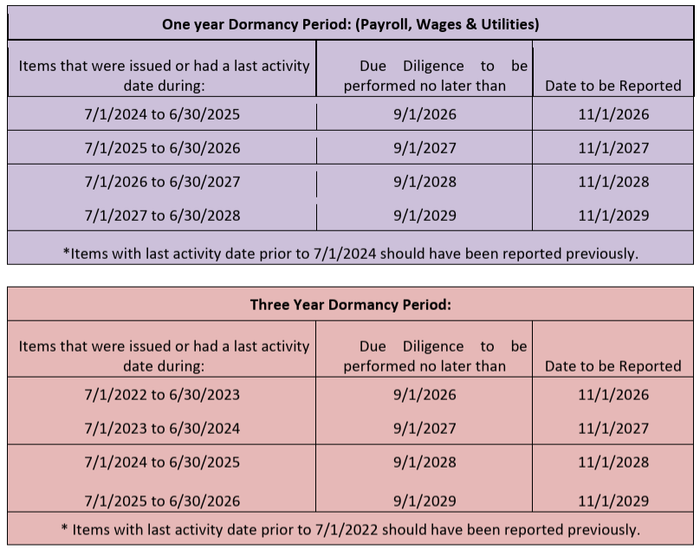
Reporting Table

Slide 17
When and How to File a Report
  Indiana County Clerk Court reports are due annually on November 1st
Report Property Electronically In Three Easy Steps:
Create your NAUPA formatted report
Submit your report via the IndianaUnclaimed.gov website
Submit your payment
  Online Payment
  Physical check payable to "State of Indiana"
  (Holder Summary must be attached to check and mailed to):
  Office of the Indiana Attorney General
  Unclaimed Property Division
  P.O. Box 2504
  Greenwood, IN 46142

Slide 18
Owner Information to Report
  Include ALL identifying information about the owner
  Full name
  Last known address
  Social Security Number or Tax ID Number
  Date of birth
  Cause number (under account number)

Slide 19
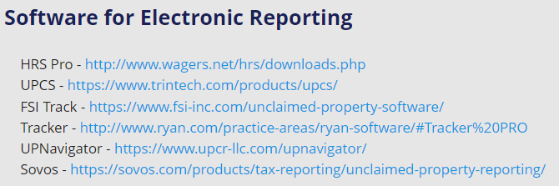

How to Report
Our website offers two options for submitting your report.
1. Upload NAUPA formatted file
Our website provides a list of
software for creating NAUPA
formatted files.
2. Manual Online Reporting (MOR)
After registration, a unique secret key
will be assigned to you by the system.

Slide 20

Reporting Resources
Please visit the Reporting Resources page for a list of useful reporting resources.
Our Step-by-Step Reporting Guide provides instructions with screen shots for submitting your manual report and uploading a NAUPA formatted file.
Reports must be submitted electronically.
CD’s and paper reports are not accepted.

Slide 21

Reporting
Common Holder Mistakes
  Overpayment – often payment without records attached
  Underpayment – amount on remitted check does not reconcile with amount on report
  Missing Owner data and/or poor-quality data
  Owner names are not in proper fields
  Dormancy periods are not met
  Due Diligence is not complete
  Incorrect NAUPA/Property codes
  Relationship codes are omitted

Slide 22
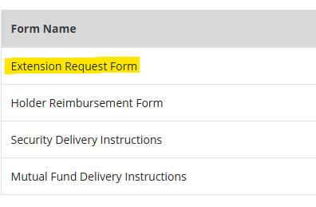
Extension Requests
Requests for extensions are accepted up to 30 days before the reporting deadline.
Our website’s Reporting Resource page provides the extension request form.
The completed extension application and explanation on letterhead are required for the application to be accepted. The completed form and letter of explanation can be e-mailed to updholder@atg.in.gov or mailed to the address below:
Indiana Unclaimed Property Division
P.O. Box 2504
Greenwood, IN 46142
1.866.462.5246

Slide 23

Tutorial Videos

Slide 24
Contact Information
Reporting Inquiries: updholder@atg.in.gov
1-866-462-5246
Office of the Indiana Attorney General
Unclaimed Property Division
P.O. Box 2504
Greenwood, IN 46142
Amy T. Hendrix, Director
Amy.Hendrix@atg.in.gov
Patience Senter, Reporting Supervisor
Patience.Senter@atg.in.gov
Sam Sites, Deputy Attorney General
Samuel.Sites@atg.in.gov

