Slide 1
Record Management

Slide 2
Records Management
Director - Loretta Robinson
Program Director – Christyna Eaton
Program Coordinators – Carrie Brown and Ashley Littleton
Notes:
Good Morning, I hope everyone is doing well, learning a lot and having a little fun along the way. I am Christy the Program Director for Records management. I Have Carrie Brown with me today she is one of the program coordinators you may have spoken with if you call the court line or have sent an email for assistance. Ashley Littleton is my other program coordinator back in the office over seeing the rest of the department while we are here with all of you.

Slide 3
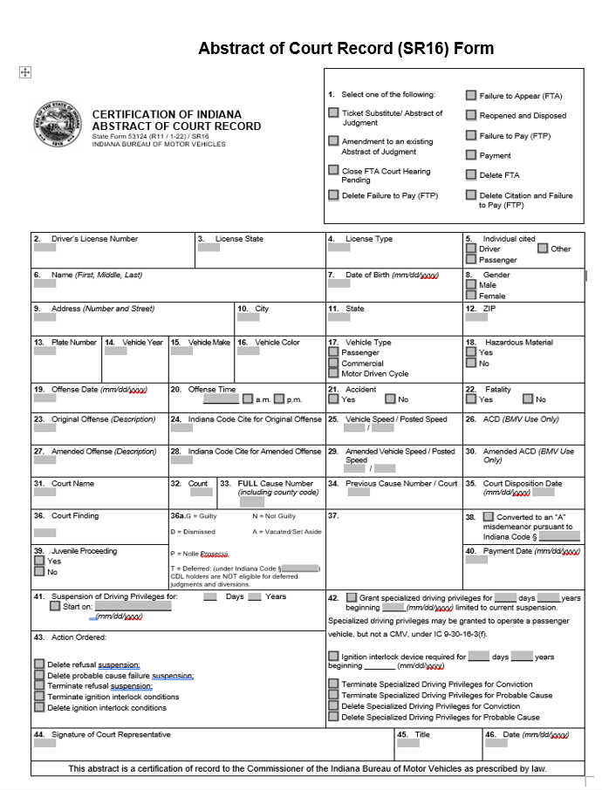
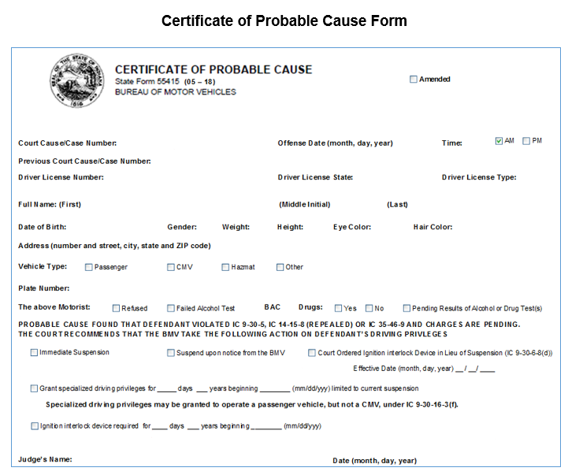
The SR16 and PCA
Notes:
Today we will talk a little about the SR16 and the PCA, Special Driving Privileges, CTOR, and how the courts have the ability to send almost every type of action for a driver record to the BMV electronically. These are copies of what the SR16 and PCA look like.

Slide 4
The SR16 and PCA
      Add Conviction(s)
      Add/Delete FTA/FTP/Conviction
      Add SDP with or without interlock
      Delete/Terminate SDP or interlock for conviction or PC
      Delete/Terminate PC suspension
Notes:
The SR16 provides the ability for most of the actions the court is wanting to take on a driver record. Such as the ability to:
Did you know there are events in Odyssey that enable the court to create and mark an SR16 to have Special Driving Privileges (SDP) or SDP w/Interlock. You can also mark the PCA for SDP or SDP W/Interlock or IIL. Removing the need for you to send a separate court order for an individual case.
Now there are times when the Bureau will still need the order for SDP and that is when a court wants to give SDP on multiple suspensions. Example – a driver has 4 suspensions; 2 are for different case numbers and 2 are administrative suspensions Like DSP and HTV 5/10 yr suspension.

Slide 5
The SR16 and PCA Cont.
  PC Failure; Refusal; Pending Results
      Special Driving Privileges with Interlock
            vs
        Interlock in Lieu of Suspension
Notes:
On the PC there are selections for SDP with or without interlock and an option for Court ordered interlock in lieu of suspension. We get questions from courts on what is the difference between these options? Well let me tell you. Interlock vs Interlock in lieu of suspension (meaning no suspension)
Interlock in Lieu of means the court wants the driver to have the interlock device on their vehicle instead of having a license suspension, this gives the driver a conditional license for driving and there is no indication of a suspension on the ODR.
Interlock can only be applied to a driver record if it is issued with SDP. This means when the court wants the suspension to remain on record but to be closed/terminated and a condition of SDP with interlock will be applied to the record. The suspension would still be shown on the ODR. Also keep in mind a refusal does not qualify for SDP per statue.

Slide 6
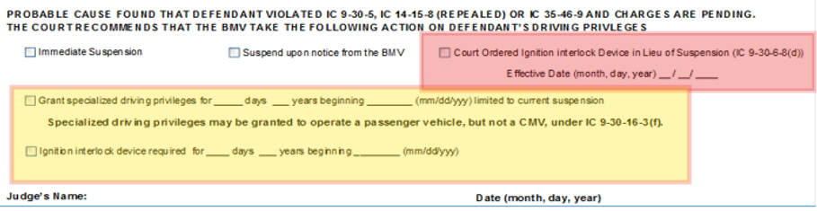
The PCA
Notes:
This shows the 2 options on the PC . In Red this is for interlock in lieu of where the suspension is not viewable on the record. The yellow is where the SDP with or with out the interlock.

Slide 7
Court Orders
  Waiving Reinstatement Fees
  Conviction/Judgment was sent in error
  SDP for HTV administrative suspensions
  Court Ordered Suspensions
  Granting expungement under IC 35-38-9
Notes:
There are still situations where a Court Order needs to be sent to the Bureau for actions to occur on a driver record such as:
With all the actions you can do with the SR16 there are times we still need a court order like:
Orders for SDP for Admin suspension –like Life HTV suspensions or 5-or 10-year HTV suspension or DSP
CTOR susp – example court wants to suspend the driver for not following the conditions set by the court like complete a driver safety course.
When it is for Expungement -- The BMV requires certain information to be in the expungement orders to process the order properly like the Cause Number for the conviction(s) being expunged must be provided so we know what to expunge. If this is not clear it may result in a return to the court for verification of the cause number(s) the action is being applied.

Slide 8
Odyssey/INcite Interface for BMV Portal
  Questions regarding Odyssey or Incite Portal should be directed to the Office of Court Technology (OCT) helpdesk.
  These programs are monitored by OCT not the BMV.
  Check your Activity Report did the SR16/PC transmit to the BMV?
Notes:
We get questions all the time like
I know everyone sees the “BMV” and thinks we run these programs but we do not OCT does.
“What “event” do I need to do to send the FTP to the BMV?”
“How do I process an interlock on the PC in Odyssey?”
“How do I force an SR16 on a dismissed DUI case, so the BMV removes the PC suspension?”
“How do I amend the information on the SR16 that was sent to the BMV?”
Activity report -- “I submitted something to the BMV, but I do not see it on the record, why not?”
If no, then there is an error that needs to be corrected before it will transmit the helpdesk for OCT can help you.
If yes, does the report show it was printed? Printed SR16/PC will go through the manual process. Processing time is 7 to 10 business days.

Slide 9
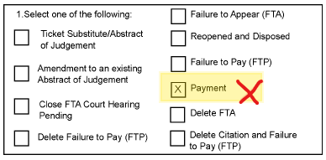
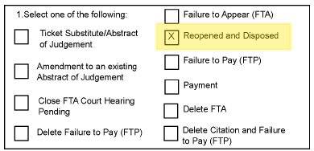
Questions Continued
FTA suspension needs Reopen and Disposed to be closed. Cannot use a Payment to close FTA.
Notes:
Remember when I stated one of the questions from the courts has been “I submitted the information why isn’t it on the record?” Well, if the SR16 isn’t marked properly then it won’t have the action the court wants to take on the driver record completed properly. you should check the record. You have access to view a driver record within Incite. The OCT helpdesk can help you if you do not know where to look or need access to that option.
Here’s an example: Let us assume the court is closing an FTA suspension, but the SR16 is marked as ‘Payment’. This will not work to clear the FTA suspension and would be returned to court for verification of action. The correct marking to close an FTA suspension would be “Reopened and Disposed”.

Slide 10
Out-of-State Drivers
What happens to IN citations given to out-of-state drivers?
How long does it take for that state to process?
What if the driver calls and says their state still has them suspended or hasn’t received compliance?
Notes:
IN citations that are for an out of state driver are sent to the State of Record (SOR) (i.e. the driver’s licensing state).
Other states may have longer processing times; we do not know what the times are for another state.
The driver should inquire with their licensing state for the processing schedule. They may have a reinstatement fee to pay to that State DMV. However, we are always happy to re-send the information for the driver to their SOR.

Slide 11
Common Reasons for Court Returns
Unable to verify individual
Special Driving Privileges (SDP)
Amendments
Expungements
Notes:
The BMV receives many SR16s/Court Orders for processing every day. The BMV frequently returns SR16s and court orders to the court(s) for additional information or clarification.
To allow for faster processing and fewer court returns, keep the following items in mind:
If the BMV is unable to verify the individual cited in the court document(s) then the document will be returned to the court requesting more information. Providing all the identifiable information for the driver helps us to determine which John Smith, Betty White, or Mary Jones we are looking at. If the officer has provided any driver licensing information, be sure to include that when submitting SR16’s & Court Orders –
Amendments – if there are any changes being made to something already on the driver record an SR16 must be marked as amended to make changes
Orders for expungement does not contain the reference to the misdemeanor/felony case(s) numbers in which to expunge from the record.

Slide 12
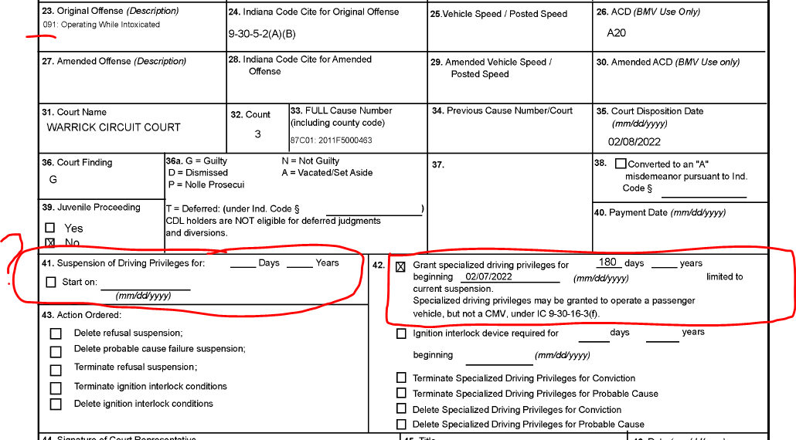
Example reason for Court Return
Notes:
Example of SDP marking on the SR16 SDP- BMV must be given the effective suspension(s)that the SDP is going to apply to. Also, if the SDP order has multiple durations listed, we can only apply one.

Slide 13
SR22 Insurance Information
Changes that occurred with HEA 1199
Notes:
Effective 12/31/2021 HEA 1199 allows FTPs, FTAs, No Insurance suspension, and no insurance fees to be stayed upon receipt of an SR22. Much like Specialized Driving Privileges, a driver can operate a motor vehicle while the suspension is in a Stayed status.
An individual would be required to carry the SR22 for three years following the expiration of an Unsatisfied Judgement suspension or OWI suspension.
SR22 information must be submitted electronically by the driver’s Insurance Company through a BMV approved program.
We will not accept paper insurance documents from the individual or the court.
The driver’s status will switch to conditional for the specialized driving privileges (SDP) once all reinstatement requirements have been satisfied. You must have SR22 for SDP
The driver must have SR22 on file with the BMV and the SR22 must be dated within the past three years in order to satisfy the requirement of SR22.

Slide 14
Changes that occurred with HEA 1199
Failure to Appear
Notes:
Failure to Appear
Court must submit an SR16 with “Reopened Disposed” marked. The offense date, offense number, and case number must match the FTA on record.
On or After 12/31/21
FTA suspension(s) remain an indefinite suspension
FTA suspensions can only be applied to misdemeanors and felonies
Having an insurance provider submit SR-22 insurance will “Stay” the suspension.
FTA suspensions can be stayed indefinitely as long as an active SR22 is on file. The driver still must appear in court to terminate the FTA suspension. If SR22 is canceled and a reopen/disposed has not been received, then the driver will become re-suspended for the FTA until a reopen/disposed or a new SR22 has been received.

Slide 15
Failure to Pay
Changes that occurred with HEA 1199
Notes:
FTP are now a 3-year suspension
FTPs can be stayed for the duration of the suspension with an SR22.
FTP suspension will terminate after one of the following has been met:
A SR16 payment is received from the court
The three-year suspension has expired
The driver maintains SR22 for the entire three years

Slide 16
Changes that occurred with HEA 1199
No Insurance Suspensions
Notes:
No Insurance suspensions that became effective on or after 12/31/2021 are now indefinite suspensions. If a Certificate of Compliance cannot be provided, the driver must maintain SR22 for 180 consecutive days to terminate the suspension.
If the driver completes the 180-day stay, they are not required to pay the no insurance fee to reinstate their driving privileges.
If a SR26 cancellation of SR22 is received during the 180-day stay, the stay is removed, the suspension is reopened, and a new 180-day holding period starts.
No Insurance suspensions that were effective prior 12/31/2021 had a 90-day mandatory suspension that should have expired by now. For these no insurance suspension(s) the driver can reinstate their driving privilege without having to pay the reinstatement fee by maintaining SR22 for 180 consecutive days.
If a SR26 (cancellation of SR22) is received during the 180-day stay, the fee is placed back into an active status which will suspend the driver and a new 180-day holding period will start.

Slide 17
Document Processing Time
Records Management processing time takes approximately 7 – 10 Business Days once received from the courts. Please refrain from resending documents prior to the 10 day turn around time as this builds up the processing queues and will delay completion of your document.
If the driver believes their record has an error, they can request a Material Error Review. This can be found on our website. It is an electronic form submission.
If there is a reason for longer processing times, we will ask Court Services to post the information on INCITE so the courts will know there may be additional processing time occurring.
Some documents must go to the Legal Department for processing or review and may experience a minor processing time increase.

Slide 18
BMV Contact Information
BMV Court/ Clerk Phone Number – (317) 234-6382
  Do not give our contact information to the public or to attorneys
  Leave a voicemail, otherwise we do not know you called
  Voicemails left will receive a call back within two (2) business day(s)
BMV Court/ Clerk Email Box – bmvcourts@bmv.in.gov
  Court/ Clerk questions should be submitted to the BMV Court/ Clerk Email Box
  Courts/ Clerks should expect a response (either email or telephone call) within two (2) business day(s)
Submitting Court Documents via Email – courtdocuments@bmv.in.gov
  This email is for documents only. Questions will not be answered from this email.
Our fax number is (317) 233-5153

Slide 19
Office of Court Technology Helpdesk Assistance
Court Technology Helpdesk Telephone Number: 1-888-275-5822
Email: helpdesk@courts.in.gov
Melissa Smith
Email: melissa.smith@courts.in.gov
Telephone: (317) 234-2713
Annette Page
Email: annette.page@courts.in.gov
Telephone: (317) 234-3064

Slide 20
Contact Center Information for the Public
BMV Contact Center Telephone– (888) 692-6841
    All calls are answered in real time.
    All calls are logged to ensure issue resolution as
    well as identifying additional areas for improvement.
Customers can email the Contact Center by going to https://www.in.gov/bmv/contact
Customers can chat with the Contact Center by signing into their account on MyBMV.com.
Notes:
If at any time you have a question, you can always call the court/clerk line. We may be momentarily unavailable due to break or lunch. Please leave a message; we will call you back. If the question is unable to be answered by the BMV clerk, it will be escalated to someone who can better assist.
Please remember that the contact information
that has been provided is for the court clerks to utilize.
The Contact Center phone number is the only one
that should be given to the public.

