Slide 1





prepping for the
Primary
Election
Presented by:
Brad King (R) & Angie Nussmeyer (D), co-directors
Matthew Kochevar (D) & Valerie Warycha (R), co-general counsel
Spring 2026
Clerks’ association Conference

Slide 2


Acronyms
ABS: Absentee
CEB: County Election Board
ePB: Electronic Poll Book
D/R/L: Democratic, Republican, Libertarian Parties
FPCA: Federal Post Card Application
FWAB: Federal Write-In Absentee Ballot
IED: Indiana Election Division
IEC: Indiana Election Commission
M/O: Military & Overseas Voters
PC: Precinct Committeeman
SAMC: Statewide Address Mailing Confirmation Notice
TTX: Table Top Exercise
VLM: Voter List Maintenance
VR: Voter Registration

Slide 3


Review Security Plan
Everchanging threat landscape requires CEBs to continuously review & improve their security plans to ensure they are prepared for physical, cyber, or natural disaster events.
“READINESS TURNED INTO RESULTS”

Slide 4

LEFT OF BOOM
Preparation for the “boom”
Review security plans after each election & continuously improve
What about geocoding voting locations to share with public safety agencies? Is that helpful to your partners?
Maintain/ cultivate relationships with public safety & gov’t partners
Prep emergency “to go” boxes with materials to stand up a voting location if necessary
RIGHT OF BOOM
Activate your plan
Image by brgfx on Freepik

Slide 5

PHYSICAL SECURITY OF VOTING SYSTEMS, ePBs
Counties MUST follow IC 3-11-15-46, unless CEB adopted own plan
CONTINUITY OF OPERATIONS PLANNING
Review After Action Report from last election & make adjustments to improve plan
Incident Response Plan templates & trainings on SVRS County Portal
Cyber Incident Response
Be certain to have IT contact on file with SOS
Contact SOS/IED if any cyber incidents occur
Emergency “To-Go” Box
Kits containing basic information to stand up voting location
EAC’s TTX IN A DECK
Simple scenarios to test incident readiness
BAKER TILLY, CIVIX READINESS OUTREACH
Email reminders to perform tasks to update poll locations & early voting sites, election night reporting, county directory, etc.
ELECTION READINESS

Slide 6

Federal Post Card Application (FPCA)
Combined VR & ABS request that is valid for one calendar year (Jan. 1 to Dec. 31)
Extended VR Deadline
Register up to one week before election when using FPCA
Military voter discharged in final week before election? Special VR permissions in state & federal law
Permitted to file form by email/fax
Unlike state or federal VR forms, county MUST accept an FPCA by email or fax (or mail)
Allowed to vote by mail, email, or fax
Request to vote by mail = Same deadline as everyone else (11:59PM, 12-days before election day)
Request to vote by email/fax = deadline to receive FPCA is noon, day before Election Day

Slide 7


01
Military Voters
+ Spouses & Dependents
Military & Overseas Voters Use FPCA
Overseas Voters (Plan to Return to US)
02
03
Overseas Voters (Return Uncertain)
04
Overseas Voters (Never Lived in US)

Slide 8

Federal Post Card Application (FPCA)
Military voters & their spouses/dependents
Military spouses, even if they never lived in Indiana, may use the Indiana address of their partner who is in the military to register to vote
Overseas voter who intend to return
Registered to vote at their last Indiana residence
Receive a “full” ballot by email, fax, mail
In primary election, voter must indicate their political party (D or R) on the application
If not, the voter is not entitled to receive a ballot in the primary, but the form may be used for voter registration purposes
Absentee application is to be processed for November election given its “ongoing” nature

Slide 9
Federal Post Card Application (FPCA)
Overseas voter whose return is uncertain
Provides the residence address where voter last resided in Indiana for at least 30-days before departing overseas
Registered to vote in the precinct of the voter registration office
Receives a “federal only” ballot by email, fax, mail
In 2026, ONLY candidates for US House & MUST include a write-in line
In NOVEMBER, straight party device must be included
In primary election, voter must indicate their political party (D or R) on the application
If not, the voter is not entitled to receive a ballot in the primary, but the form may be used for voter registration purposes
Absentee application is to be processed for November election given its “ongoing” nature

Slide 10

Federal Post Card Application (FPCA)
Overseas voter who NEVER resided in Indiana for at least 30-days before residing overseas
MUST deny the application
COUNTIES MUST BEGIN SENDING ABS BALLOTS NOT LATER THAN 3/21/26!
All voters with an ABS application (ABS-Mail, VPD, FPCA) that is REVIEWED & APPROVED by county’s ballot ready date must be sent by method selected by voter (mail, email, fax)
Don’t forget to request an earlier ballot ready date in SVRS if planning to mail BEFORE 3/21
After initial push, ABS ballots must be sent SAME DAY the application is reviewed & approved

Slide 11

EMAILED ABS BALLOTS TO M/O VOTERS USING FPCA
Deadline to file FPCA for EMAILED ABS ballot
NOON, May 4, 2026 (May primary)
NOON, Nov. 2, 2026 (November general)
Deadline for CEB to RECEIVE M/O EMAILED ABS ballot
6PM, Election Day (May 5, 2026 or Nov. 3, 2026)
MAILED ABS BALLOTS TO M/O VOTERS USING FPCA
Deadline to file FPCA for MAILED ABS ballot
11:59PM, April 23, 2026 (May primary)
11:59PM, Oct. 22, 2026 (November general)
Deadline for CEB to RECEIVE M/O MAILED ABS ballot
If stateside military, 6PM, Election Day – the same as all “civilian” voters
If overseas military or overseas civilian, noon, ten (10) days after election day IF postmark is on or before election day
Noon, May 15, 2026 (May primary)
Noon, Nov. 13, 2026 (November general)
MUST process ABS ballot from M/O voter if voter is otherwise eligible
Overseas Military & Overseas US Citizens can have envelope hand-canceled at their APO (Army Post Office) or DPO (Diplomatic Post Office)
Note: Denmark is no longer operating (or is limiting) its international mail services for letter (not parcel) services. If you have an M/O voter residing in Denmark, discuss any concerns with your voter and encourage the use of an emailed ballot.
FPCA Voters Ballot Return & USPS Postmarks

Slide 12

FWAB IS THE BACK-UP BALLOT IN CASE THE ORIGINAL ABS BALLOT SENT TO M/O VOTER IS NOT RECEIVED BY THE CEB BY DEADLINE DATE
FWAB DOES NOT REPLACE THE FPCA!
Cannot use the FWAB to register to vote or request an ABS ballot in Indiana
If voter submits a FWAB only, counties cannot process it
Ask voter to complete and send in the FPCA
If the deadlines to register or request an ABS ballot using the FPCA have not passed for the election, you can process the FPCA, send the ABS ballot to the voter & safely store the FWAB in the event the original ballot is not timely received
Federal Write-In Absentee Ballot (FWAB)
IF ORIGINAL M/O ABS BALLOT DOES NOT ARRIVE ON TIME, CONFIRM WHETHER VOTER SUBMITTED A FWAB. IF SO, AND VOTER IS OTHERWISE ELIGIBLE, A BI-PARTISAN REMAKE TEAM WILL FOLLOW STATE REMAKE PROCEDURES TO MARK AN OPTICAL SCAN BALLOT CARD.

Slide 13
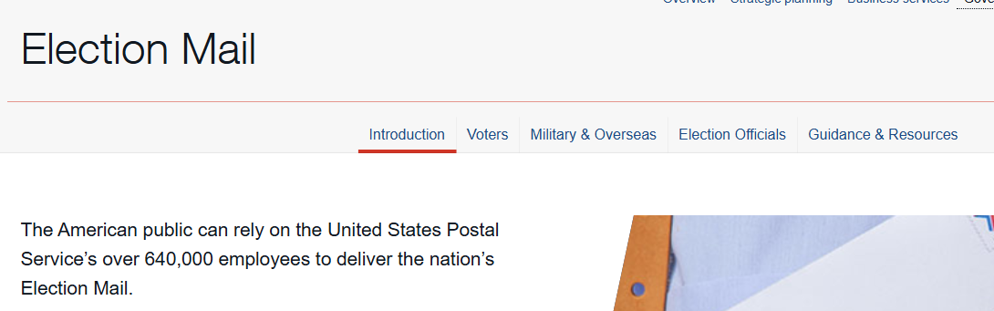
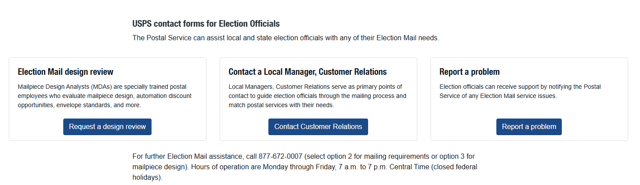
USPS ELECTION MAIL
NEW Website: usps.com/electionmail
(Do NOT use electionmail.org)

Slide 14
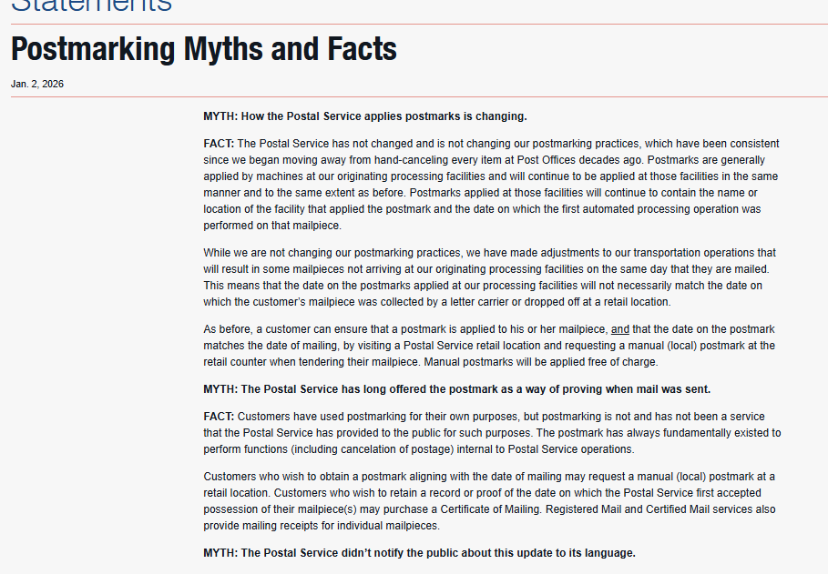
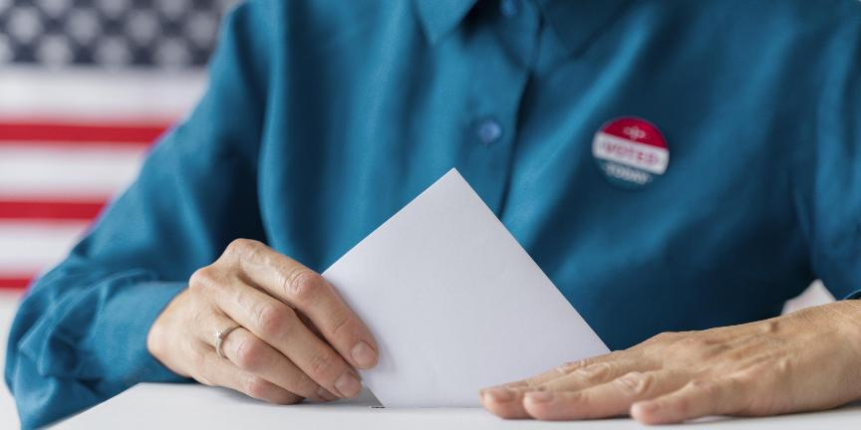

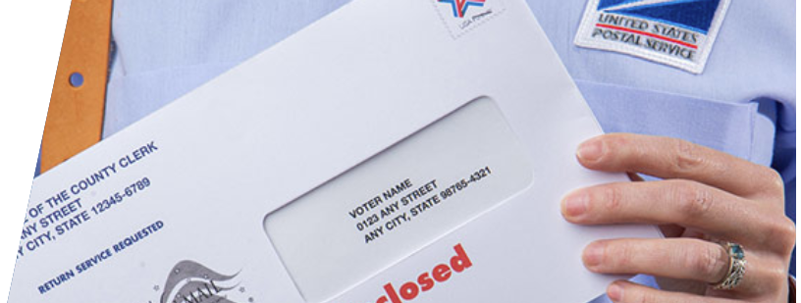
POSTMARKS
https://about.usps.com/newsroom/statements/010226-postmarking-myths-and-facts.htm

Slide 15

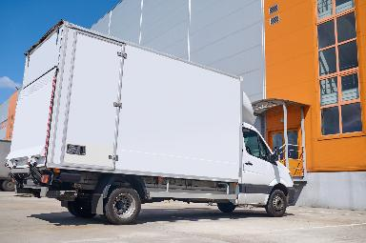


Postmarks & Returning Mailed Ballots
Regional Hubs
Hand-cancel
Certificate of mailing
With the changes in recent years to consolidate regional hubs, mail may not receive the returned postmark until it hits that hub. Voters can go to their retail USPS office to…
Retail associates at the USPS Postal Office counter can hand cancel postage for free to ensure the mailing receives a postmark on the day the ballot is mailed
Customers can request a certificate of mailing to retain proof or record of the date the USPS took possession of their mail

Slide 16



Filling Ballot Vacancies:
No D/R filed for local office on May ballot
Option 1: Fill by Direct Appointment
Requires a resolution or motion captured in meeting minutes to vest that authority with county chair or central committee
Must expire on primary election day in 2026 for Ds, 2028 for Rs
County party organization may shorten the time period, but it cannot exceed this four-year period when PCs are elected
Direct appointment must be made by noon, July 3, 2026
Paperwork to file with CEB by noon, July 6, 2026:
CAN-31: Declaration of candidacy
CAN-12: Statement of economic interests
CAN-29: Certificate of Candidate Selection (mark box C)
COPY of resolution or meeting minutes
Note: if there is only one or no eligible PC to vote in a ballot vacancy caucus, the chair makes the direct appointment as a function of law
The paperwork described above must be filed by the same deadline; however, there would be no resolution/meeting minutes attached as CAN-29 form has checkbox (box A) to confirm there were “fewer than two” eligible PCs to vote

Slide 17


Option 2: Hold a Caucus
CAN-30 Notice of Caucus MUST be:
Sent to eligible PCs by first class mail at least 10 days before caucus is held AND
Filed with CEB by noon, 10 days before caucus is held
At least 72 hours before caucus, CAN-31 Declaration of Candidacy MUST be filed with:
Chair of caucus AND CEB
No CAN-30 notice filed with clerk? Must reject CAN-31
Caucus must be held by noon, July 3, 2026
Party is responsible for following state law (IC 3-13-1), and maintaining their records (IC 3-5-4-10)
Note: Ds elect PCs in May 2026; PC eligibility rules for caucus are a little different.
All elected PCs within the election district are qualified to vote in caucus
Only appointed PCs that were re-appointed to the same precinct after May primary election are eligible to vote in a ballot vacancy caucus
Same rule applies to Rs in 2028, when their PCs are on the May ballot
Filling Ballot Vacancies:
No D/R filed for local office on May ballot

Slide 18
Option 2: Hold a Caucus
Post Caucus Paperwork to file with CEB by noon,
July 6, 2026:
CAN-12: Statement of Economic Interests
CAN-29: Certificate of Candidate Selection (mark box B)
No CAN-31, CAN-30 filed with CEB as required by previous deadlines? Must reject CAN-29
Filling Ballot Vacancies:
No D/R filed for local office on May ballot
LIBERTARIAN PARTY Ballot Vacancies:
Ballot access rules require L Party to hold a convention to nominate candidates. If no candidate is nominated for an office at their convention, ballot vacancies may be filled after giving notice to clerk of their intent to do so at least 10 days before state chair can fill the vacancy. Must fill ballot vacancies by noon, July 3, 2026; CAN-32/CAN-12 due by noon, July 6, 2026.

Slide 19


BALLOT VACANCY FAQ
Beginning May 8 until noon, July 3, 2026
Only applies to scenarios where no D/R filed to run in the primary election (or L convention did not fill an office & submit notice to clerk at least 10 days before filling vacancies)
Candidates may withdraw from general election ballot & withdrawal procedures are found in IC 3-13-1 (or IC 3-13-2, in final 30 days)
“When can the D/R parties start to fill their ballot vacancies if no one filed for an office in the primary?
“We only had 1 D & 2 Rs file to run in a vote for 3 race. Can the parties fill these vacancies?
YES!
“When do the parties have to hold their caucus/make appointment to fill a ballot vacancy – July 3 or July 6?”
Deadline to HOLD caucus or make DIRECT APPOINTMENT:
NOON, July 3, 2026
-- BUT DUE TO JULY 4 HOLIDAY --
Deadline to FILE Candidate Selection Paperwork with CEB:
NOON, July 6, 2026

Slide 20

Noon, July 15, 2026
All candidates can withdraw for ANY reason by this deadline
D/R/Ls get to fill a ballot vacancy within 30-days of CAN-24 being filed
Follow same forms & vacancy procedures on previous slides (IC 3-13-1); however, final paperwork must be filed not later than noon, five days after vacancy is filled
Independents do NOT get to fill ballot vacancies
Minor parties may fill ballot vacancies
After Noon, July 15, 2026
All candidates can withdraw for LIMITED reasons by this deadline:
Death | Moved out of Election District | Disqualified under IC 3-8-1-5
Conflict with Hatch Act or Judicial Employee Restrictions
Follow same vacancy procedures (IC 3-13-1) noted above
Oct. 4 to Nov. 3, 2026
All candidates can withdraw for LIMITED reasons in final 30 days:
Death | Move out of Election District | Disqualified under IC 3-8-1-5
Conflict with Hatch Act or Judicial Employee Restrictions
Follow IC 3-13-2, which has modified vacancy procedures for D/R/L parties, including different forms
d/r/l candidate withdrawal

Slide 21

SAMCs
Cannot mail any SAMC during freeze period
Hold ALL SAMC “undeliverables” until AFTER election & AFTER vote history is applied
Returned SAMC with voter changes CAN be processed to…
Change status to active when inactive voter confirms residence address & signs card
Update registration address if a move within the county if VR deadline has not passed, making sure voter signs card & answers age/citizenship questions
Cancel registration at voter’s request, if signed by voter
VLM & FREEZE PERIOD
HOLD BMV DECLINATION HOPPER WORK DURING FREEZE PERIOD | CANNOT SEND SAMCS!
Disenfranchisement & Cancellations
Continue to process during “freeze”…
DOC Hopper/Sheriff info & send notice of disposition
Death Hopper/info to move status to cancelled
Cancellations at voter’s written request

Slide 22


Property Tax Database & VR
IC 36-1-8.5: Restricting Addresses in Property Tax Database
Permits certain covered individuals to ask County Assessor to restrict their address in the county’s property tax database
When approved, covered individuals may request that certain agencies restrict their address from disclosure
THIS STATUTE DOES NOT APPLY TO THE SVRS/VR RECORDS
Previously, the law only applied to the CAN-9 legal notice of primary election
Could NOT publish or include address of a covered person on the notice
Law changed in 2024 & candidate addresses are no longer included in CAN-9
NOTE: Potential law change that would require redacting addresses on campaign finance filings; More to come!

Slide 23
Election Law Stories & Lessons
1. Stay updated with election law changes
Ripley County Sheriff was on vacation and couldn’t sign the notice of election.
Indiana Constitution Article 5 Section 14 - deadline for Governor’s action.
2. Importance of Ballot Proofing
Whitley County left a congressional candidate off the primary ballot.
IC 3-11-2-2.1
3. Know about the no home rule statute
Delaware County court order to extend polling hours
IC 36-1-3-8(a)(12)
IC 3-11.7-7
4. May not know a candidate died unless it receives news coverage or you know them.
Grant County had a local office candidate die. Coroner couldn’t get death certificate in final 30 days.
IC 3-11-3-29.3 and IC 3-11-3-29.4

Slide 24





QUESTIONS?

