Slide 1
USPS Election Mail Recommendations and Updates
FY26
Jerod Siddle, Central Area Field Specialist
Trina Webb, Manager, Customer Relations
Indiana District
March 4, 2026
Version: 1/09/2026

Slide 2
The Postal Service’s Role in the Election Process
The Postal Service is committed to fulfilling our role in the electoral process and we provide a secure, efficient and effective way for citizens to participate when policymakers decide to use mail as part of their elections or when voters choose to use our services to participate in an election.
The Postal Service has a robust and tested process for proper handling and timely delivery of Election Mail.
Every federal election cycle, we make efforts across the nation to inform local and state election officials about mailing procedures, our operational standards, and our recommended best practices for utilizing the mail.

Slide 3

Postmarking and Service Standards

Slide 4
Postmark Definition
August 12, 2025 –Proposed rule filed in the Federal Register – Comment Period ended on 9/11/2025
November 24, 2025 – Final Rule published in Federal Register
December 24, 2025 – Final Rule effective in the Domestic Mail Manual (DMM)
Addition to the Domestic Mail Manual (DMM) add Section 608.11 “Postmarks and Postal Possession.”
This Section identifies the types of Postal Service markings that qualify as postmarks, and describes the circumstances under which those markings are applied. It also advises customers of how to obtain evidence of the date on which the Postal Service accepts possession of their mailings.
This new language in the DMM does not change any existing postal operations or postmarking practices but is instead intended to improve public understanding of postmarks and their relationship to the date of mailing.
Federal Register :: Postmarks and Postal Possession
Version: 1/09/2026

Slide 5

Postmarking Myths and Facts
MYTH: The Postal Service has changed the way postmarks are applied to mailpieces
FACT: The Postal Service has not changed and is not changing our postmarking practices, which have been consistent since we began moving away from hand-canceling every item at Post Offices decades ago.
MYTH: The Postal Service has long offered the postmark as a way of proving when mail was sent
FACT: Customers have used postmarking for their own purposes, but postmarking is not and has not been a service that the Postal Service has provided to the public for such purposes. The postmark has always fundamentally existed to perform functions (including cancelation of postage) internal to Postal Service operations.
Postmarking FAQs

Slide 6

Postmarking Myths and Facts
MYTH: The Postal Service didn’t notify the public about this update to its language
FACT: The Postal Service engaged in discussions with customer groups, posted information on our website, and initiated a public notice and comment period in the Federal Register in August 2025, which concluded when the Postal Service published its final notice on this topic, including responses to the comments received, in November 2025.
MYTH: Postmarks show when and where the Postal Service took possession of my mail
FACT: A postmark date does not necessarily indicate the first day that the Postal Service took possession of the mailpiece. Rather, it confirms that the Postal Service accepted custody of a mailpiece, and that the mailpiece was in the possession of the Postal Service on the identified date.

Slide 7
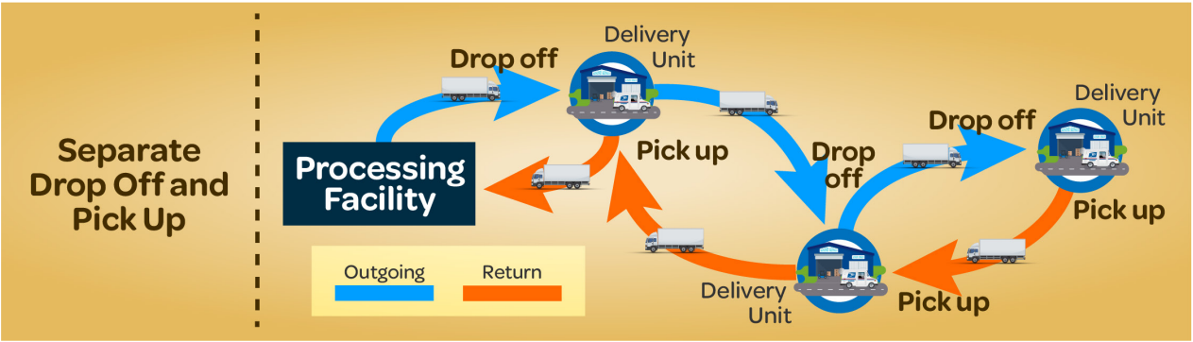
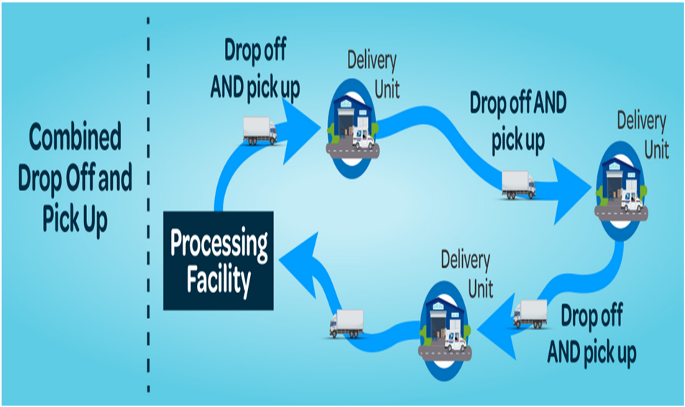

Service Standard Refinements

Slide 8
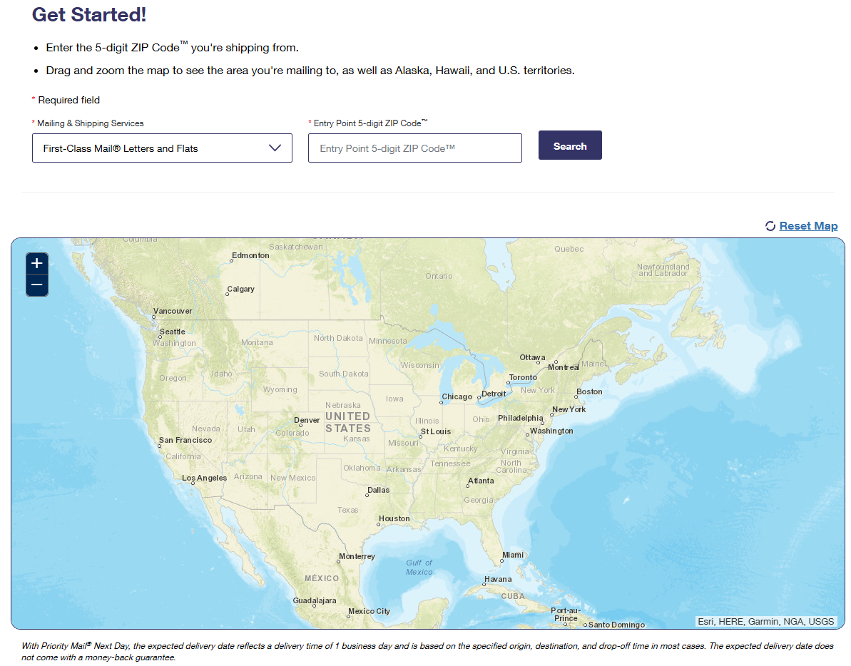
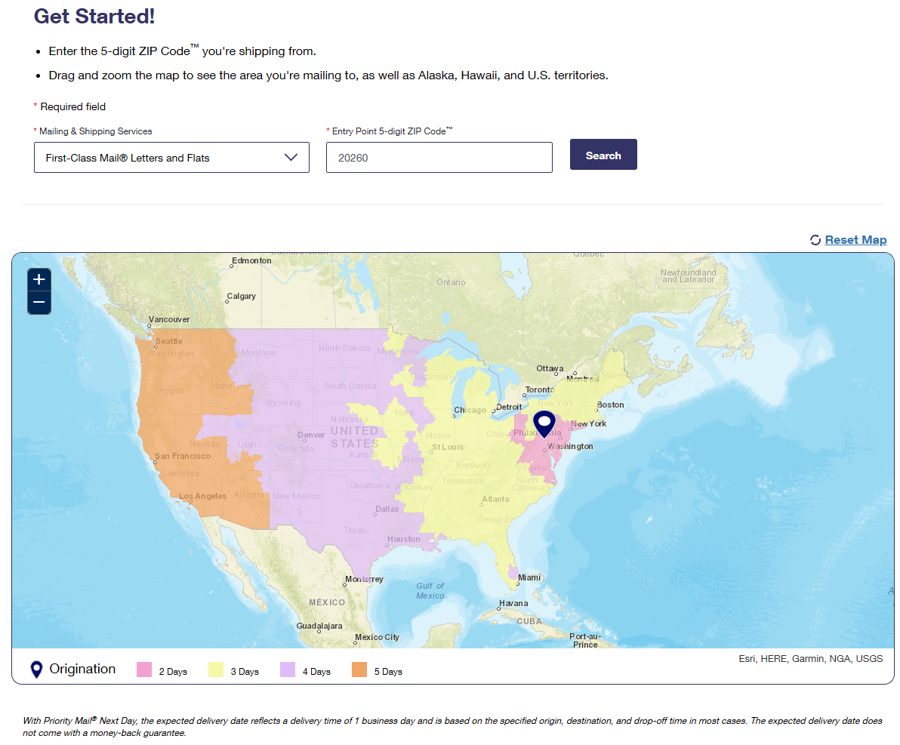

USPS Transit Time Map
https://www.usps.com/service-standards/

Slide 9

Our Message to Voters Opting to Use the Mail to Cast a Ballot
If you are eligible to vote by mail and choose to do so, you should plan ahead to give yourself enough time to complete and return your ballot by your state’s deadlines.
Be sure to know your state’s requirements and recommendations on receiving a blank ballot and mailing your completed ballot.
Mail your completed ballot before Election Day, and at least one week before the deadline by which your completed ballot must be received by your election office. Some states may recommend allowing even more time for mailing completed ballots.
A voter can ensure that a postmark is applied to his or her return ballot, and that the date on the postmark matches the date of mailing, by visiting a Postal Service retail office location and requesting a manual (local) postmark from a retail associate at the retail counter when dropping off the ballot for mailing.
Manual postmarks will be applied free of charge.

Slide 10

Election Mail Preparation and Enhancements

Slide 11

Mailpiece Design Analysts (MDAs):
Aid printers, graphic designers, and envelope manufacturers in creating election mail
Provide advice and evaluate mailpieces for machinability and automation-based prices
Assist with
Technical mailpiece design questions
Mailpiece analysis and physical review
Providing information on Intelligent Mail
Other tests, reviews, and services related to mailpiece design
Create reply mail artwork for customers
Qualified Business Reply Mail (QBRM)
Courtesy Reply Mail (CRM)
Contact the MDA Customer Service Help Desk
Customers with Mailpiece Design requests may contact an MDA directly by dialing 1-877-672-0007, press Option 3 for MDA or by sending an email to MDA@usps.gov.

Slide 12
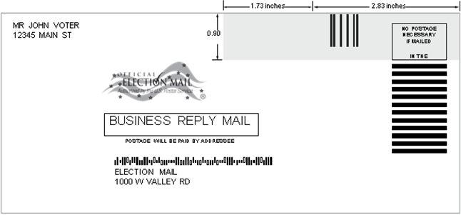
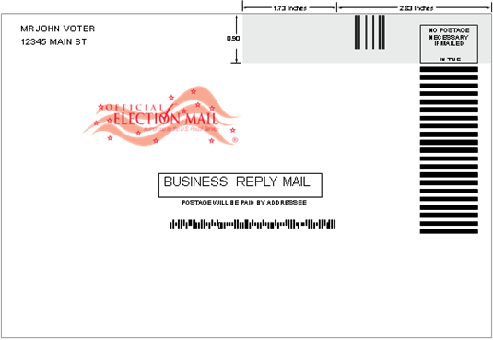

Follow and Implement USPS Recommendations on how to Design, Prepare, and Send Election Mail
Work with Mailpiece Design Analysts to review and approve of mail pieces
Create automation compatible mail pieces
Use Qualified Business Reply Mail (QBRM) with Intelligent Mail barcode Accounting (IMbA®) for return Ballot Mail
Send Ballot Mail using First-Class® Mail

Slide 13
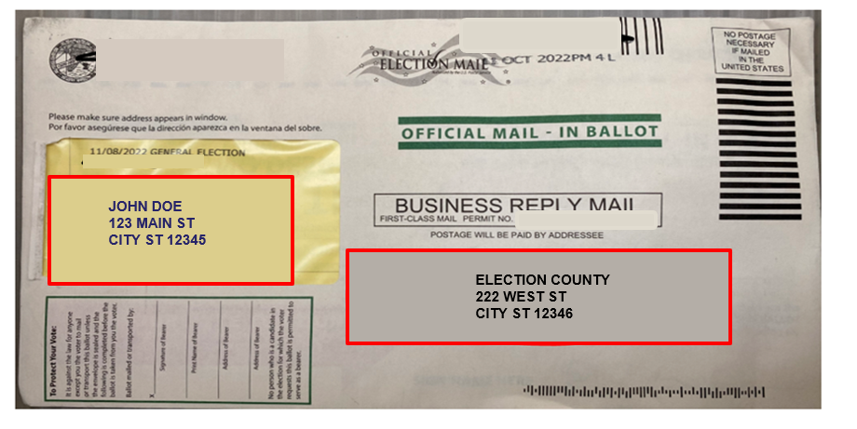
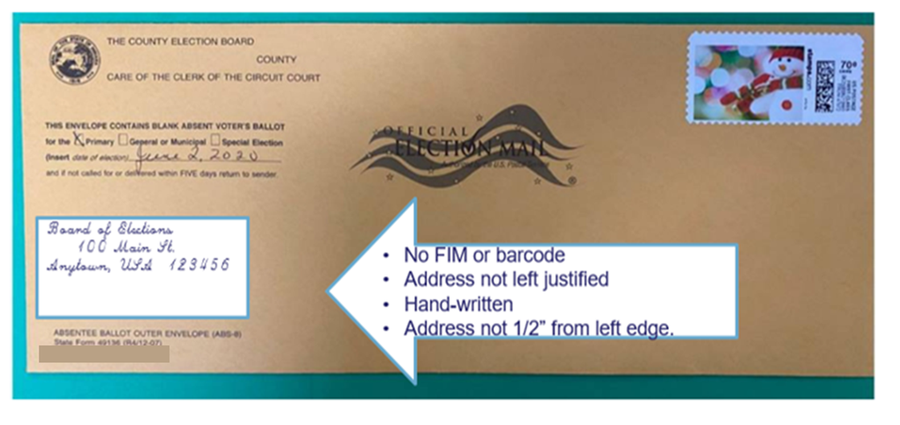
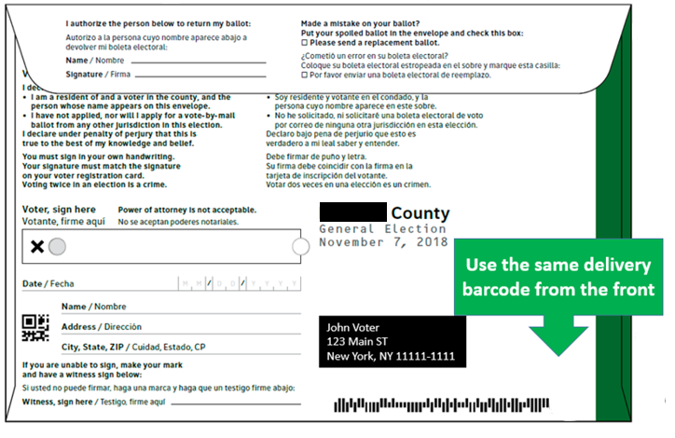

Mailpiece Design Issues
Missent/Missort
Looping
Damage to the mail and other mailpieces
Delay processing and delivery
Two Different Addresses on Address Side
Missing Reply Format Elements
Too much information on the non address side

Slide 14
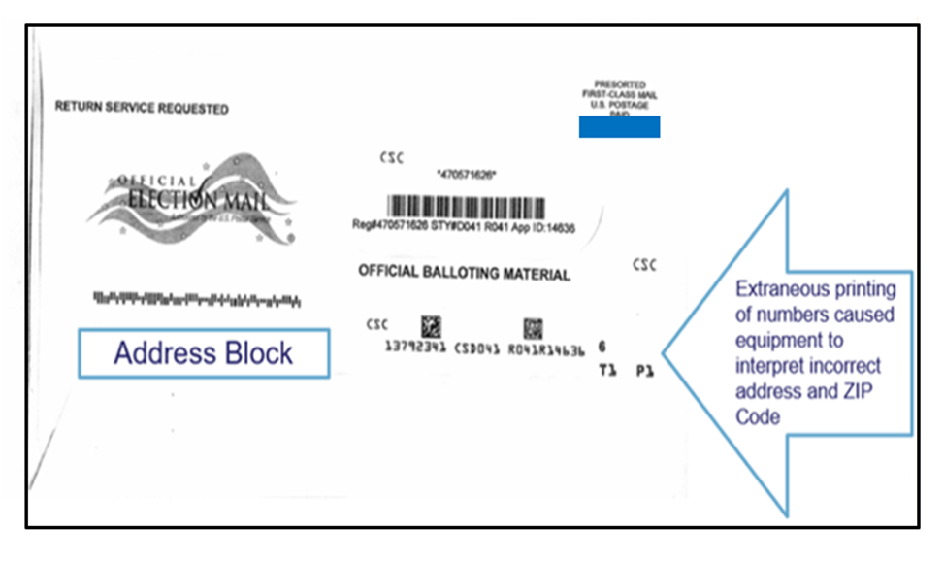
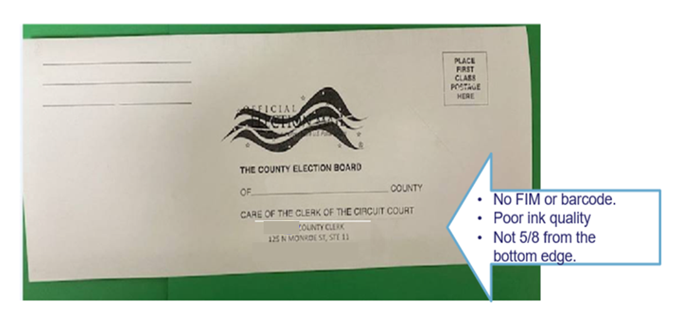
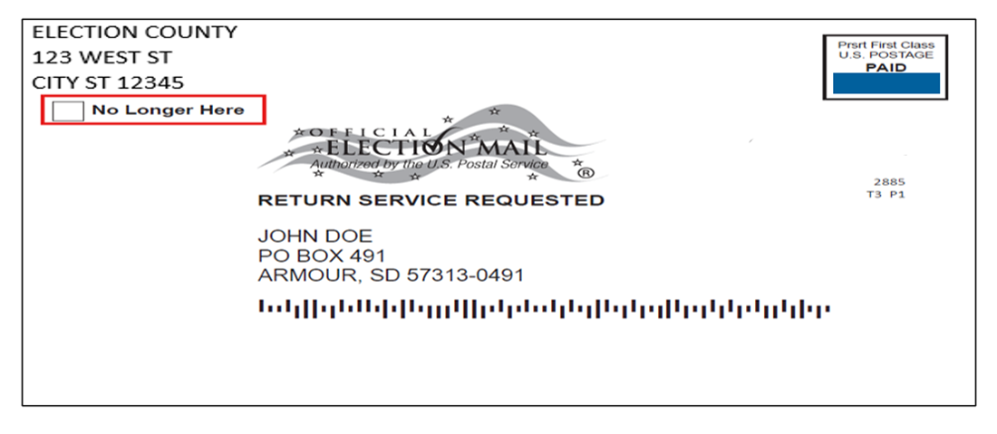
Mailpiece Design Issues
Looping
Missent/Missort
Damage to the mail and other mailpieces
Delay processing and delivery
Extraneous Printing
Missing Reply Format Elements
Obsolete/Invalid Endorsement

Slide 15
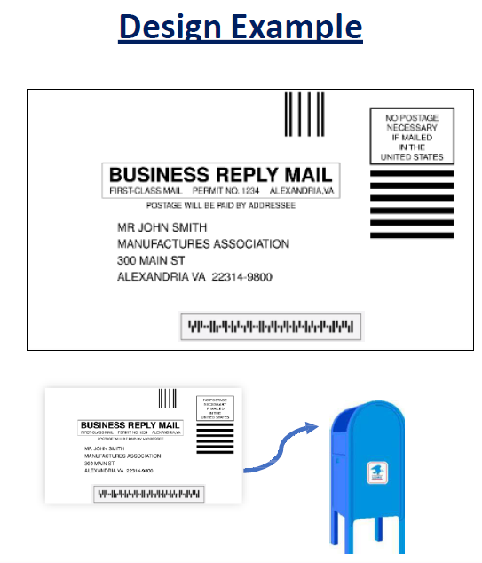


Qualified Business Reply Mail
First-Class & Priority Reply Mail
Mailer pays the return postage and fees
Only Card and Letter mail types are allowed
One Zip+4 assigned for Cards
One Zip+4 assigned for Letters up to 3.5 oz
Intelligent Mail barcode (IMb) Required
Discounted pricing

Slide 16

Benefits of QBRM and the Uniform Rate
Letters
Single per piece rate for QBRM letters up to 3.5 ounces
One Zip+4 assigned for letters up to 3.5 ounces
Reduces the likelihood that mail pieces will exceed the weight limit upon reply
Mail is invoiced and delivered quicker, improving customer experience
Opportunities to move to High-Volume BRM to QBRM with migration to Intelligent Mail barcode Accounting (IMbA) for deeper discounts
Note:
Basic and High-Volume BRM mail not affected by this change – only QBRM
All QBRM Cards will be assigned a unique Zip+4
Flats and Parcels are not eligible for QBRM

Slide 17

Qualified Business Reply Mail
Business Customer Gateway:
https://gateway.usps.com
Find Certified Vendors and Providers:
https://postalpro.usps.com/certifiedmsps
Postal ProTM:
https://postalpro.com/
Scan this QR code to view a chart detailing the available Special Services
Mailing & Shipping Solutions Center
(MSSC) Help Desk
Monday – Friday, 7am - 7pm CST
1-877-672-0007
MSSC@usps.gov

Slide 18

Serialized Intelligent Mail barcode IMb®
Intelligent Mail® Barcode for Letters and Flats: 6-Digit and 9-Digit Mailer IDs
1
2
3
4
5
6
7
8
9
10
11
12
13
14
15
16
17
18
19
20
21
22
23
24
25
26
27
28
29
30
31
Barcode ID (2N)
Service Type ID (3N)
Mailer ID (6N)
Serial Number (9N)
Routing Code (0, 5, 9, or 11N)
1
2
3
4
5
6
7
8
9
10
11
12
13
14
15
16
17
18
19
20
21
22
23
24
25
26
27
28
29
30
31
Barcode ID (2N)
Service Type ID (3N)
Mailer ID (9N)
Serial Number (6N)
Routing Code (0, 5, 9, or 11N)
The Intelligent Mail® barcode is used to track letters & flats in the mailstream.
The fields in the barcode allow mailers to create individual IDs for each mailpiece so they can be tracked.
For optimal tracking of election mail, Local Election Offices need to use the correct entries for the Service Type ID (STID), Serial Number, and Routing Code fields.

Slide 19
Key Benefits of IMbA
Value-Added Service - Automated invoicing through the IMbA is provided to the customer
Improved Consistency – Mail availability is more consistent and timely on a daily basis
Expedited Processing – Receive mail earlier in the day; reducing float time with efficient and effective mail processing
Reporting Enhancements – QBRM mail pieces with serialized barcodes, enables IMbA customers to view invoicing via Informed Visibility or BCG in PostalOne!
Seamless Transition – QBRM customers who submit samples after January 2023 will be automatically enrolled into IMbA parallel
Uniform Rate - One rate for QBRM letters weighing up to 3.5 ounces

Slide 20

Intelligent Mail® for Small Business Tool
The Intelligent Mail® for Small Business Tool (IMsb Tool) is a free online tool specifically designed for small-volume mailers.
It’s a web-based program.
No software or downloads required
The Tool creates unique Intelligent Mail barcodes (IMb) for printing on address labels or mail pieces.
Electronic postage statements are automatically created.
The Tool supports DSCF (Destination Sectional Center Facility) entry rates and all automation presort discounts along with the Full-Service discount.
The annual presort fee may be waived if all mailings are submitted as Full-Service! Fee Waiver Fact Sheet
Address list is cleansed
Validates addresses within the database are accurate.
Reduces amount undeliverable mail
Ability to remove duplicates from mailing list.

Slide 21
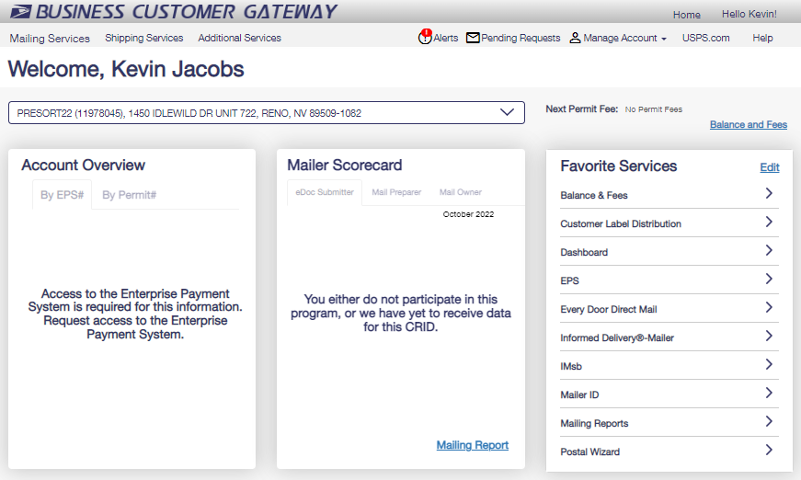

Intelligent Mail® for Small Business Tool
No special software or installation is required to use the IMsb Tool.
Access the application via a web browser (e.g., Google Chrome, Microsoft Edge)
Log in through the IMsb link on the Business Customer Gateway® at gateway.usps.com
The IMsb Tool “Go to Service” link is located on the Mailing Services page. It can also be placed in your Favorite Services on the BCG Home page.

Slide 22
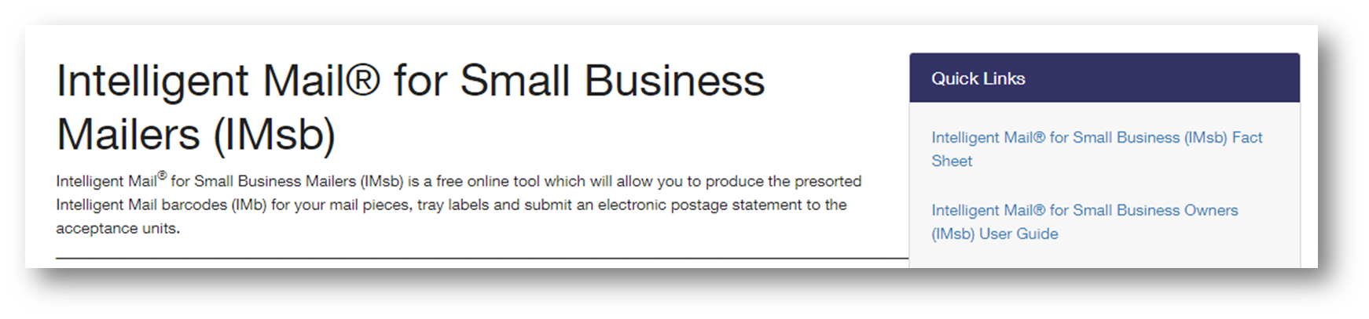

Intelligent Mail® for Small Business Tool
Contact your local BMEU manager for additional information.
You can access the current IMsb User Guide located on the right-hand side on the IMsb Tool landing page.
IMsb Tool page at PostalPro : Intelligent Mail® for Small Business Mailers (IMsb) | PostalPro
The User Guide can also be found on IMsb Tool page at PostalPro.
Intelligent Mail for Small Business Owners (IMsb) User Guide | PostalPro (usps.com)
Mailing & Shipping Solutions Center (MSSC) Phone: 1-877-672-0007 Email: MSSC@usps.gov
Business Postage Price Calculator (usps.com)

Slide 23
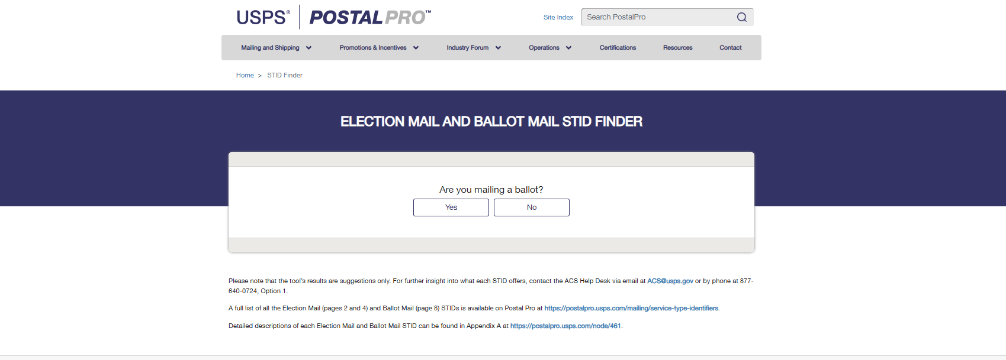

STID Finder
Designed to assist election officials and their mail service providers in selecting an appropriate Election Mail and Ballot Mail STID for their outbound mailings
https://postalpro.usps.com/election-ballot-stid-finder

Slide 24
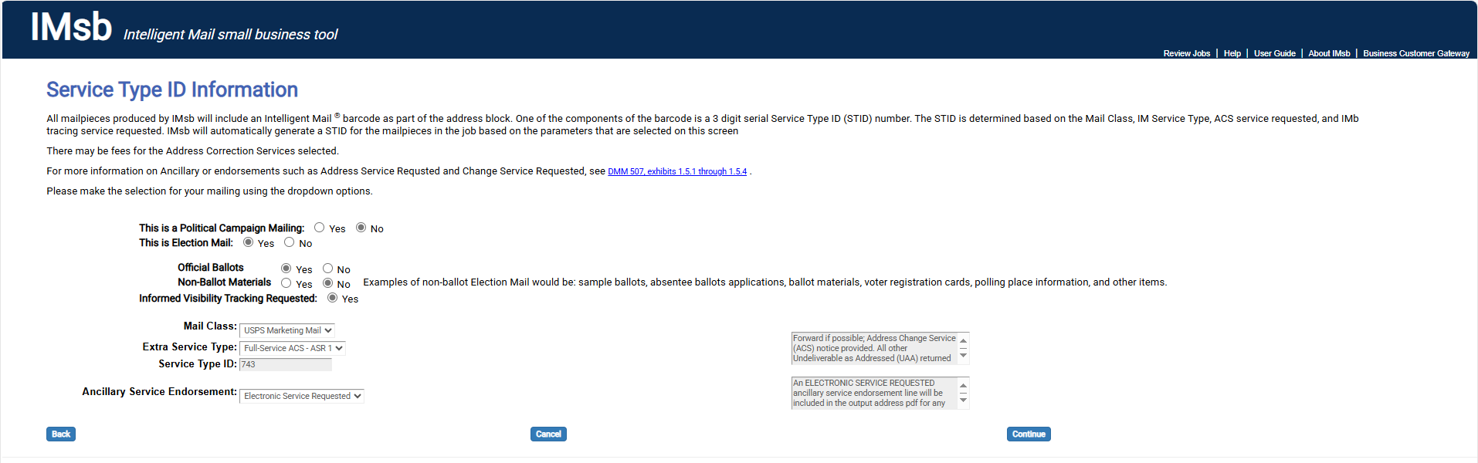

Ballot Mail Postage Statement Check Box
Improved discrete tracking of all Official Ballot Mail volume

Slide 25
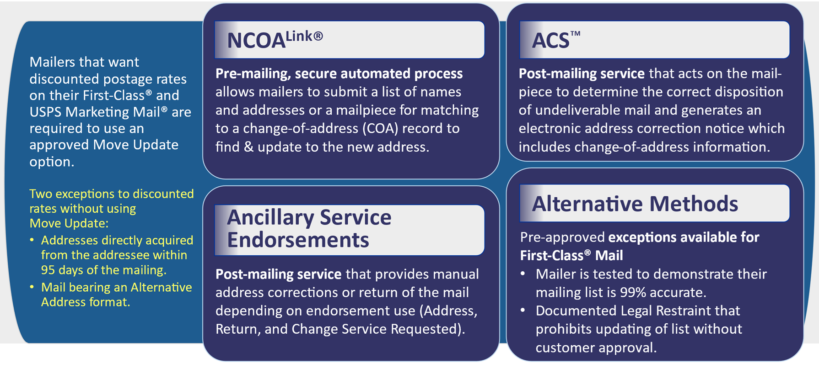
Move Update
https://postalpro.usps.gov/moveupdate/guide

Slide 26

Address Change Service (ACS)
Post-mailing address correction service that allows mailers to receive Change of Address (COA) information and other reasons for non-delivery electronically
Post-mailing services are not Move Update compliant
Only use for first mailing or infrequent mailing (for example annual tax notices)
Four service options:
Full-Service (Free for FS qualifying pieces)
OneCode
Intelligent Mail Package Barcode (IMpb)
Traditional
Note: No-fee Full-Service ACS will be extended to qualifying Basic automation and non-automation mailpieces for mailers who enter at least 95% of their mail as Full-Service in a calendar month.

Slide 27
Printing & Mailing Schedule
The Postal Service continues to recommend the use of First-Class Mail for time sensitive Election Mail, particularly outbound Ballot Mail.
All inbound (return) Ballot Mail must be sent First-Class Mail unless the voter chooses to expedite delivery using Priority Mai or Priority-Mail Express.
The process for designing, printing, and mailing Election Mail materials takes time. Be sure to consult with a Mailpiece Design Analyst early in the process to ensure your Election Mail is designed properly and includes all of the recommended visibility tools.
Managers of Customer Relations, Mailpiece Design Analysts, and other Postal Service experts are available to assist you with your Election Mail program.

Slide 28
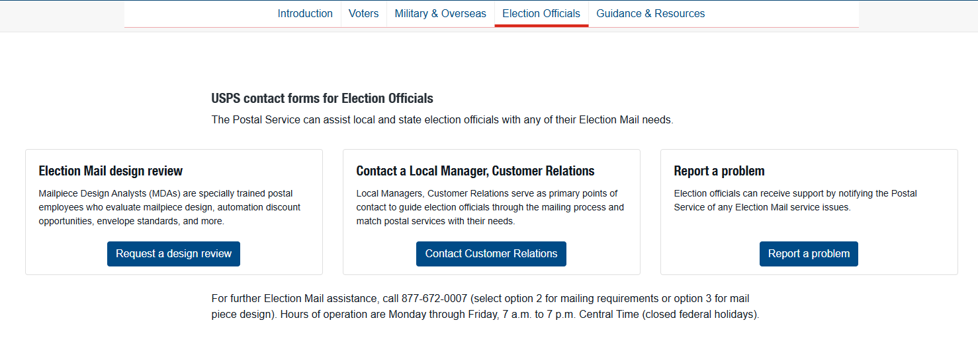
Advances to USPS.com/election mail
New Site to report Election Mail Issues
Single location for all customer facing Election Mail related service requests.
Service Requests will be routed to USPS CRM application
Aligns with all current USPS service ticket processes
Election Mail - usps.com

Slide 29
Future Updates

Slide 30
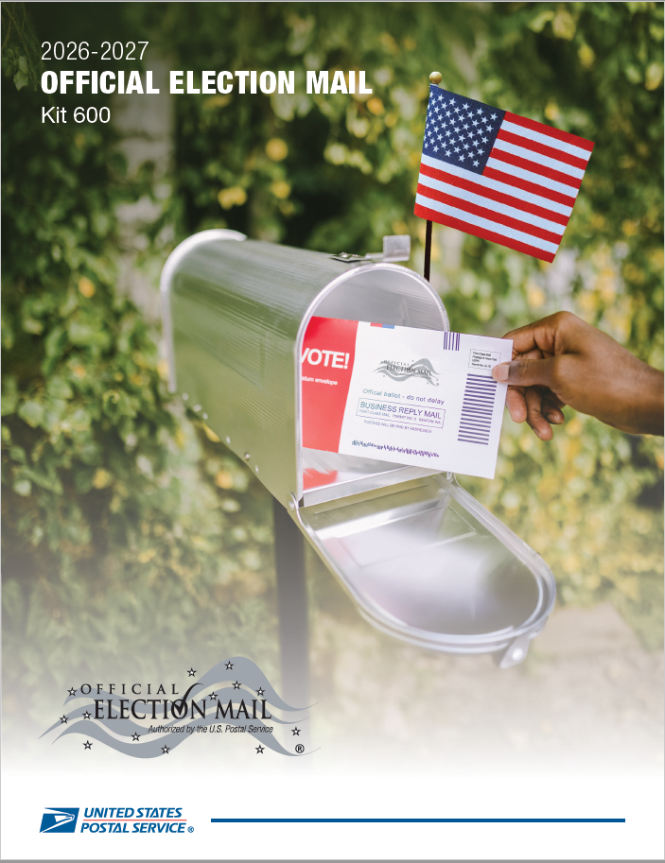

Kit 600
2026-2027 Official Election Mail Guide (Kit 600) Published Online – February 2026
Distribution to All State Executives and Local Jurisdiction Administrators – Mar 2026
Updated Pub 631, Official Election Mail – Graphic Guidelines and Logos & Pub 632, State and Local Election Mail – User's Guide
STID Finder Tool
Election Mail & Ballot Mail Checkbox
Postmarking DMM Update
Pull Out Postmarking Fact Sheet
Contact Information for MCRs and MDAs
Strengthened Definition of election official use for the OEM Logo
USPIS Fact Sheet
Service Standard Update

Slide 31
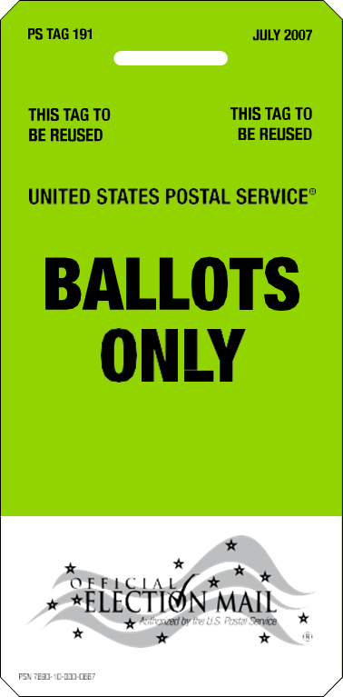
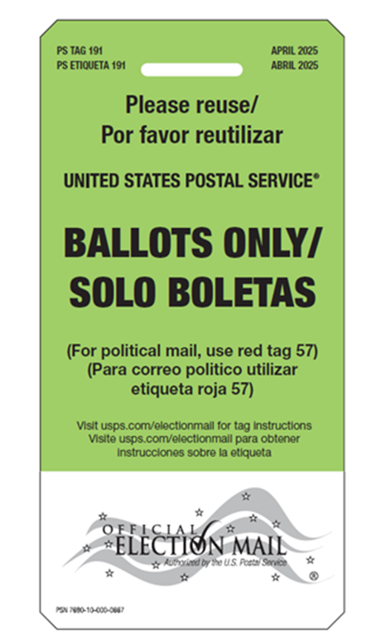
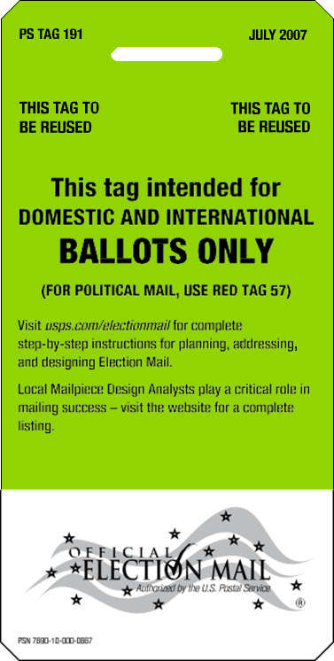

Coming Soon! Bilingual Tag 191
Existing Front
Existing Back
NEW Front & Back

Slide 32


Election Mail Day 2026
Election Mail Training
Election Mail Officials and Mail Service Providers play critical roles in ensuring the secure, precise, and timely delivery of Election Mail.
Election Mail Training supports these responsibilities by providing practical tools, strategies, and best practices tailored to enhance your expertise
Election Mail Training Topics
Election Mail processing, compliance, and best practices
Mailpiece Design and Address Quality Solutions
Informed Visibility
Engineering Insights
USPS tracking tools for improved visibility
Service Type Identifiers (STID)/Address Quality Solutions
Qualified Business Reply Mail (QBRM) with IMbA - Intelligent Mail barcode Accounting

Slide 33

Resources
usps.com Election Mail Site
Service Standard Changes on usps.com
Fact Sheet - PDF
FAQ - PDF
Overview of the changes – Video
Overview of the consumer tools (including map) – Video
Links to other resources
Service Standards Map: Service Standards Map
Service Standards Details: Overview of Changes
Intelligent Mail® Barcode Resources: IMB Postal Pro

Slide 34


Details to share with your Manager Customer Relations
Outbound Election Mail
What is your anticipated mailing volume per mailing?
What vendors do you use?
What date(s) will you be entering your mail?
What location(s) will you be entering your mail?
Other information about your mailing plans.
Please provide your final outbound and return envelope designs for Mailpiece Design Analysts review.
Inbound Election Mail
When is the deadline for ballots to be returned to elections offices?
Delivery Mode?

Slide 35



Manager Customer Relations Contact Information
Trina Webb
Manager Customer Relations, Indiana District
Office:(317) 870-8250
Email: trina.y.webb@usps.gov

Slide 36
Questions?

Slide 37

Thank You!

Slide 38


ACS Process
Mailer chooses an ACS method and enrolls in ACS through: https://postalpro.usps.com/acs/eACS001.pdf
COA information is generated in the process and sent to the mailers electronically.
Undeliverable mailpieces are intercepted and directed either to the Postal Automation Redirection System (PARS) or Computerized Forwarding System (CFS), depending on the ACS method.
Mailer modifies the mailing label, address block and mailpiece accordingly to the ACS service applied.

