Slide 1

Mental Health First Aid 101
Indiana Clerks Association –
Southern District Conference
March 10, 2026
Provided by:
Hamilton Center, Inc

Slide 2
Learning Objectives
Identify the impact of mental health challenges
Explain common mental health disorders
Review your role and how you can assist others in times challenges/crisis
Learn ALGEE method
Review self care strategies

Slide 3

WHAT IS MENTAL HEALTH?
Mental health is a state of wellbeing in which the individual:
Realizes their own abilities.
Can cope with the normal stresses of life.
Can work productively and fruitfully.
Can contribute to their community.
Positive Mental Health
20
N/A

Slide 4
WHAT IS A MENTAL CHALLENGE?
A mental health challenge is when:
There is a major change in a person’s thinking, feeling, or acting.
The change interferes with the person’s ability to live their life.
The interference does not go away quickly and lasts longer than typical emotions or reactions would be expected to.
Early Signs and Symptoms
Worsening Signs and Symptoms
Crisis Signs and Symptoms
MENTAL HEALTH CHALLENGE
Diagnosed with Mental Illness/ Mental Disorder
N/A
13

Slide 5
MENTAL HEALTH STIGMA
Mental health stigma means the negative attitudes toward people with mental health challenges.
Mental health stigma can lead to discrimination, which is when people with mental health challenges are treated differently because of their illness.
Stigma can make it hard for people to talk about their challenges and get help.
15
N/A

Slide 6
HOW COMMON ARE MENTAL DISORDERS?
Approximately 1 in 5 adults in the United States are diagnosed with a mental disorder in a single year.
Almost half of all U.S. adults will experience a mental health challenge at some point over the course of their lifetime.
22
N/A

Slide 7
RISK FACTORS FOR MENTAL HEALTH CHALLENGES
Poverty
Poor peer relationships/isolation
Stigma
Mistrust in health care system
Selective expression of symptoms
Historical trauma
CULTURAL
SOCIAL
FAMILIAL
Mistreatment
Abuse or trauma
Family history of substance use
Stressful life events
PSYCHOLOGICAL
Chronic medical conditions
Family history of mental disorders
Previous history of mental disorder
BIOLOGICAL
N/A
15

Slide 8
PROTECTIVE FACTORS
Spirituality or religiosity
Sense of cultural identity and belonging
CULTURAL
Having a good social support system
Engagement in activities outside of the home
Economic stability
SOCIAL
Consistent home/family routine
Healthy habits
FAMILIAL
High self-esteem
Ability to control and regulate emotions
Having and using coping strategies
Close relationships
PSYCHOLOGICAL
Good nutrition
Healthy physical exercise
BIOLOGICAL
N/A
15

Slide 9
THE IMPACT OF TRAUMA
ADVERSE CHILDHOOD EXPERIENCE
DISRUPTED NEURO- DEVELOPMENT
SOCIAL, EMOTIONAL, COGNITIVE IMPAIRMENT
ADOPTING RISKY BEHAVIORS
DISEASE, DISABILITY, AND SOCIAL PROBLEMS
EARLY DEATH
89
N/A

Slide 10

WHAT IS PERSON-FIRST LANGUAGE?
“A person living with schizophrenia.”
“A person without housing.”
“A person diagnosed with bipolar disorder.”
“A person who uses drugs.”
N/A
13

Slide 11
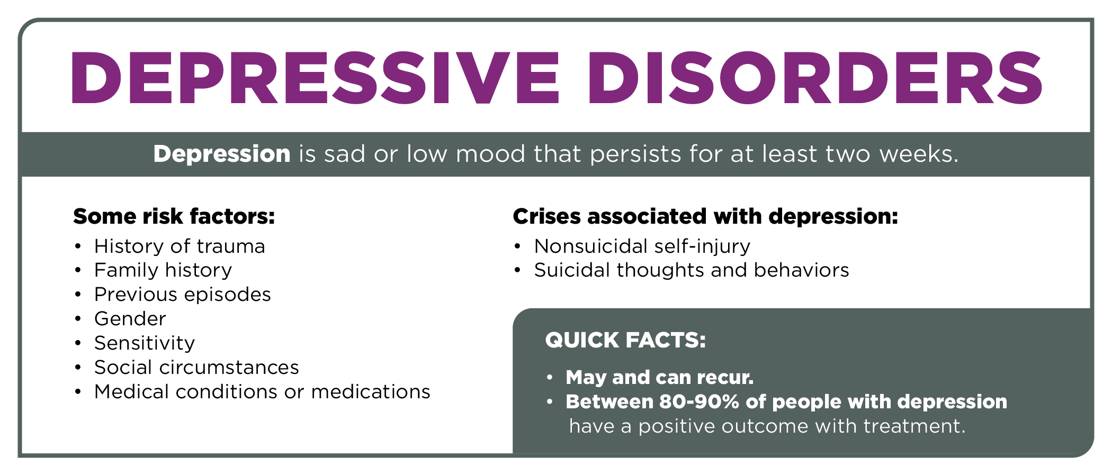
DEPRESSIVE DISORDERS: QUICK FACTS
61
25

Slide 12
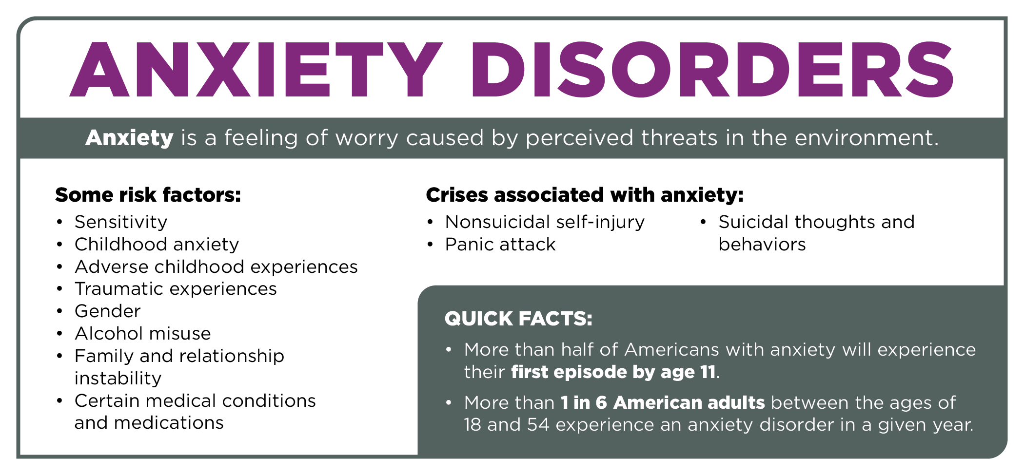
ANXIETY DISORDERS: QUICK FACTS
75
26

Slide 13
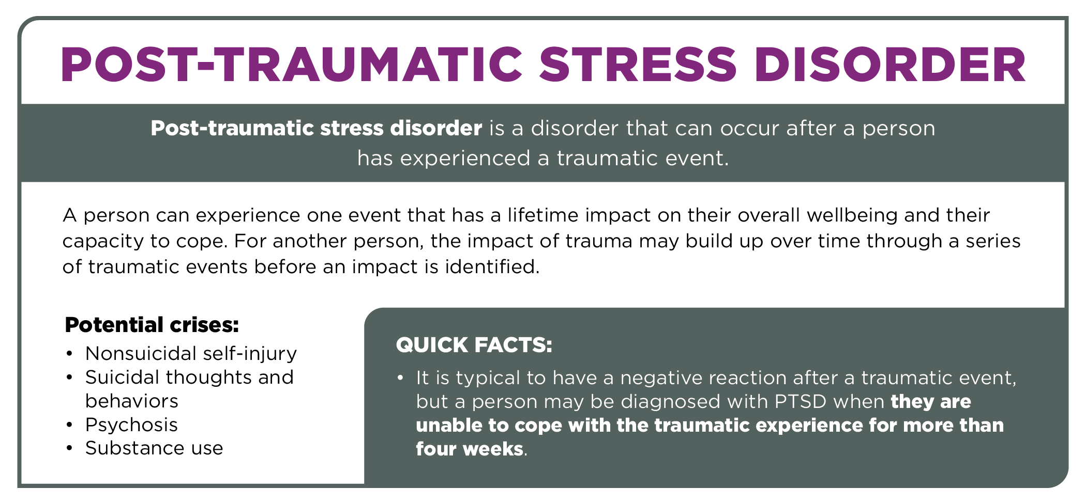
PTSD: QUICK FACTS
87
26

Slide 14
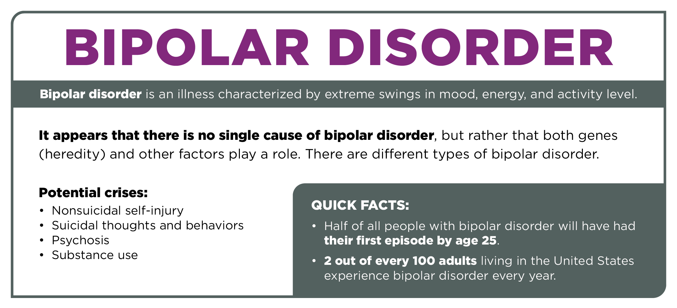
BIPOLAR DISORDER: QUICK FACTS
101
27

Slide 15
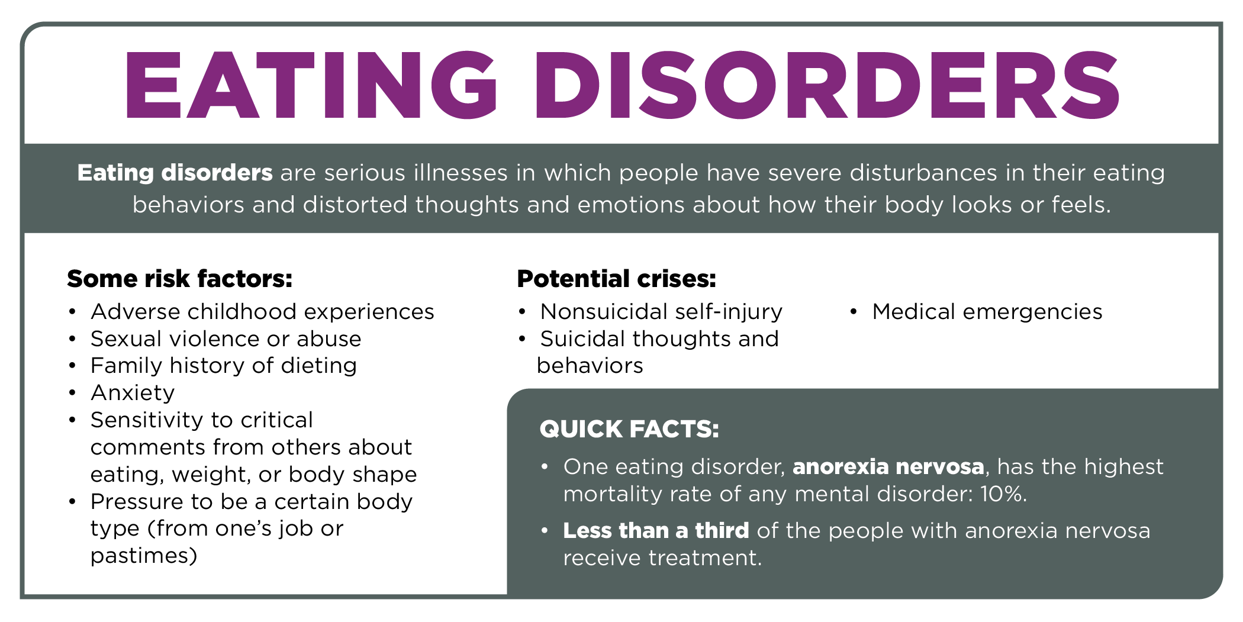
EATING DISORDERS: QUICK FACTS
123
28

Slide 16
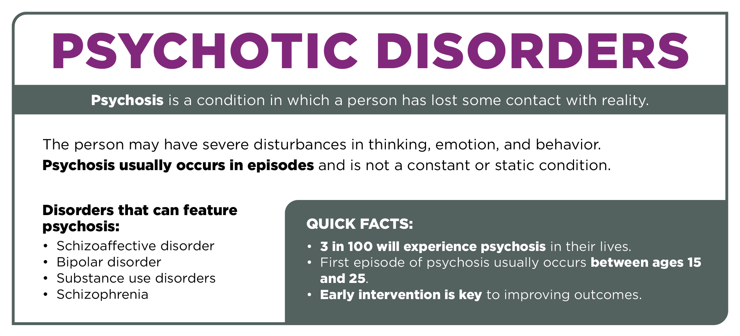
PSYCHOTIC DISORDERS: QUICK FACTS
109
27

Slide 17
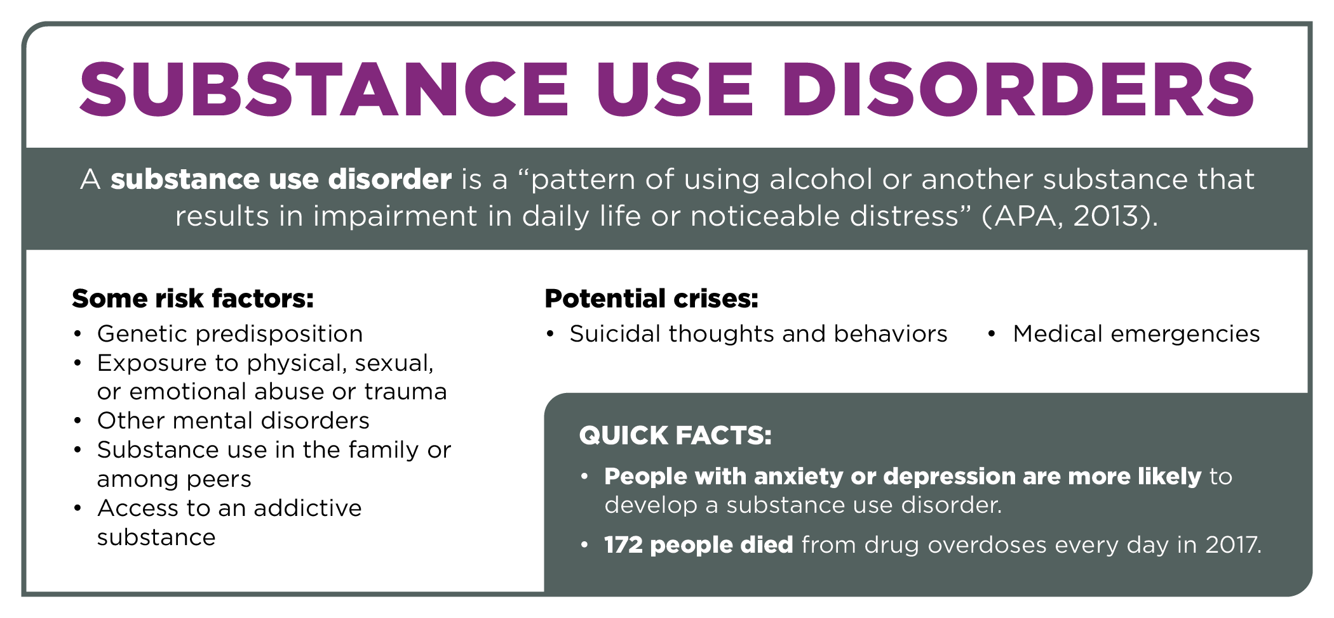
SUBSTANCE USE DISORDERS: QUICK FACTS
135
25

Slide 18

WHAT IS YOUR ROLE AS A MENTAL HEALTH FIRST AIDER?
Mental Health First Aiders…
Do not diagnose or treat themselves or others.
Observe changes in behaviors.
Offer a nonjudgmental listening ear.
Respect the individual’s privacy.
Serve as a vital link to early intervention.
Respect and honor the individual’s culture.
N/A
10

Slide 19
ALGEE
Assess for risk of suicide or harm.
Listen nonjudgmentally.
Give reassurance and information.
Encourage appropriate professional help.
Encourage self-help and other support strategies.
N/A
N/A

Slide 20
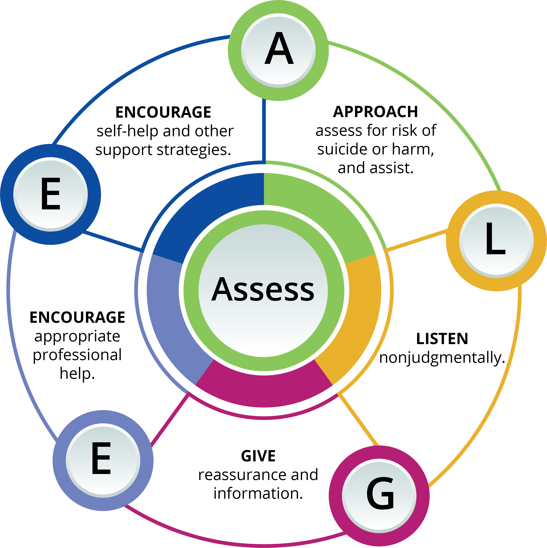
THE MENTAL HEALTH FIRST AID ACTION PLAN
40
N/A

Slide 21
ACTION A: ASSESS, APPROACH, AND ASSIST IN A NON-CRISIS
Approaching and Assisting in a Non-crisis Situation
Plan to talk privately about your concerns, at a mutually convenient time in a place free of distractions.
Be aware that a person may not open up to you until they are sure that you care.
A person may downplay what they are going through to avoid upsetting you or may not recognize there is a problem.
Let the person know you are ready when they are — do not put pressure on them to talk right away.
41-42, 47
N/A

Slide 22

ACTION L: LISTEN NONJUDGMENTALLY
Effective nonjudgmental listeners pay special attention to two main areas:
Verbal cues and how they are conveyed.
Nonverbal cues and how they are conveyed.
43-45, 50
35

Slide 23

ACTION L: LISTEN NONJUDGMENTALLY
Cultural Considerations
Respect the individual and their experience.
Don’t make assumptions.
Be mindful of language and expressions.
Recognize what might make it hard for someone to get help.
Set aside your own beliefs and reactions to focus on the needs of the person to be heard, understood, and helped.
Ensure you do not express any negative judgments.
View linguistic, cultural, and family diversity as strengths.
43-45, 50
36

Slide 24
ACTION G: GIVE REASSURANCE AND INFORMATION
What is Reassurance and Information?
Reassurance is a statement, comment, or action that helps remove a person’s fears.
Information helps a person understand a concept, discuss options and next steps, and indicate when a person needs additional help or support.
HOPE WITH
FACTS
45, 51
36

Slide 25
ACTION G: GIVE REASSURANCE AND INFORMATION
DOES NOT SOUND LIKE | SOUNDS LIKE
I remember during my breakup, I just threw myself into work. What you should do is … | Breakups can be tough. It's natural for you to be hurt and upset.
You really need to talk to a professional about that. | I'm here for you if you want to talk. There are also people who are trained to help you work through these feelings.
You'll get over it. Just don't worry about it. | You are not alone.
The way you’re handling this isn’t healthy. | I care about you and I’ve noticed a change in _______ (mood, eating, exercising, etc.).
46, 51
N/A

Slide 26
















ACTION E: ENCOURAGE APPROPRIATE PROFESSIONAL HELP
Professionals Who Can Help
MEDICAL DOCTORS
ADVANCED PRACTITIONERS
PSYCHOLOGISTS
SOCIAL WORKERS
COUNSELORS AND THERAPISTS
CRISIS SUPPORT SPECIALISTS
SUBSTANCE USE PROFESSIONALS
CERTIFIED PEER SPECIALISTS
46, 51
37

Slide 27
ACTION E: ENCOURAGE APPROPRIATE PROFESSIONAL HELP
What if the Person Doesn’t Want Help?
Encourage the person to talk with someone they trust.
Never threaten the person with hospitalization or any punitive action.
Remain patient.
Remain friendly and open. The person may want your help in the future.
46, 51
37

Slide 28
ASSESSING FOR RISK OF SUICIDE OR HARM
Types of Crisis Situations:
MAY BECOME A CRISIS | IMMEDIATE CRISIS
Panic attack. Aggressive behaviors. Substance misuse. Following a traumatic event. Nonsuicidal self-injury. | Medical emergency. Suicidal thoughts and behaviors. Severe effects of alcohol or drug use (substance use crisis). Severe psychotic states.
186 - 209
N/A

Slide 29

CRISIS SITUATIONS: SAFETY CONSIDERATIONS
Safety of all involved is paramount.
Assess and intervene in a manner that enhances safety and effective resolution.
People with mental health disorders are more likely to harm themselves than someone else.
How you initially respond to a person with a mental health or substance use challenge can have a tremendous impact on the safety of all involved.
185-209
53

Slide 30
CRISIS SITUATIONS: DE-ESCALATING A SITUATION
Speak slowly and confidently with a gentle, caring tone of voice.
Do not argue or challenge the person.
Do not threaten.
Do not raise your voice or talk too fast.
Use positive words instead of negative words.
Stay calm and avoid nervous behavior.
Do not restrict the person’s movement.
Try to be aware of what may increase the person’s fear and aggression.
Pause, if needed, during the conversation.
REMEMBER
If your safety or the safety of the person or others is at risk, get help immediately.
185-209
185-209
53

Slide 31
MAY BECOME A CRISIS: AGGRESSIVE BEHAVIORS
Aggression and violence are not the same.
People with mental health challenges only account for 4% of violent crime and are more likely to be the victim of violence.
A First Aider Can…
Understand the symptoms for what they are.
Speak slowly and confidently with a gentle, caring tone of voice.
Stay calm and avoid nervous behavior.
Consider taking a break from the conversation.
Try to be aware of what may increase the person’s fear and aggression.
What is seen as aggression can vary between individuals and across cultures. Aggressive behaviors may also be a response to fear.
Do Not:
Argue • Threaten
Challenge • Fidget
KEY ACTIONS:
Ensure your own safety.
Attempt to de-escalate the situation.
Connect to appropriate professional help as needed.
185-209
56

Slide 32
CRISIS: SUICIDE
WARNING SIGNS:
Talking or writing about death, dying, or suicide.
Threatening to hurt or kill themselves.
Looking for ways to kill themselves, seeking access to means.
Showing anxiety or agitation.
Being unable to sleep or sleeping all the time.
Feeling no reason for living, no sense of purpose in life.
Feeling trapped, like there is no way out.
Thinking there is no reason for living.
Thinking there is no safe way out of a bad situation.
HOW TO APPROACH:
Speak in a calm, non-accusatory manner.
Appear confident, like a duck on a pond: Calm on the surface, but “paddling hard” internally to determine next actions.
Try to understand how they feel from their point of view. Encourage them to express their feelings. Be empathetic and focus on concern for their wellbeing.
Instill hope by asking about long-term plans or goals and letting them know that the feeling doesn’t last forever.
KEY ACTIONS:
Connect them with a professional.
If you don’t feel as though you can keep the individual or yourself safe, get help immediately.
185-209
59

Slide 33
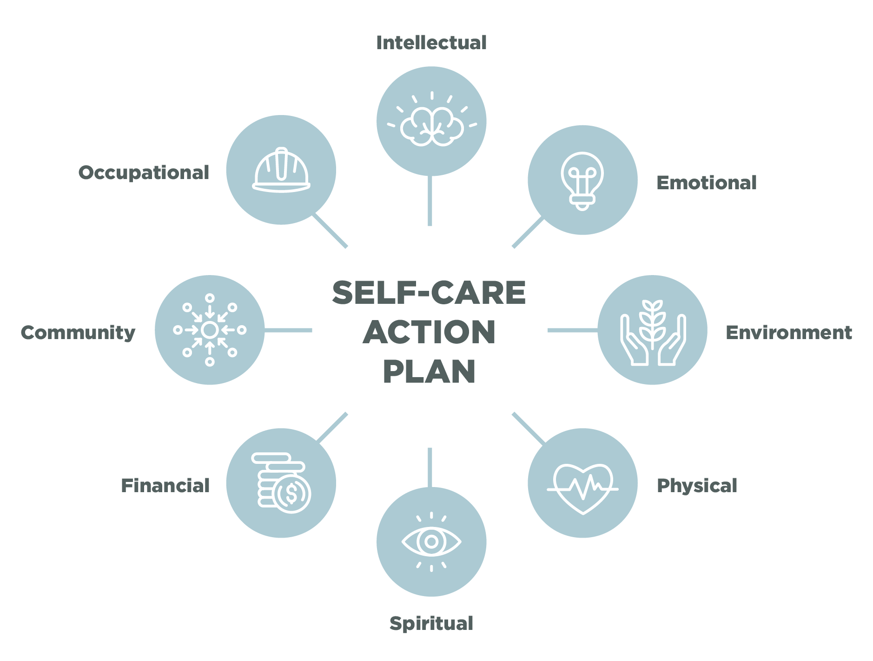
SELF-CARE ACTION PLAN: REVISIT
Ideally, we engage in self-care on a regular basis. But sometimes it is hard. How do you know when you need to refuel with self-care?
When you need to debrief during or after providing MHFA, who can you contact from your Self-care Action Plan?
55-58
74

Slide 34
SUPPORT RESOURCES
National Suicide Prevention Lifeline
Lifeline offers free services 24/7.
Call 1-800-273-TALK (8255) or visit suicidepreventionlifeline.org.
Help is also available in Spanish by calling 1-888-628-9454
Crisis Text Line
Text “MHFA” to 741741 for free 24/7
crisis counseling or visit crisistextline.org.
210
N/A

Slide 35
Thank you! Questions
Erika McKinney
emckinne@hamiltoncenter.org
Emily Owens
eowens@hamiltoncenter.org

