Slide 1

ELECTRONIC SAMPLE BALLOTS
David W. Shelton
Knox County Clerk
dshelton@knoxcounty.in.gov

Slide 2

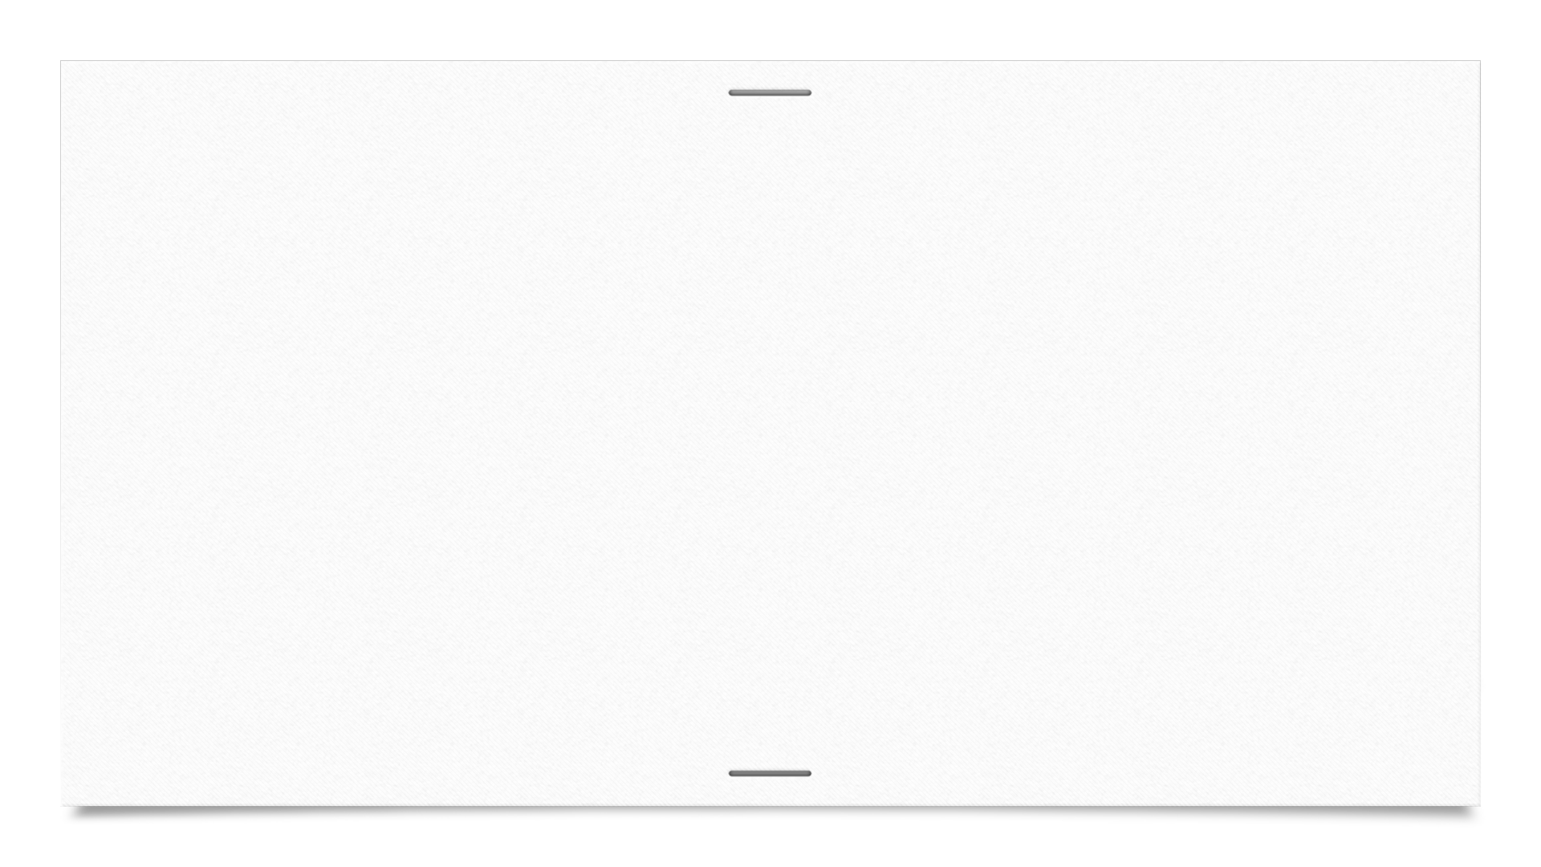

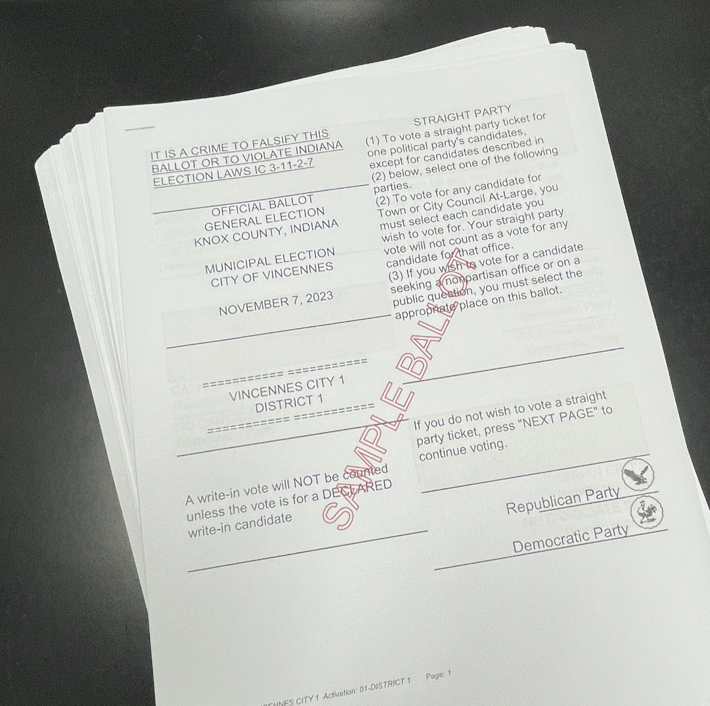
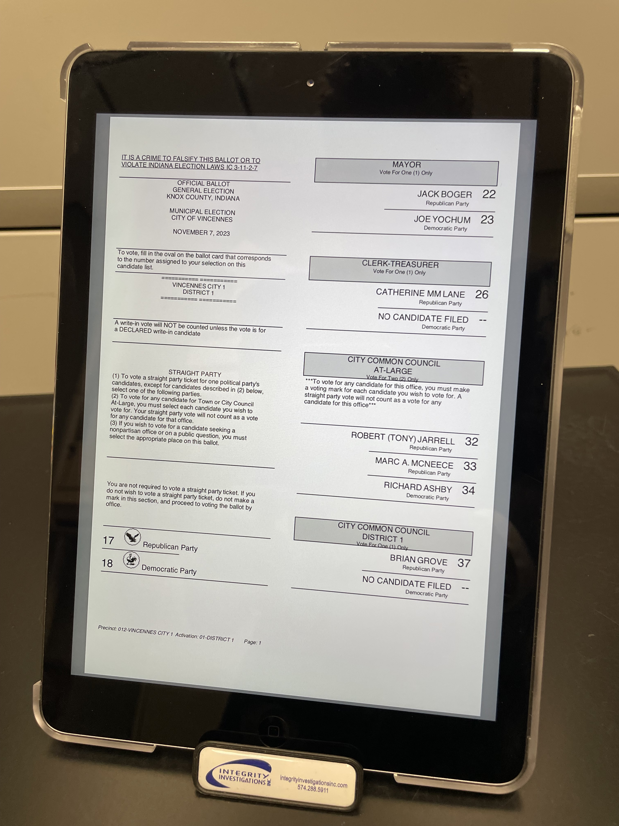
Electronic Sample Ballots
Save printing costs and time, save a tree.
A modern way to address sample ballot requirements.
From idea, to pilot, to proposed legislation,
to State Law.

Slide 3
Problem Description: Especially in a Vote Center County, the requirement of posting sample ballots is problematic. A sample ballot of each precinct is required to be posted at each Vote Center. In Knox County, the 2022 General Election sample ballot included over 250 pages. In larger counties, the number of pages of sample ballots easily exceeded 1500 pages. This presents a problem of making sure each Vote Center has every sample ballot available. Excessive printing requirements, difficulty of finding a specific sample ballot at a vote center and labeling each sample ballot by precinct is time consuming.
Goals: Increase efficiency of election administration by employing additional technology to ease the requirements of displaying sample ballots at Vote Center locations. Decrease usage of paper sample ballots, reducing e-waste by re-using outdated ePoll books, and reducing labor required to produce the paper sample ballots.

Slide 4
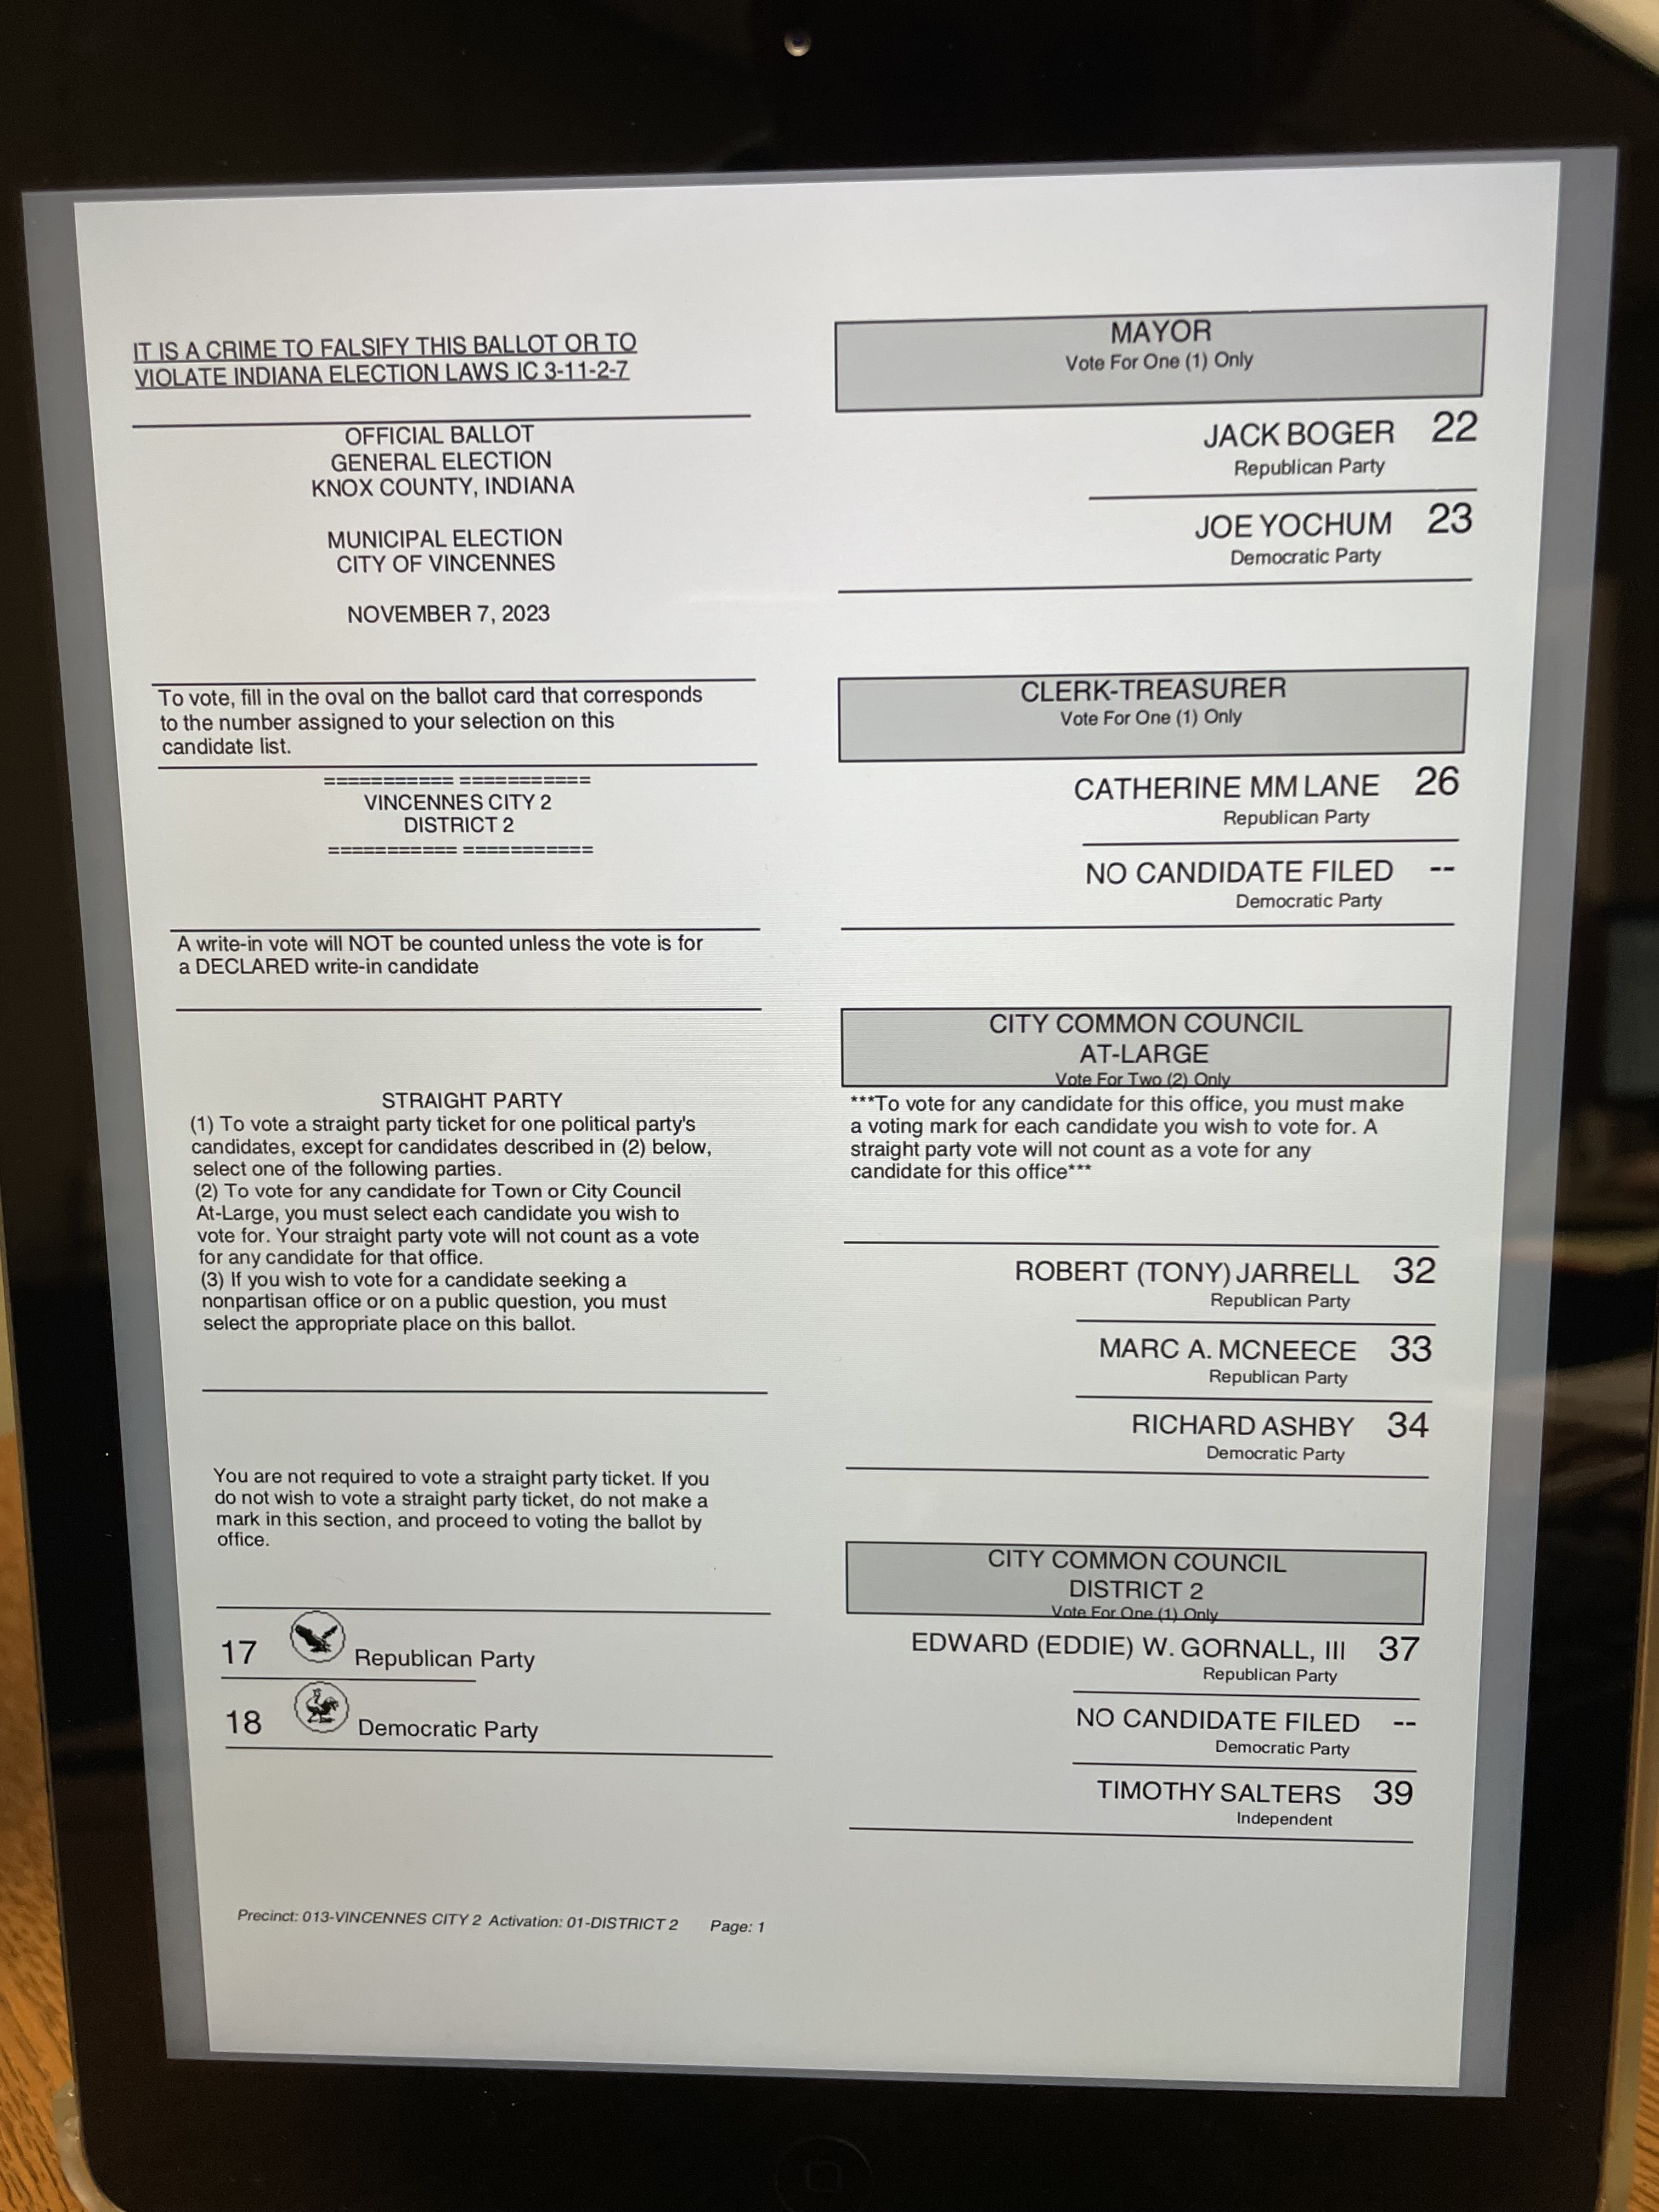
Action Plan: While already in use in Knox County, this project will basically reverse engineer the process by evaluating the steps, identifying improvements to simplify the programming of electronic tablets for use as sample ballots, and assuring all ePoll book software has been safely and correctly removed from older ePoll books. Implementation goal will be the September District Fall meetings in 2023. This was the only Clerk related legislation to pass in the 2023 Indiana General Assembly session.
Managing, training, and assessing election personnel by providing a modern alternative to electronic sample ballots. Creating public value by reusing older ePoll books that could only sit on a shelf, be returned to the vendor, or transferred to another county. Implementing practices to improve election administration by setting up SOP and obtaining permission from the IED and/or VSTOP to provide instructions to all Indiana counties on how to use electronic tablets for sample ballots.

Slide 5
Step #1: Make sure ePoll Book software is removed!!!
Removal is accomplished via vendor. Must be connected to a network and removed through ePulse, or other vedor system. (if repurposing older ePoll book).
Removal of ePoll book software will result in factory reset of the iPad.

Slide 6
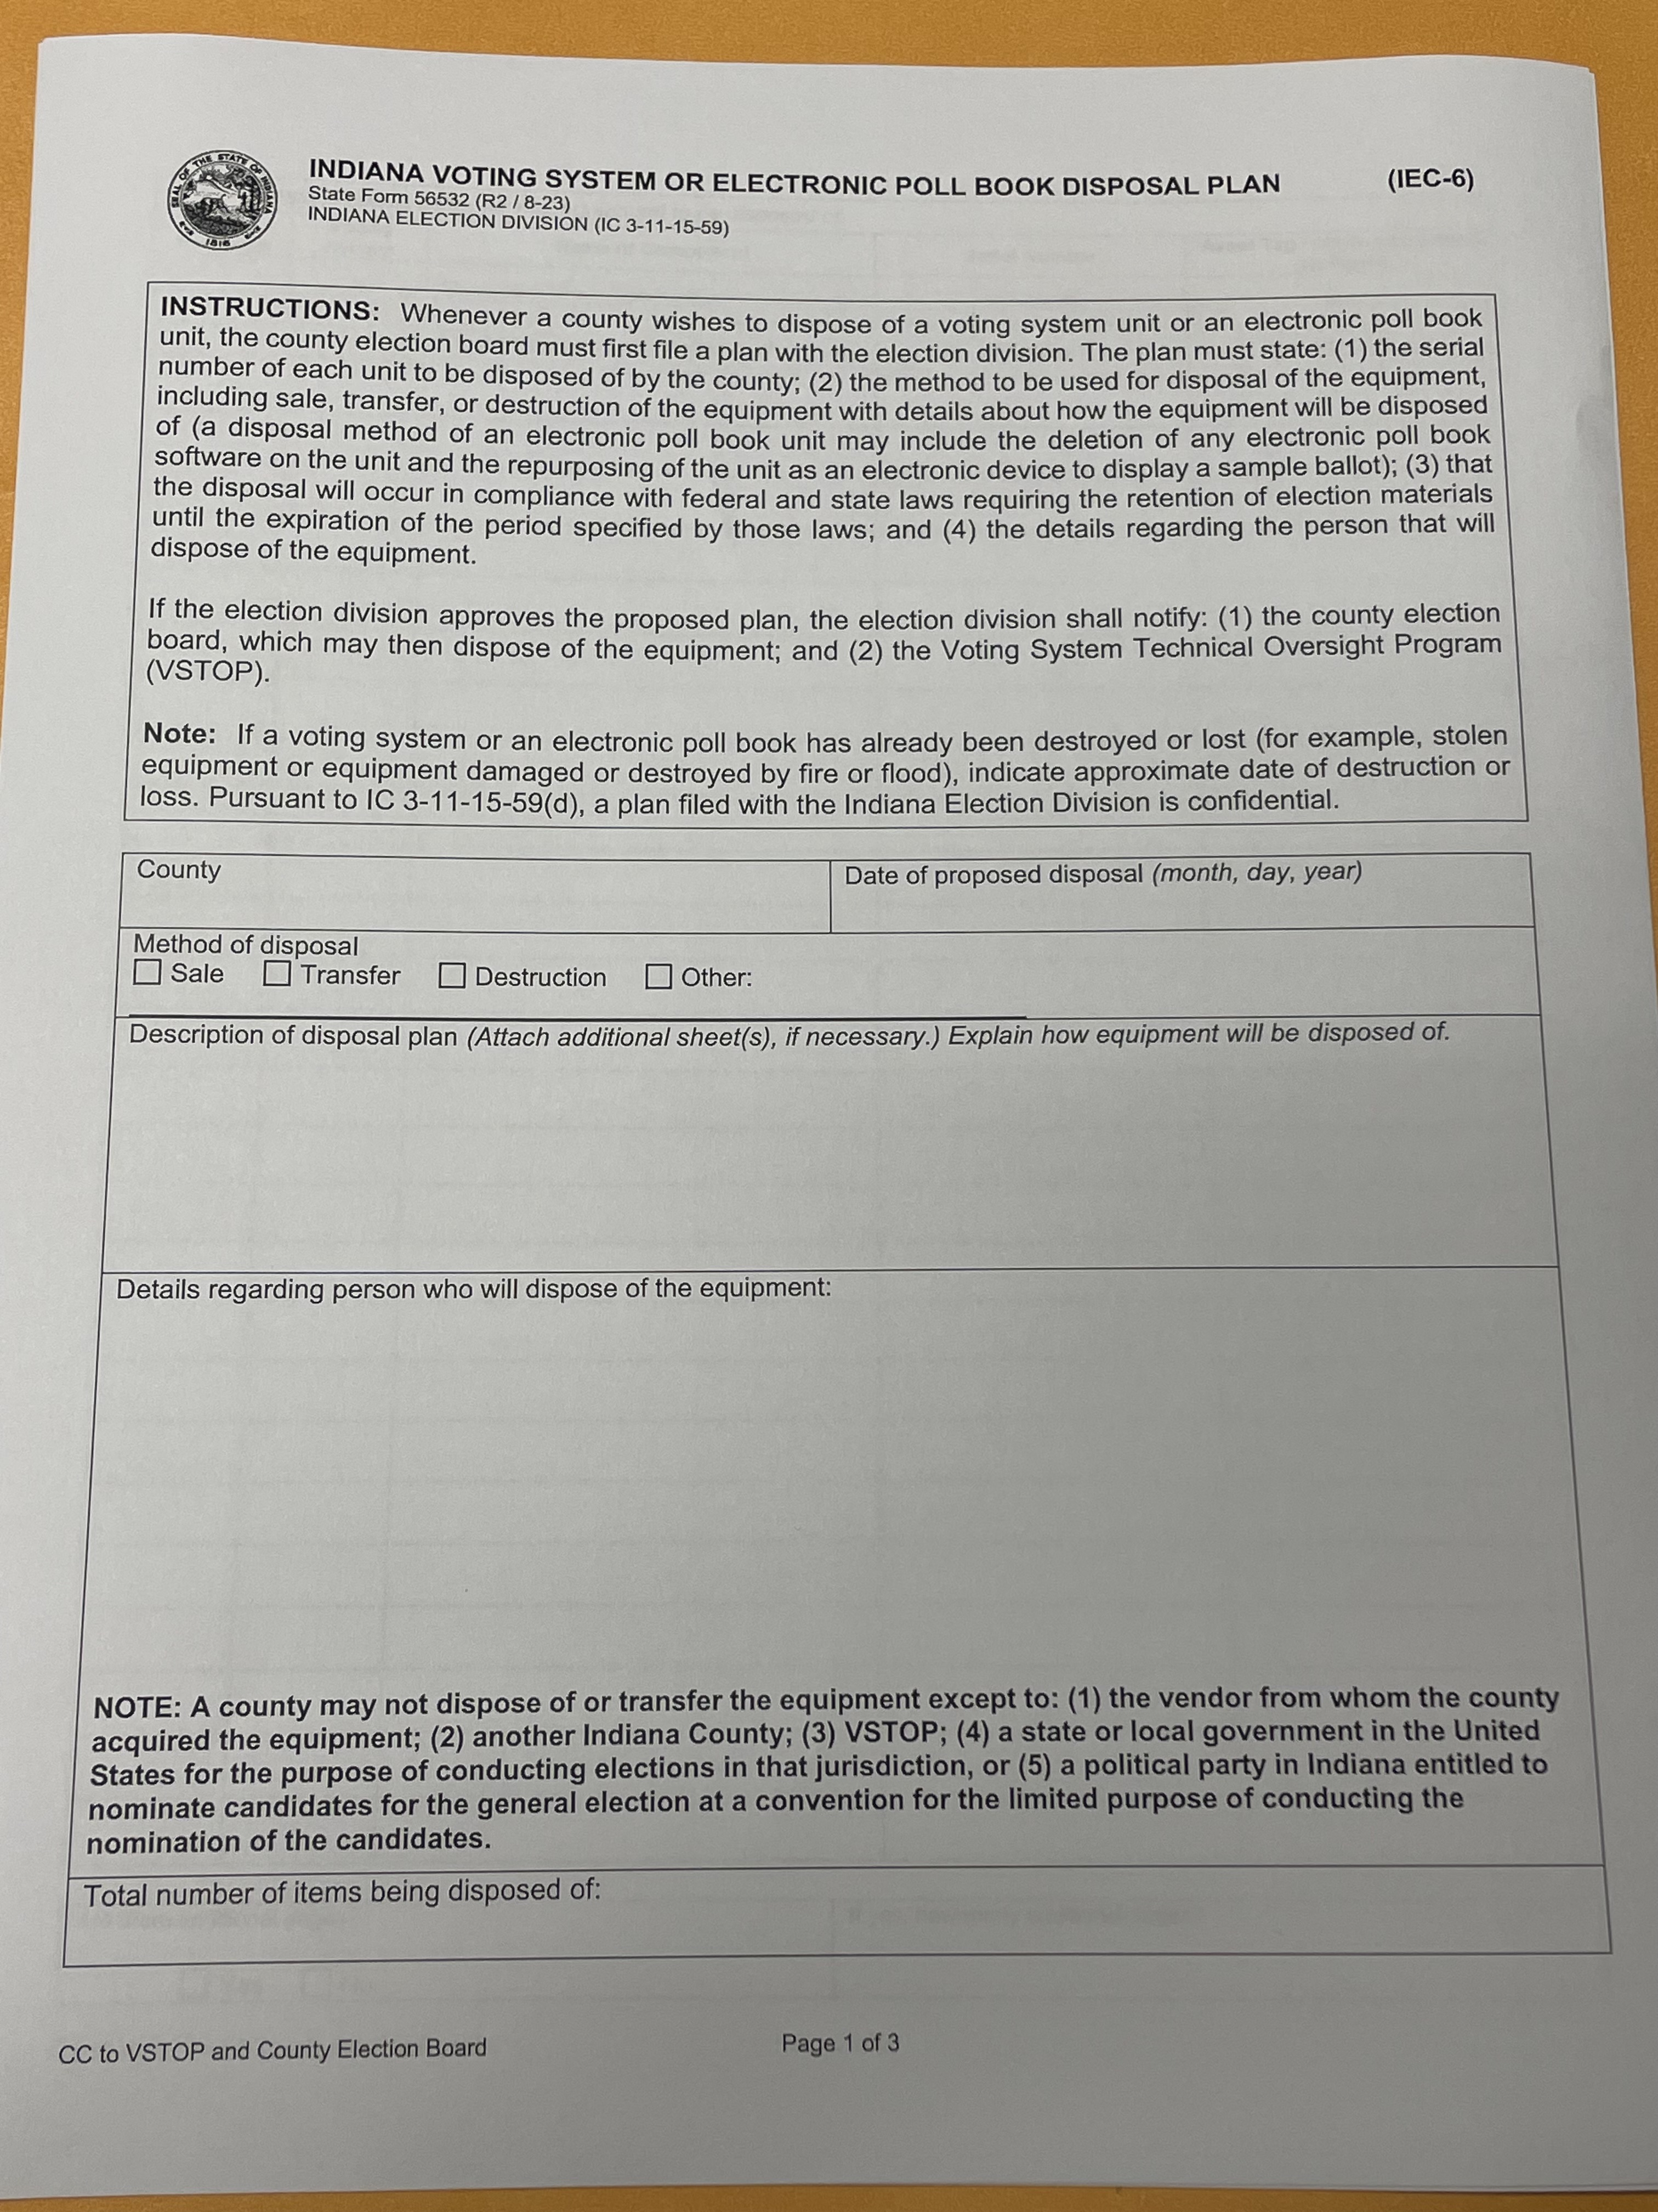
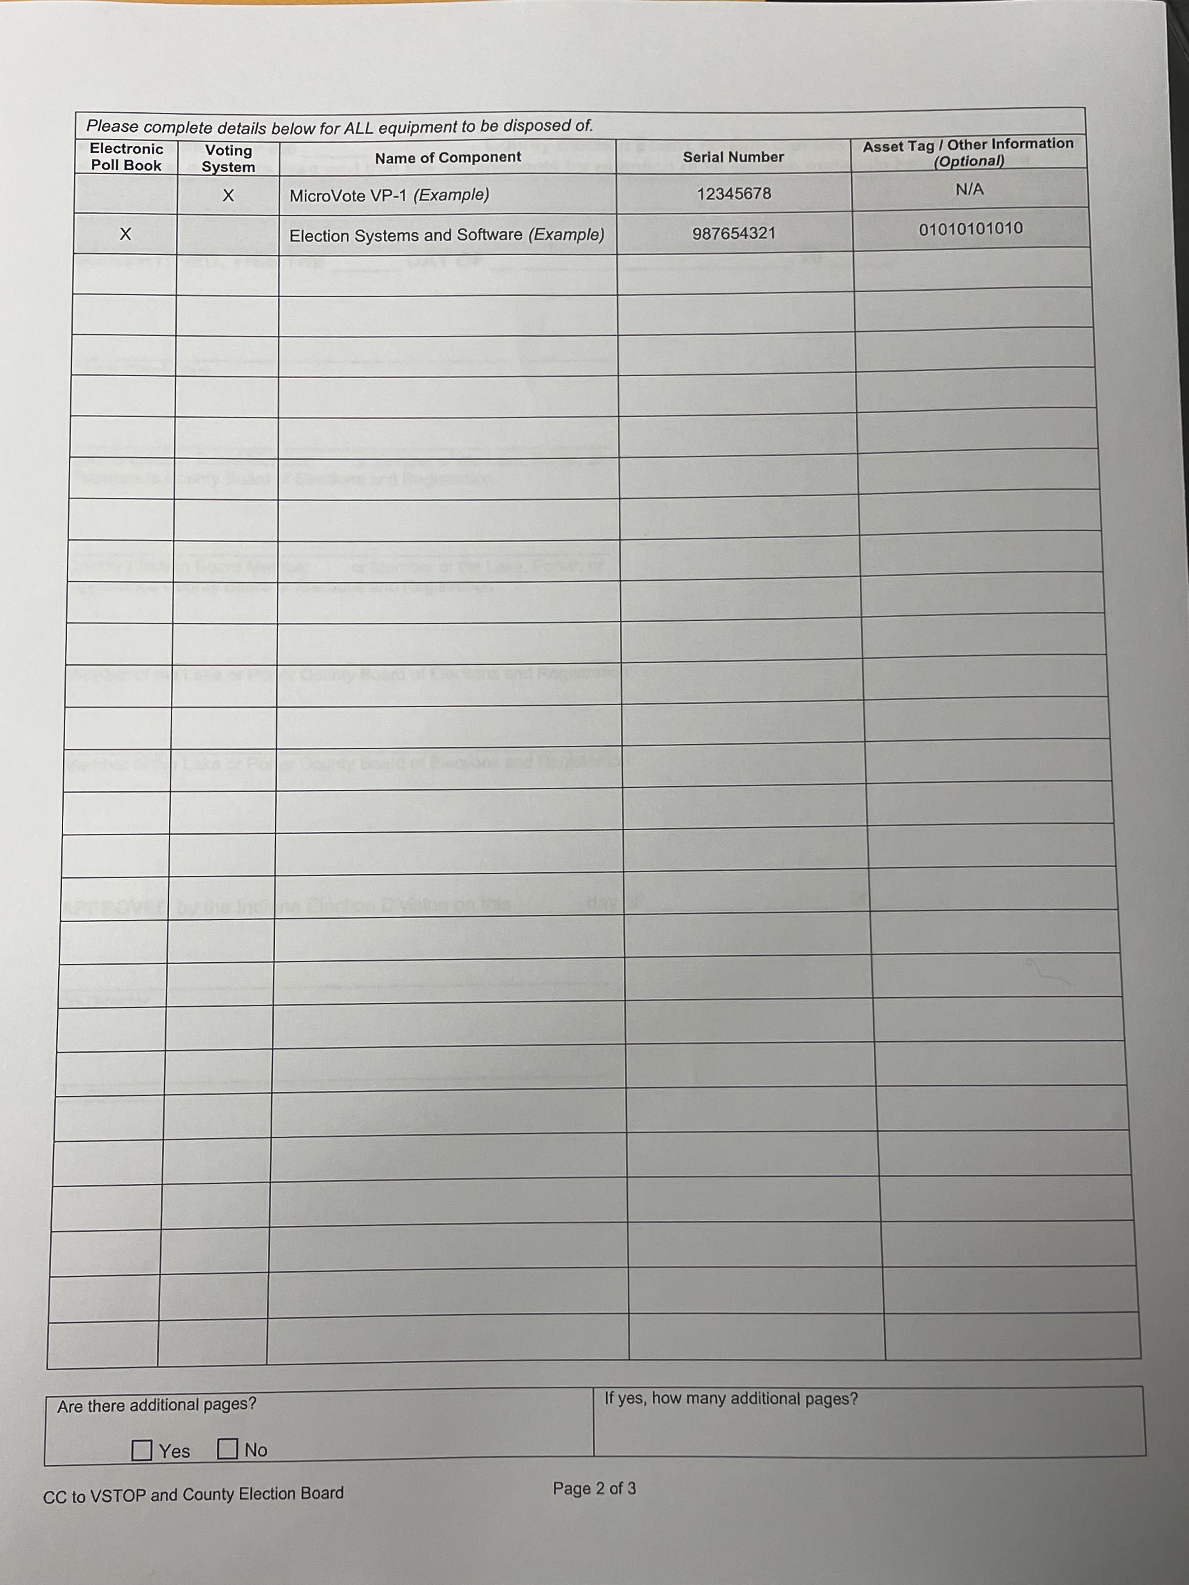
Step #2: IEC-6 Form!
IEC-6 Must be approved by CEB.
IEC-6 Must be approved by IED.
IEC-6 process must be completed even if you are using old ePoll books in house.

Slide 7
Set-up of iPad for sample ballots.
Create iCloud account.
Use same account for each sample ballot tablet.
Use easy to remember user and password for sample ballot tablets.
Using same account on all sample ballot tablets will allow files to be emailed to all tablets at the same time.
After ballot proofs are approved, use the Master ABS file for electronic sample ballot purposes.
Save Master ABS on your computer.
Email Master ABS to the iCloud account.

Slide 8
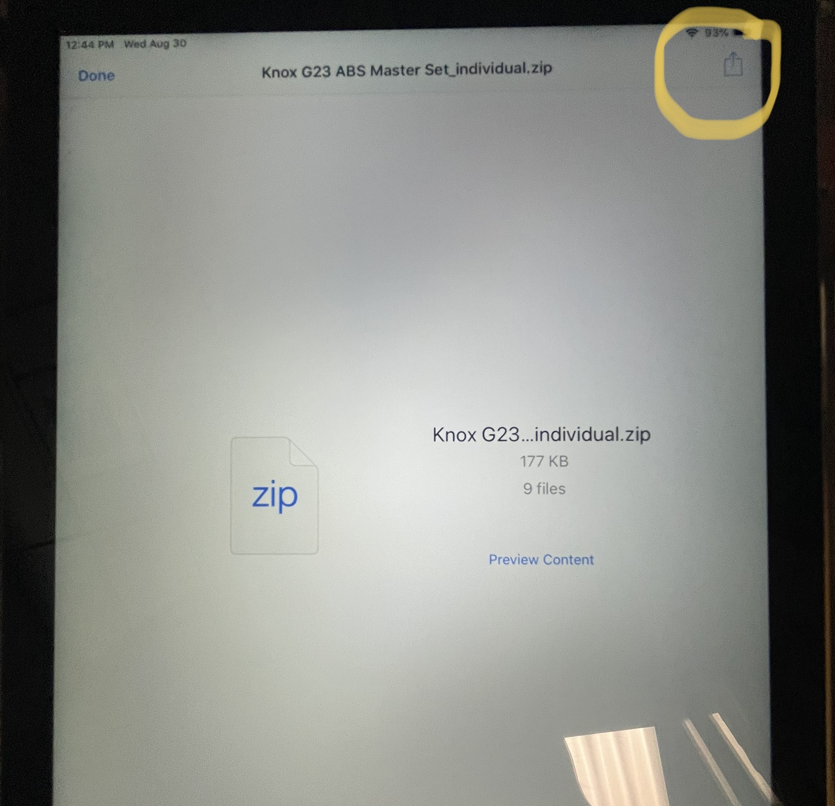
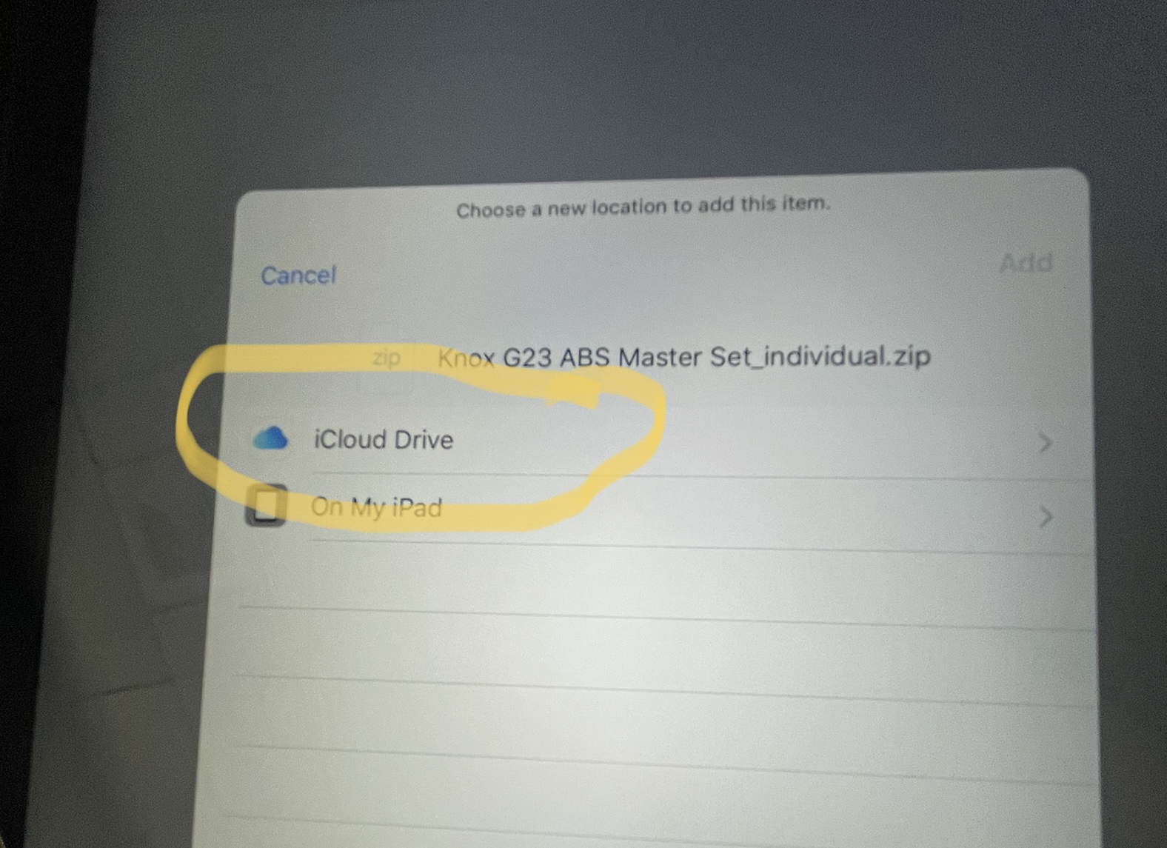
Save Master ABS File to tablet.
Open email, open attachment.
Click the upload icon on the top right corner.
Save to files
Will be prompted to save to iCloud Drive
Master ABS File will be available in the preview content, even if not connected to a network.

Slide 9
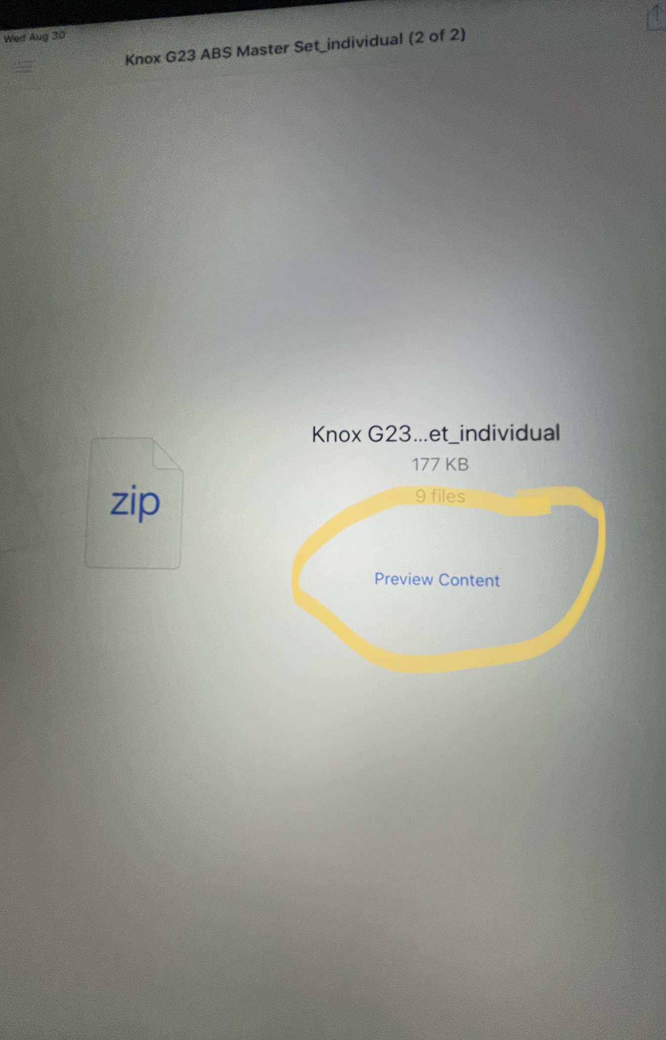
Go to home screen, open “Files”
File will have been saved as a zip file
Tap on “Preview Content” to view sample ballots.
The first ballot, according to your Precinct Key order, will be displayed at first.

Slide 10
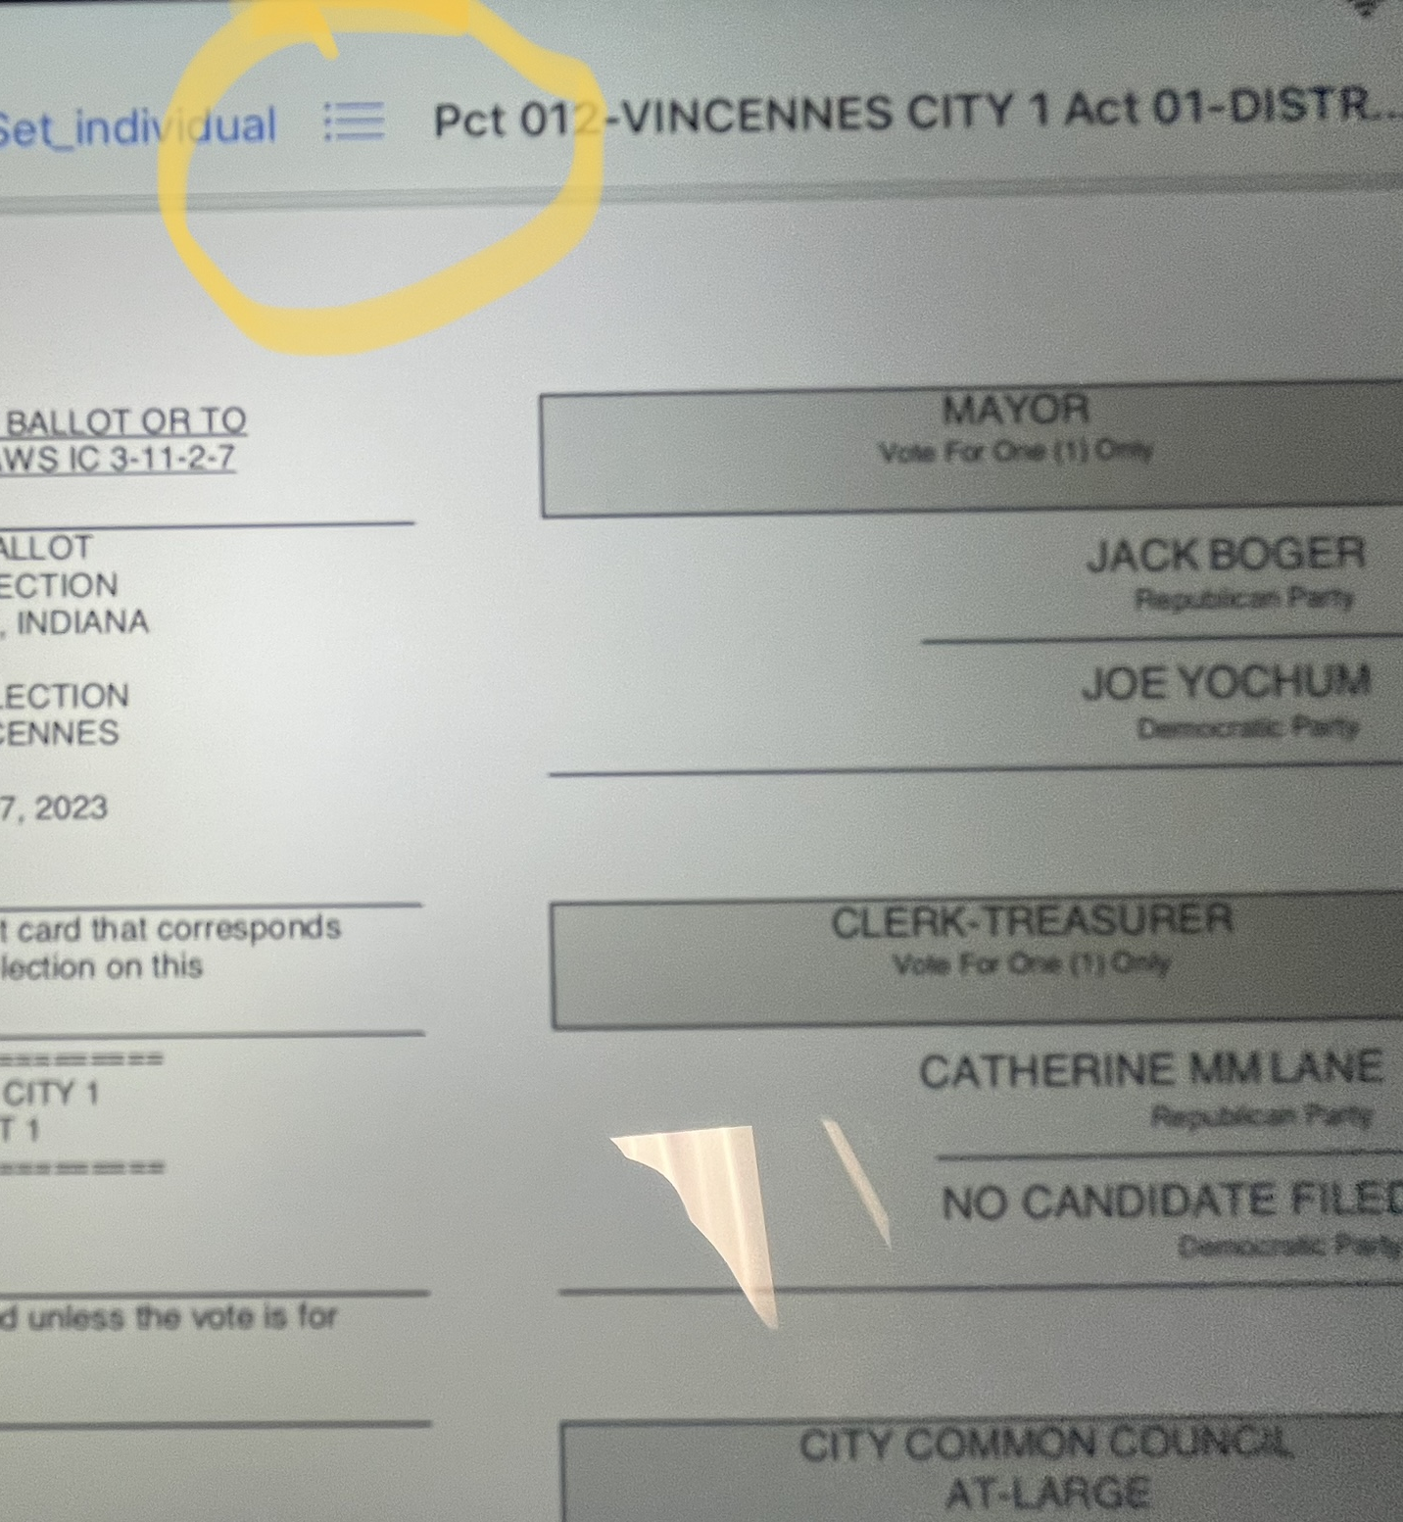
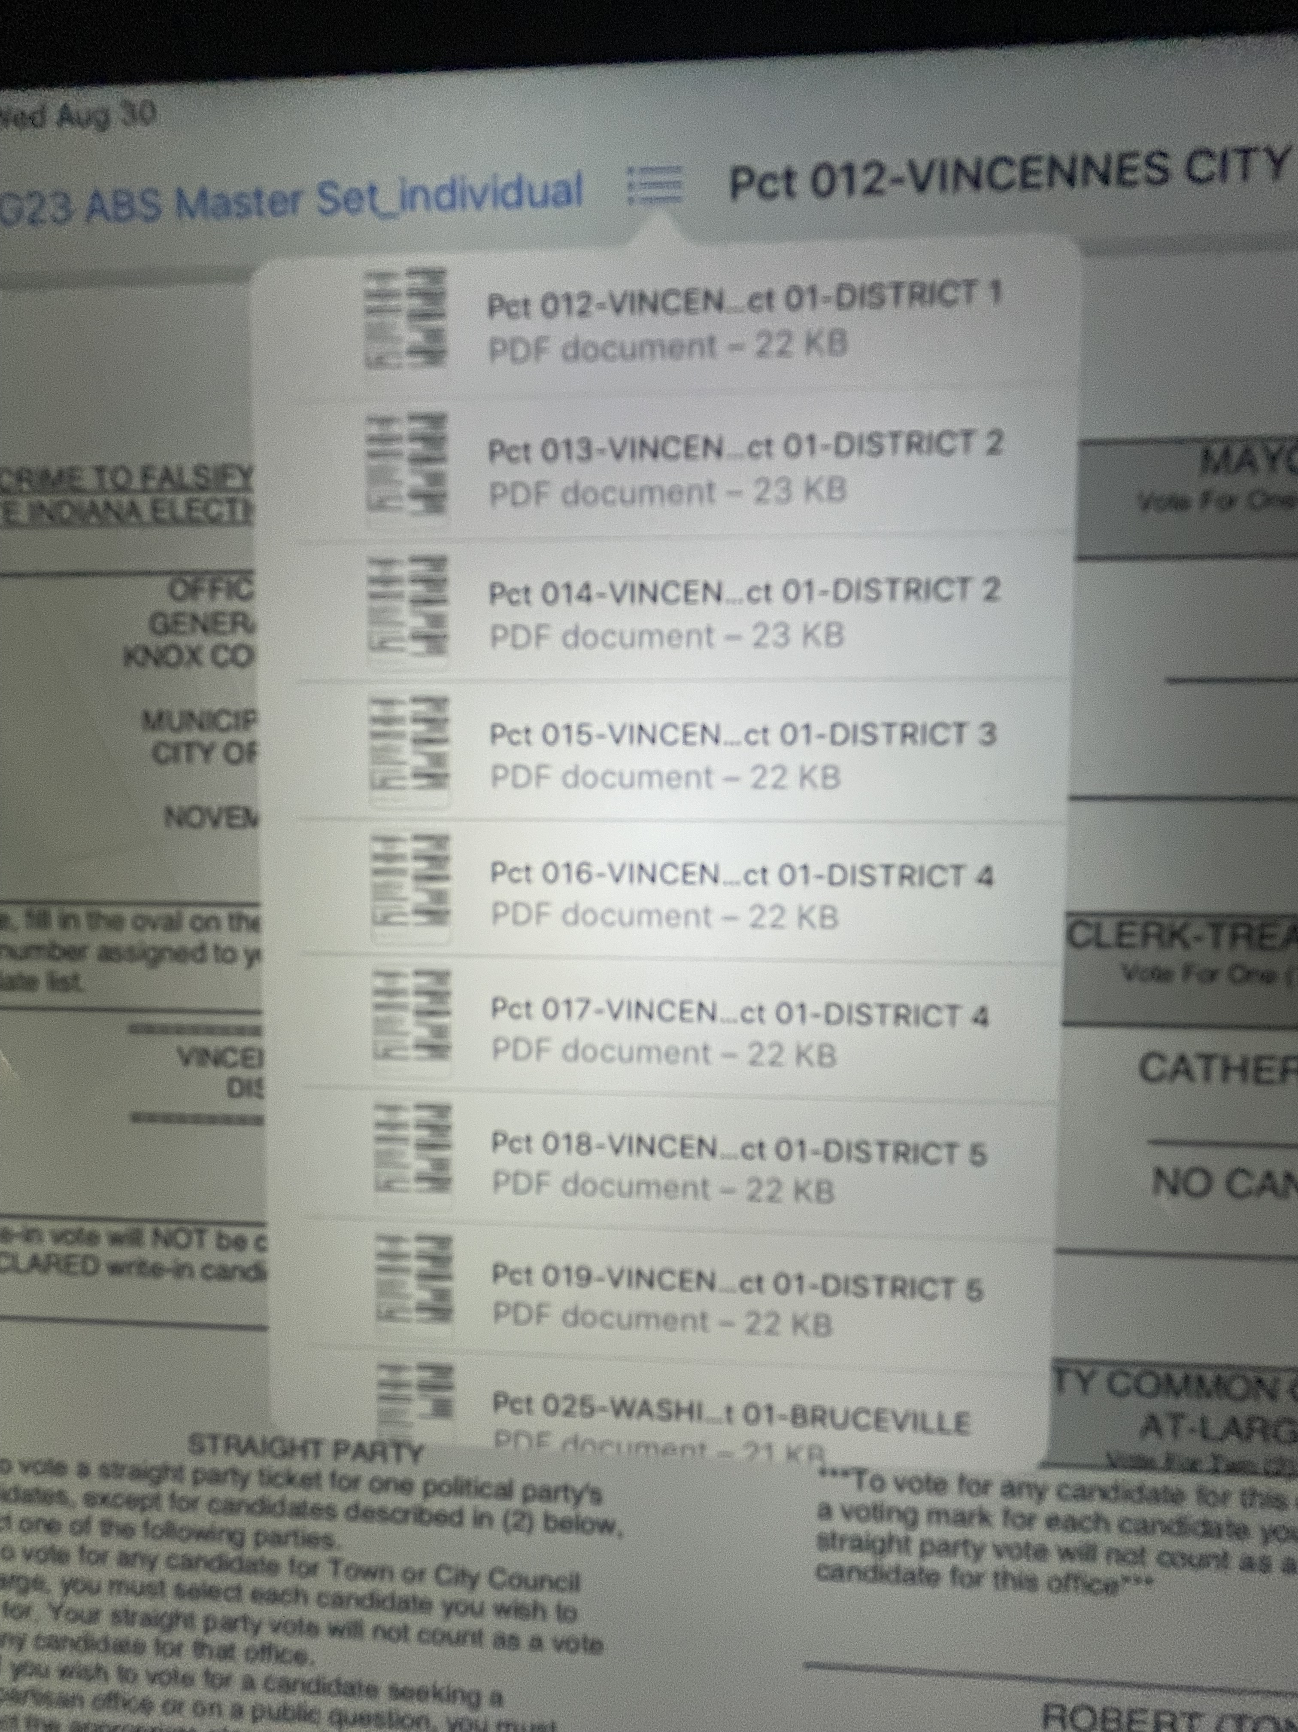
Accessing all Sample Ballots
When the first ballot is displayed, you can access all other available ballots in the menu.
When you tap on the menu icon, available sample ballots will be displayed in a drop down box.
Sample ballots in the menu are displayed in Precinct Key order.
Repeat this process on each electronic tablet used for sample ballots.

Slide 11
Easy is not always better.
While involving a little more labor, the sample ballots can also be saved in the “Books” app on the iPad.
This provides for an easier to use menu/index of all sample ballots.
Eliminates confusion of multiple precinct districts.
Process begins the same as saving to files.
Open email, open attached ABS Master File.
Click “Preview Content”.

Slide 12
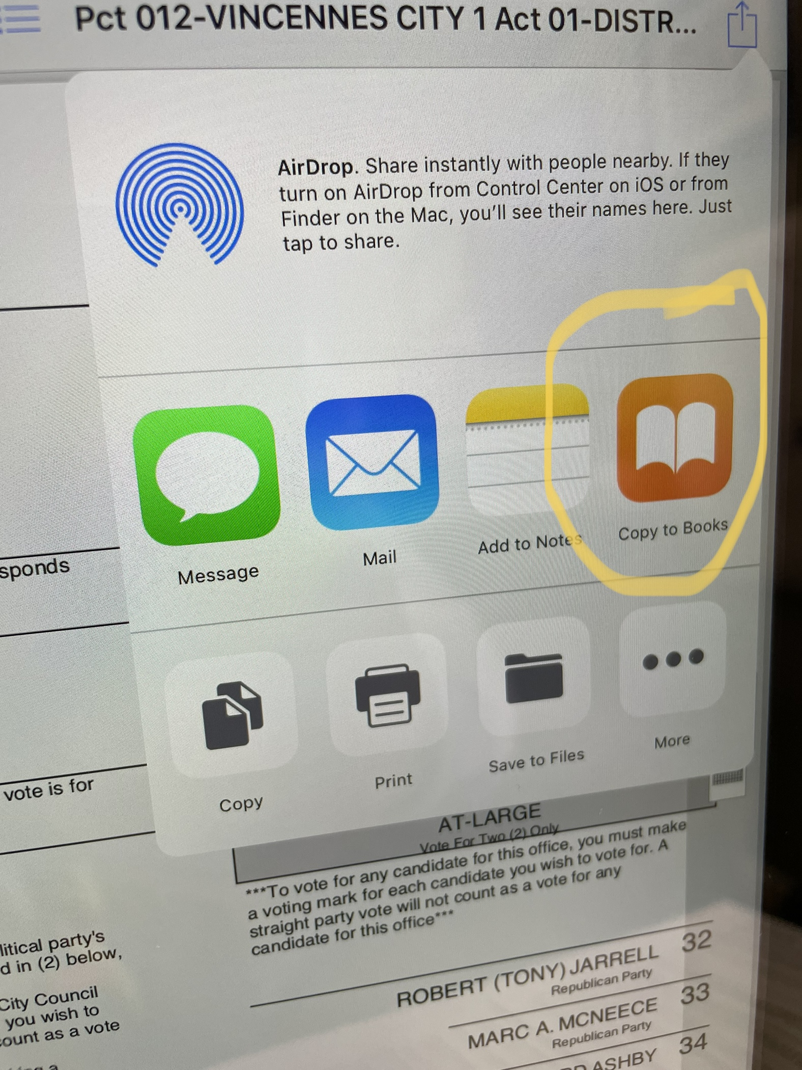
Saving Ballot Files to “Books”
Open the File.
For each ballot, open from menu.
Click on the upload icon on the top right corner.
Copy to “Books”
Must repeat for each ballot.

Slide 13
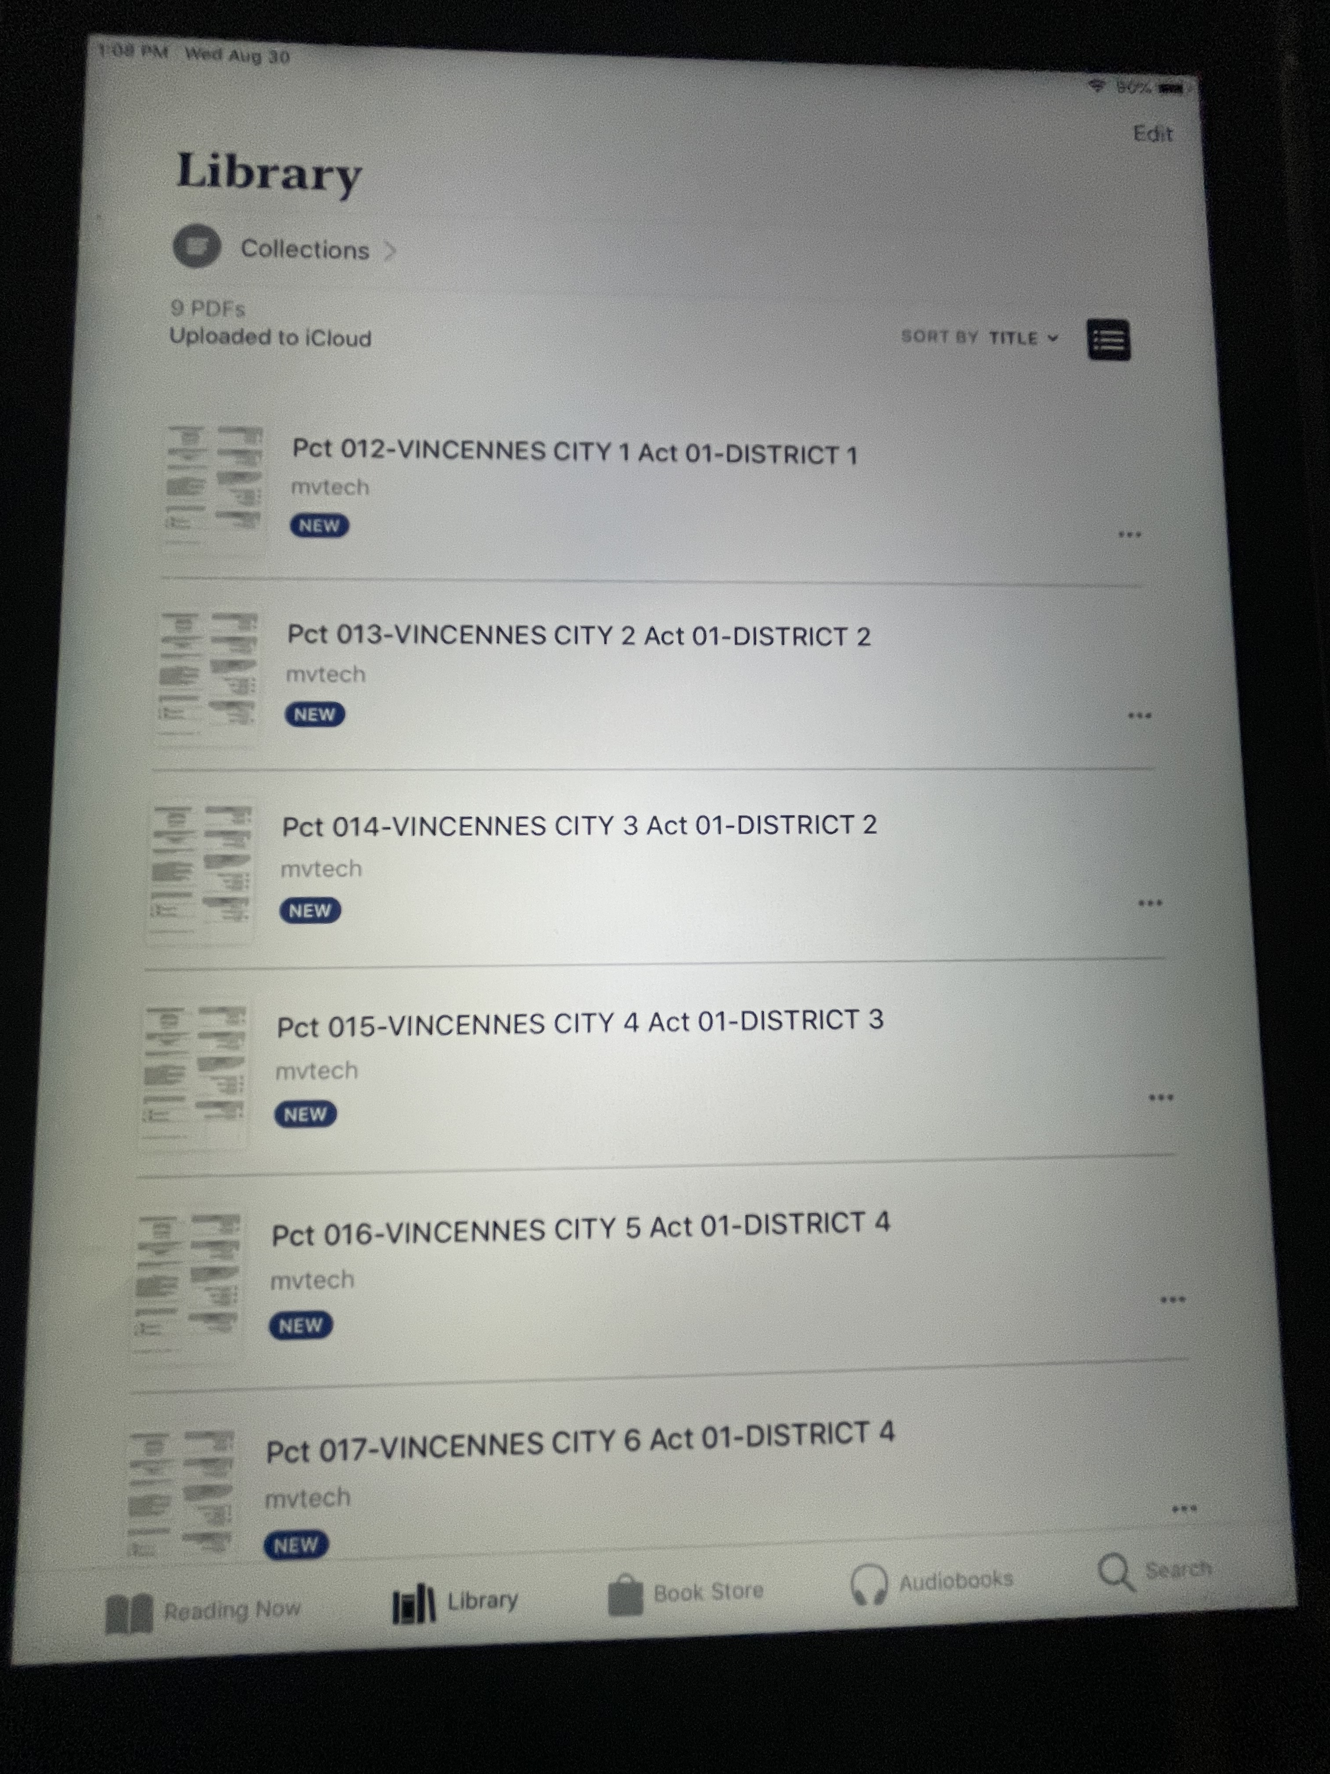
Library menu in Books.
Easier to view and find correct ballot requested.
More time consuming to install.
Must be individually uploaded to each tablet used for sample ballots.

Slide 14
Questions? I’m not an IT expert. Easier way to do it? Please share!
David Shelton
Knox County Clerk
dshelton@knoxcounty.in.gov
Office: 812 895-4927
Cell: 812 887-2957

