Slide 1
Prepping for the Primary Election
Clerk’s Association Northern District 2026 Spring Meeting
Jason Jacobs and Anola Gallion, Proficiency Management Leads

Slide 2
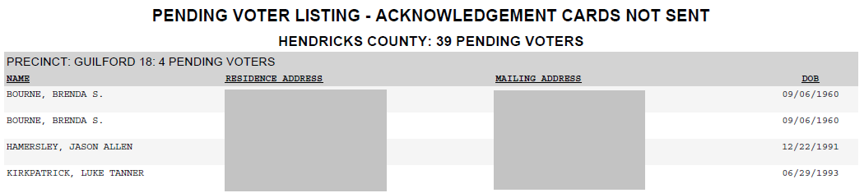
Pre-Election Tasks - Acknowledgements
Run a Pending Voter Listing – Acknowledgement Cards Not sent Report to view which registrations are currently Pending and still need to be sent Acknowledgement cards.
The Pending Period will not begin, and these voters would be prevented from potentially moving into Active status until the cards are generated and sent.

Slide 3
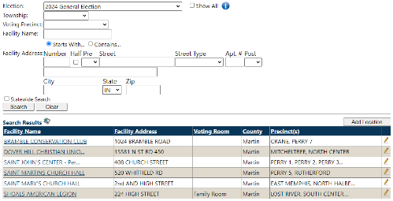
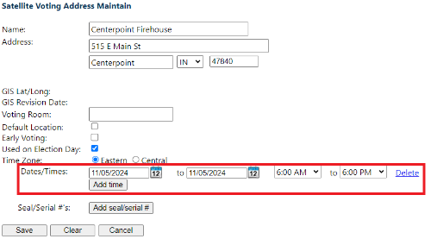
Pre-Election Tasks - Locations
Update Poll Locations/Vote Centers and Hours
Remember to update your Polling Locations/Vote Center Locations, and their hours.
This information appears on IndianaVoters.com for voters to view.
For Precinct-Level Polling locations, go to Poll > Location.
For Early Voting and Vote Center locations, go to Administration > County > Satellite Voting Maintenance

Slide 4
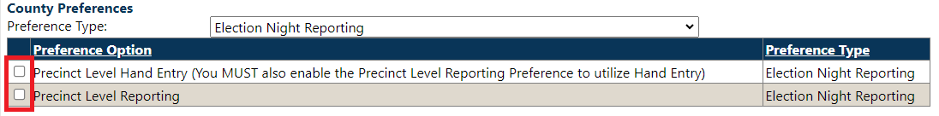
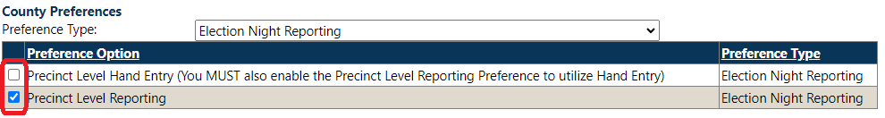
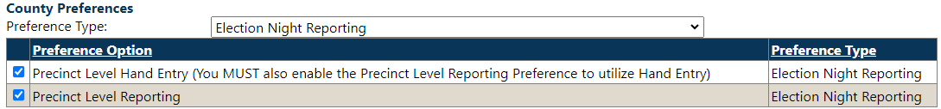
Pre-Election Tasks – Results Reporting
Selecting your Election Night Results Reporting Preference (no later than 6 p.m., Friday, May 1)
Summary Level Reporting: Hand Entry of overall Vote Totals
Precinct Level Reporting: Results upload from EMS Vendor on Election Night (Requires Mapping)
NOTE: There is state legislation currently pending that may become final as Indiana law during the next couple of weeks. We will keep you advised if and when that proposal becomes State law.
Precinct Level Hand Entry: Hand Entry of Vote Totals from every precinct

Slide 5
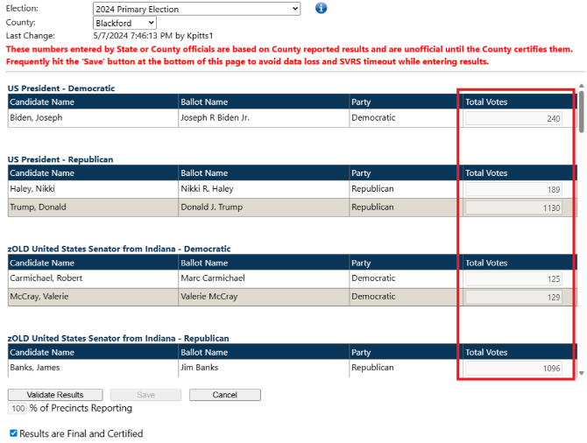
Summary Level Results Reporting
Manual entry of ONLY the Total Votes Cast for each Candidate.
Requires attaching Precinct Level Results to CEB forms during Post-Election Processing.
Precinct Level (Upload) preferences revert to Summary Level if mapping is not complete by 6 p.m., Friday, November 1.

Slide 6
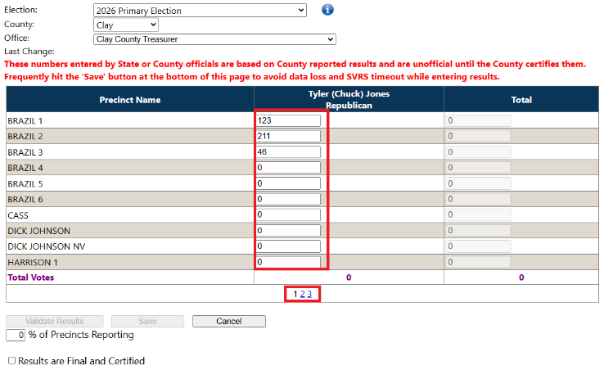
Precinct Level Hand Entry Results Reporting
Manual entry of ALL vote totals from each precinct for each candidate.
Change offices in the drop-down box and change pages for more precincts.
DO NOT enter Total Votes Cast in first box and come back later to complete entry.

Slide 7
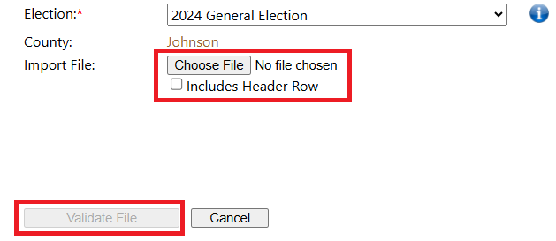
Precinct Level Results (Upload) Reporting
Requires mapping of offices, candidates, etc. prior to the election
Upload of a precinct results file from your voting system vendor’s EMS system.
CSV is the preferred file Type for uploading
After validating the upload file, return to the Office Results page to confirm totals, validate and save results
Election > Election Results > Election Results Upload
NOTE: There is state legislation currently pending that may become final as Indiana law during the next couple of weeks. We will keep you advised if and when that proposal becomes State law.

Slide 8
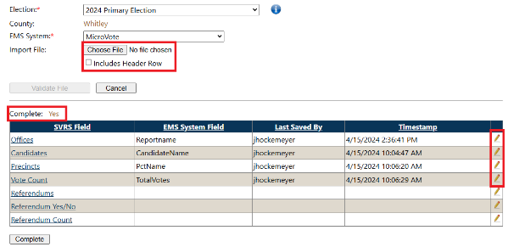
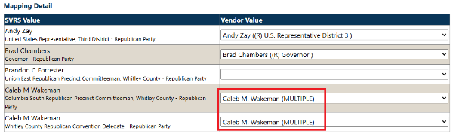
Precinct Level Results - Mapping
Administration > County > Mapping Upload
Upload a “Zero File” from your voting system vendor’s EMS system.
Match the Vendor Value field from the Zero File to the SVRS value for each category
If a candidate is running for multiple offices, the office name for the candidate in the vendor value will display as (Multiple) and may be used in all areas for the candidate during mapping

Slide 9

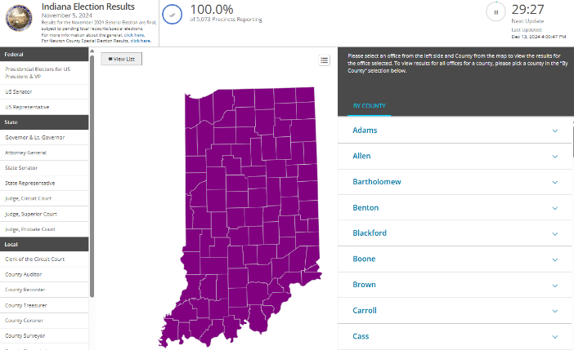
Public Site – IndianaVoters.com
IndianaVoters.com is available to the public to view Election Results and perform many other tasks, including updating voter registrations and submitting absentee applications
Many items entered in SVRS will display on this site including, but not limited to: Polling Locations/Vote Centers, Voting Hours, Who’s on the Ballot and a voter portal where voters may track the status of their Absentee Ballot.

Slide 10
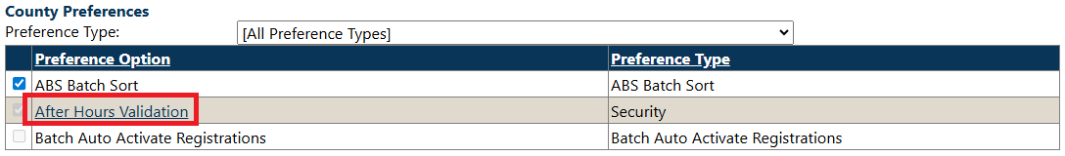
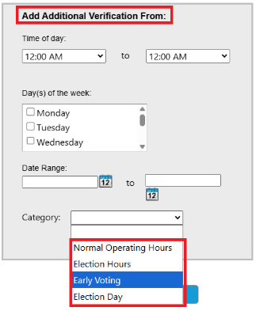
After Hours 2FA Validation
Access via Administration > System > County Preferences > After Hours Validation
SVRS includes specific times where additional 2FA Validation is required to Log In, including on weekends
County users may set specific dates and times for this additional 2FA to be in place, specifically during Early Voting.
Best practices are to set any additional dates and hours for outside of normal working hours and/or extended Early Voting dates and times.

Slide 11
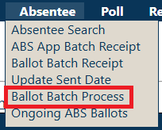
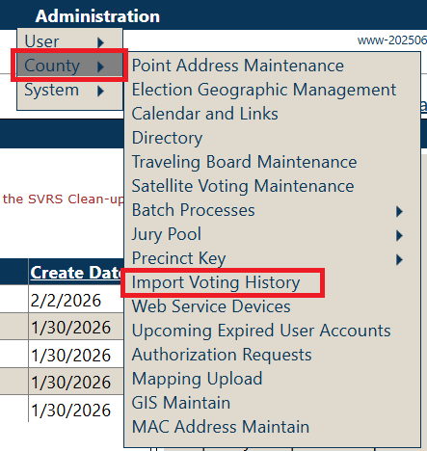
Post-Election Processing Reminders
Manually enter all Provisional Ballots and remember to update them after the Provisional Hearing(s)
Update all absentee Ballots properly, run Absentee Ballot Batch and Import Vote History processes to apply Vote History
Ensure results are updated and marked Final and Complete AFTER all CEB Hearings have been conducted
Process and finalize ALL necessary CEB forms
Run Get Winners process to attach winners from the Primary to the General Election.

Slide 12

Step-by-Step Instructions to Review
ALL Absentee Step-by-Steps
Election Prep Check List
County Election Result Entry
Poll Overview/Vote Center Satellite Location Setup
Epollbook Overview
Precinct Level Mapping and Results Upload
CEB Form Generation
Post Election Processing
2FA After Hours Validation
County Directory Use and Maintenance
All documents are on the INSVRS County Portal
Email INSVRShelpdesk@gocivix.com to request access

Slide 13
Upcoming Web Training Schedule
ePollbook Overview – 3/5 at 11 a.m.
Preparing for the 2026 Primary – 3/11 at 1 p.m. & 3/12 at 11 a.m.
Absentee & Cure Process Overview – 3/17 at 1 p.m. & 3/19 at 11 a.m.
Election Results Mapping – 3/24 at 1 p.m. & 3/26 at 11 a.m.
March Build Placeholder – 3/31 at 1 p.m. & 4/2 at 11 a.m.
IndianaVoters.com Functionality and County Inputs – 4/6 at 1 p.m. & 4/9 at 11 a.m.
County Election Results Entry – 4/14 at 1 p.m. & 4/16 at 11 a.m.
Certificate of Error Processing – 4/21 at 1 p.m. and 4/23 at 11 a.m.
Post-Election Processing – 4/30 at 11 a.m. & 5/7 at 11 a.m.
CEB Form Generation Overview – 5/12 at 1 p.m. & 5/14 at 11 a.m.
Petitions Overview – 5/19 at 1 p.m. & 5/21 at 11 a.m.
Election, Office, Candidate, and Referendum Setup – 5/26 at 1 p.m. & 5/28 at 11 a.m.
U.S. District Court Data Processing – 6/2 at 1 p.m. & 6/4 at 11 a.m.
All trainings are conducted through Microsoft Teams.
Dates and times are Eastern Time and subject to change.

Slide 14

How to
Contact
CIVIX
Helpdesk
Microsoft Teams
3. HelpDesk Contact:
1-888-467-8771
INSVRSHelpDesk@gocivix.com

Slide 15


Title
QUESTIONS?

