Slide 1


Child Support for Clerks Spring 2026
Presented by Diane Dale, Field Consultant Manager

Slide 2
Intergovernmental Cases
What we’ll cover in this session:
Intergovernmental cases – what they are and why we get them
Identifying an intergovernmental case in ISETS
Entering foreign (non-Indiana) orders in ISETS
When and why to use an OSTA subaccount
Notes:
Click here

Slide 3
Intergovernmental Cases
What these cases are and why we get them
Notes:
Click here

Slide 4
Intergovernmental Cases
Intergovernmental cases are those involving two or more governmental jurisdictions
Interstate – Case involving Indiana and another U.S. State or territory
International – Case involving Indiana and a foreign country
Uniform Interstate Family Support Act (UIFSA)
All 50 U.S. States enacted latest version (2008)
Provides uniform rules for cases involving 2 or more jurisdictions
Notes:
Intergovernmental simply means more than 1 governmental jurisdiction is involved in the case. These types of cases need administrative or judicial actions taken to establish and/or enforce child support orders across State, tribal, or international boundaries because the original jurisdiction can’t do it for some reason so they need request help. For U.S. States and territories, UIFSA was enacted to provide more uniform rules for handling cases between different jurisdictions. The most recent version of UIFSA is 2008.

Slide 5
Intergovernmental Cases
Why send child support cases to another U.S. State or foreign country?
No jurisdiction over the non-resident to establish paternity and/or support
Unsuccessful in service of process
Unsuccessful enforcement actions
Notes:
Since we, primarily, deal with other U.S. States and territories as well as some U.S. Indian tribes, our discussion today will focus on U.S. jurisdictions. Why would another State or country send a case to another State? It’s usually because the original State has tried to take an action but it’s been unsuccessful. It could be that they have no way to obtain legal jurisdiction over the non-resident parent. They may have tried to serve the non-resident with notice of a court hearing, but service of process wasn’t successful. They also may have tried to send an IWO to the non-resident’s employer but it wasn’t implemented.

Slide 6
Intergovernmental Cases
Intergovernmental cases can be initiated by:
Request from another U.S. State or territory
Request from a foreign country
Direct enrollment for IV-D services
Most Intergovernmental cases are IV-D cases.
Occasionally, a private attorney might file to register a foreign support order
for enforcement in court. These cases are typically NIVD cases.
Notes:
An intergovernmental case can be initiated by States, territories, tribes, or a foreign country. A party or parent can enroll directly with our State’s IV-D program then find help is needed from another State so it becomes an intergovernmental case. Most of these cases are IV-D. However, sometimes a party will ask a private attorney for help with a child support issue (i.e., registering another State’s order) without involving IV-D. Those instances aren’t very common, though.

Slide 7
Identifying Intergovernmental Cases
Notes:
Click here

Slide 8
Identifying Intergovernmental Cases
Two codes are used in ISETS to indicate Intergovernmental status. These codes are found on the Update Case (C8C) screen in a field labeled Interstate.
INIT means Indiana initiated a request to another jurisdiction
Also referred to as “Outgoing UIFSA” cases
RESP means Indiana is responding to a request from another jurisdiction
Also known as “Incoming UIFSA” cases
Notes:
2 codes are used in ISETS to indicate a case is intergovernmental. The code is entered in a field labeled Interstate on the Update Case screen, also called the “C8C” screen, which we’ll look at shortly. The first code is INIT which means Indiana INITiated a request to another jurisdiction. These Initiating cases are also, sometimes, referred to as “Outgoing UIFSA” cases, meaning we sent it to another jurisdiction. The other code is RESP which means Indiana is RESPonding to another jurisdiction’s request. Responding cases are also sometimes called “Incoming UIFSA” cases because they’re sent to us from another jurisdiction.

Slide 9
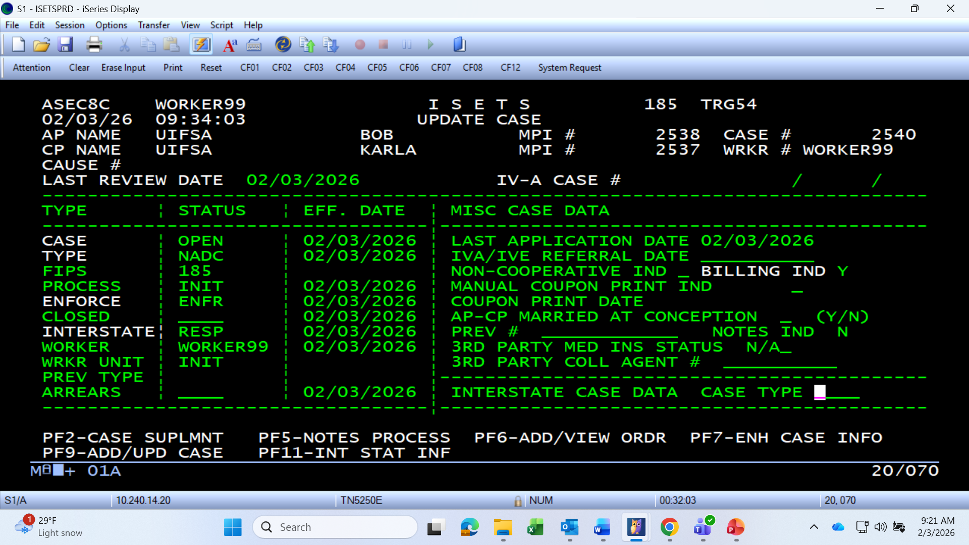
Identifying Intergovernmental Cases
Interstate status field will have RESP or INIT codes entered if case is an Intergovernmental case.
Notes:
Here is the “C8C” screen, which nickname comes from the last 3 digits of the alpha-numeric identifier of the “Update Case” screen that appears in the upper left corner. Each screen in ISETS has a unique identifier assigned to it. On this screenshot, you can see that “RESP” has been entered in the Interstate field for this case so we know that the case is an intergovernmental case and that we are responding to a request from another jurisdiction.

Slide 10
Entering Foreign Support Orders
Notes:
Intergovernmental scenario to show how to find the Interstate code in ISETS and also how to enter another State’s order using the original cause number instead of an Indiana cause number. A local cause number would not be needed in ISETS for this case because it will not be going to court in Indiana.
Local cause numbers do not need to be assigned to cases to be entered into ISETS. ISETS is a IV-D program tracking system used to track all actions taken on child support cases, not a court system. Local cause numbers only need to be assigned if the case will be heard in a local court.

Slide 11
Entering Foreign Support Orders
Local RS cause numbers are assigned when registering a non-Indiana order for modification, enforcement or both
JP/DC cause numbers are usually assigned when a request for establishment is received
Local cause numbers are not assigned when court actions will not take place in Indiana
Foreign support orders are entered using the foreign cause numbers when court actions take place in another jurisdiction
Notes:
Intergovernmental scenario to show how to find the Interstate code in ISETS and also how to enter another State’s order using the original cause number instead of an Indiana cause number. A local cause number would not be needed in ISETS for this case because it will not be going to court in Indiana.
Local cause numbers do not need to be assigned to cases to be entered into ISETS. ISETS is a IV-D program tracking system used to track all actions taken on child support cases, not a court system. Local cause numbers only need to be assigned if the case will be heard in a local court.

Slide 12
Entering Foreign Support Orders
FL issued a child support order. Custodial Party (CP) and child live in IN. Non-custodial parent (NCP) still lives in FL but is no longer paying support. CP enrolls in IV-D services in IN to enforce the order.
IN enters INIT in Interstate field on ISETS case
IN IV-D sends request for enforcement to FL
IN county Clerk’s Office adds the FL order using the FL cause number
IN county IV-D office monitors case for payments
Notes:
Intergovernmental scenario to show how to find the Interstate code in ISETS and also how to enter another State’s order using the original cause number instead of an Indiana cause number. A local cause number would not be needed in ISETS for this case because it will not be going to court in Indiana.
Local cause numbers do not need to be assigned to cases to be entered into ISETS. ISETS is a IV-D program tracking system used to track all actions taken on child support cases, not a court system. Local cause numbers only need to be assigned if the case will be heard in a local court.

Slide 13
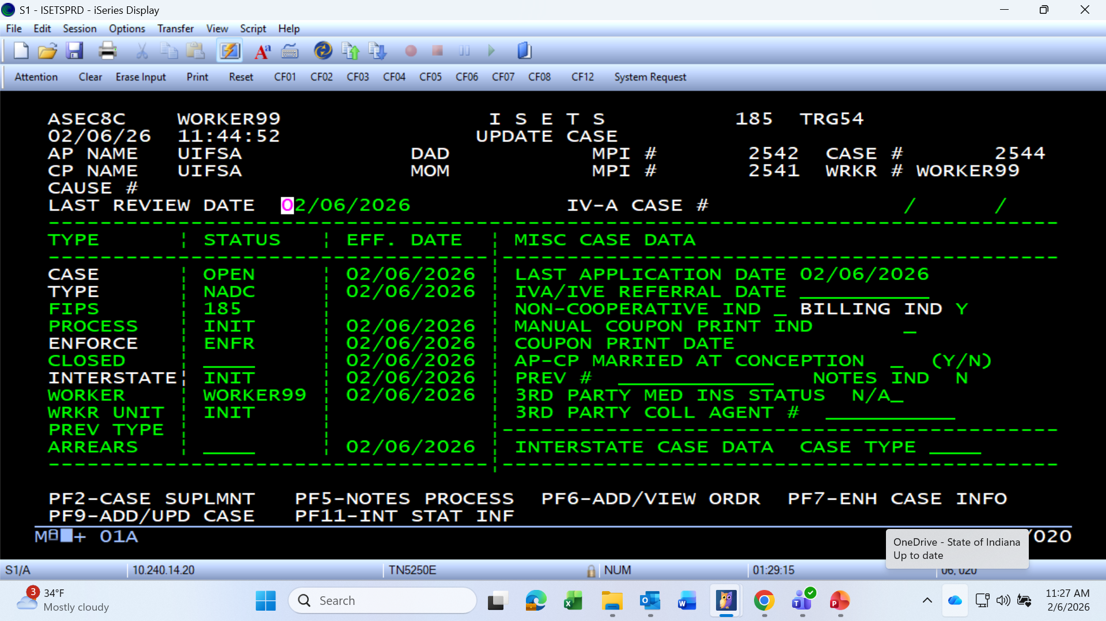
Entering Foreign Support Orders
Notes:
Screenshot to show the case has been coded as an Initiating intergovernmental case.

Slide 14
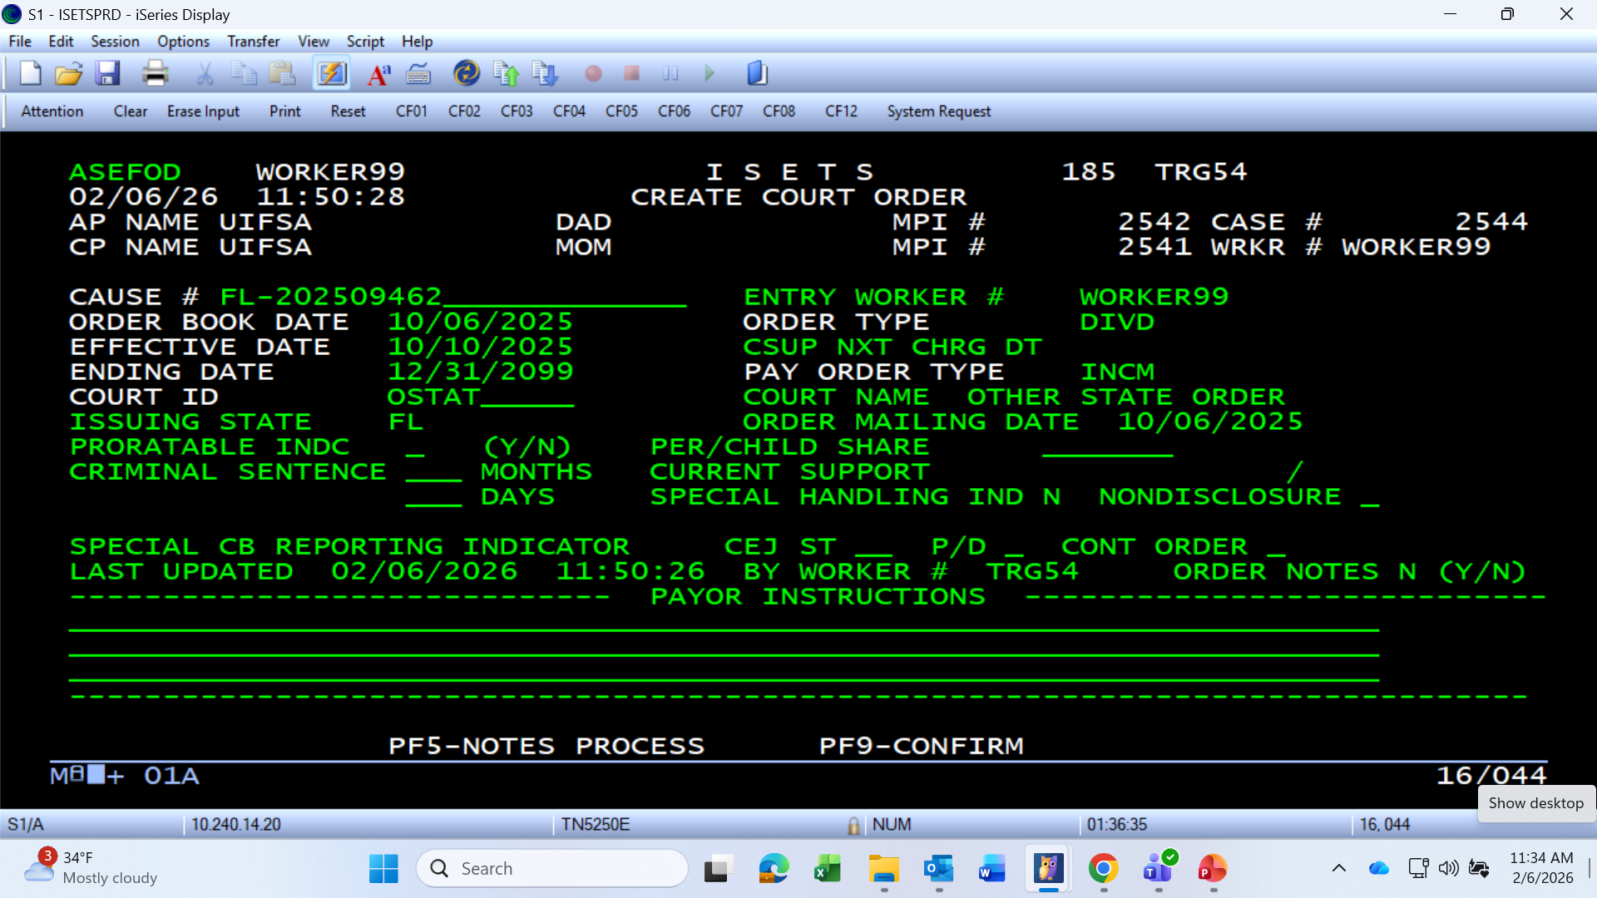
Entering Foreign Support Orders
Notes:
Screenshot shows the entry of the FL cause number and information, using the court code for “other State” court and issuing State is FL.

Slide 15
Entering Foreign Support Orders
CP and child live in TX. TX issued a child support order for NCP to pay child support to CP. NCP moved to IN and is no longer paying support. CP enrolls in IV-D services in TX to enforce the order.
TX IV-D sends request for enforcement to IN
IN enters RESP code in Interstate field on ISETS case
IN county IV-D office registers the TX order – typically by filing a petition and requesting a RS case cause type
Notes:
Walking through a scenario to show how a RESP case would be sent to IN.

Slide 16
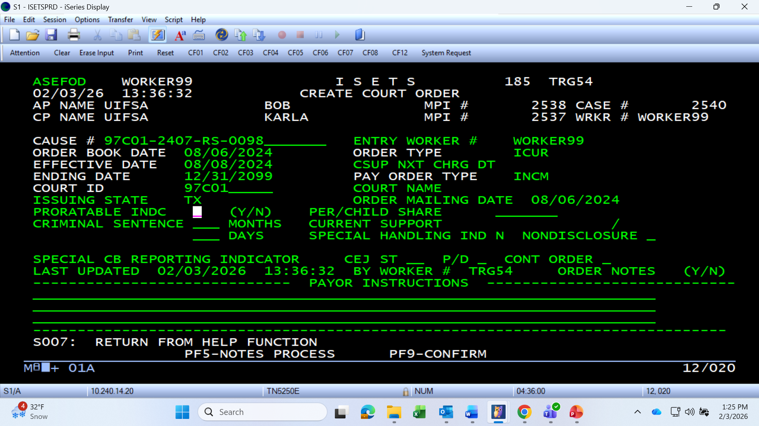
Entering Foreign Support Orders
Court ID should match the court hearing the case under the local RS cause.
Issuing State field should be the 2-digit code for the original State that issued the order.
Enter “ICUR” in Order Type field for Incoming UIFSA (Interstate) order. TX requested IN register their order.
Notes:
Click here

Slide 17
When to Use OSTA Subaccounts
Notes:
Intergovernmental scenario to show how to find the Interstate code in ISETS and also how to enter another State’s order using the original cause number instead of an Indiana cause number. A local cause number would not be needed in ISETS for this case because it will not be going to court in Indiana.
Local cause numbers do not need to be assigned to cases to be entered into ISETS. ISETS is a IV-D program tracking system used to track all actions taken on child support cases, not a court system. Local cause numbers only need to be assigned if the case will be heard in a local court.

Slide 18
When to Use OSTA Subaccounts
When should an OSTA subaccount be used for arrears balances?
OSTA subaccounts are used for balances owed to jurisdictions other than Indiana and the first jurisdiction requesting or receiving a request for services
If a case involves only Indiana and 1 other jurisdiction, there should be no OSTA subaccount created on the case
Notes:
OSTA subaccounts are needed on cases only once in a while. If more than 2 States (Indiana and 1 other State) are involved in the same case, an OSTA subaccount may be needed.

Slide 19
When to Use OSTA Subaccounts
CP enrolls in IV-D services in TX to enforce a TX support order. NCP lives in IN and is not paying. TX sends request to IN to register and enforce the TX order. CP and child lived in OH prior to moving back to TX and received TANF while there. OH sends notice to TX and IN that $500 is owed to OH.
IN enters RESP in Interstate field on ISETS case
IN registers the TX order (RS cause)
IN enters support order and creates NADCA subaccount for arrears balance owed to CP/TX
IN also creates an OSTA subaccount for OH with a $500 balance
Notes:
Scenario showing 3 States involved in a single case with money owed to the third State (OH) which would require an OSTA subaccount to be created for OH’s arrears balance.

Slide 20
When to Use OSTA Subaccounts
Issuing State field should show the 2-letter code for the State that issued the original order.
Enter the Order Type code ICUR for Incoming UIFSA (Interstate). TX requested IN register their order.
Notes:
Screenshot of entering the TX order into ISETS after Indiana registers it in the local court.

Slide 21
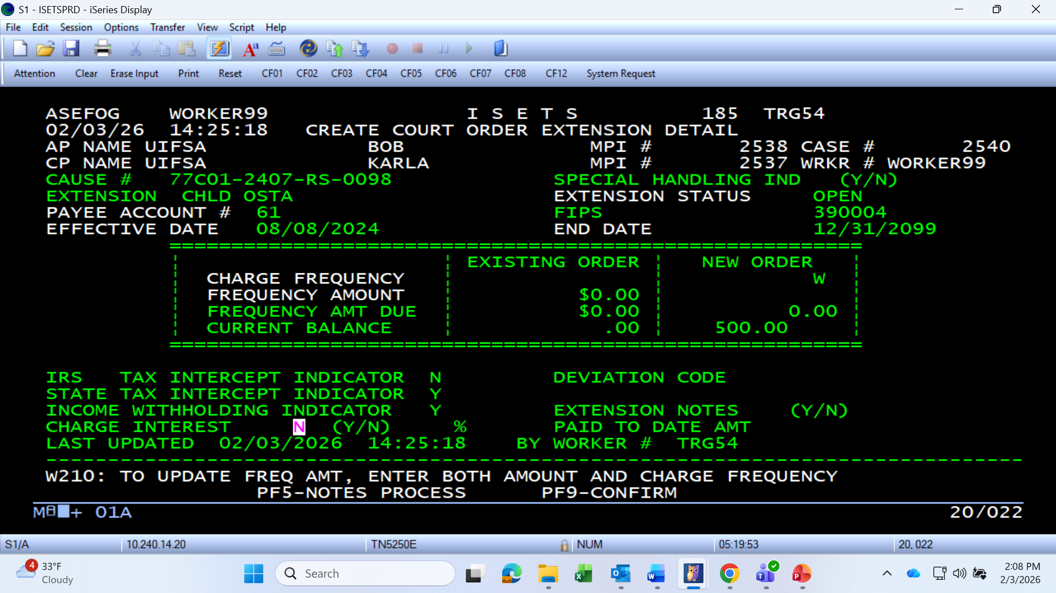
When to Use OSTA Subaccounts
Payee Account number for OSTA subaccounts should be one of the following, depending on to whom the arrears are owed:
60 – CP arrears
61 – TANF arrears
62 – FC arrears
Notes:
Screenshot showing the creation of the OSTA subaccount for OH’s State arrears balance. Due to OH being owed the money, the payee account code 61 would be used as it is for arrears that accumulated while the CP was receiving TANF in OH. It’s important to use the correct payee account number for the type of arrears balance entered in it. Also, note that OH’s payment FIPS (390004) must also be entered in the FIPS field when the subaccount is created. The payment FIPS code is the information that’s needed to correctly direct money flowing through this subaccount to OH. If the payment FIPS entered on this screen is incorrect, money will not distribute to OH correctly.

Slide 22
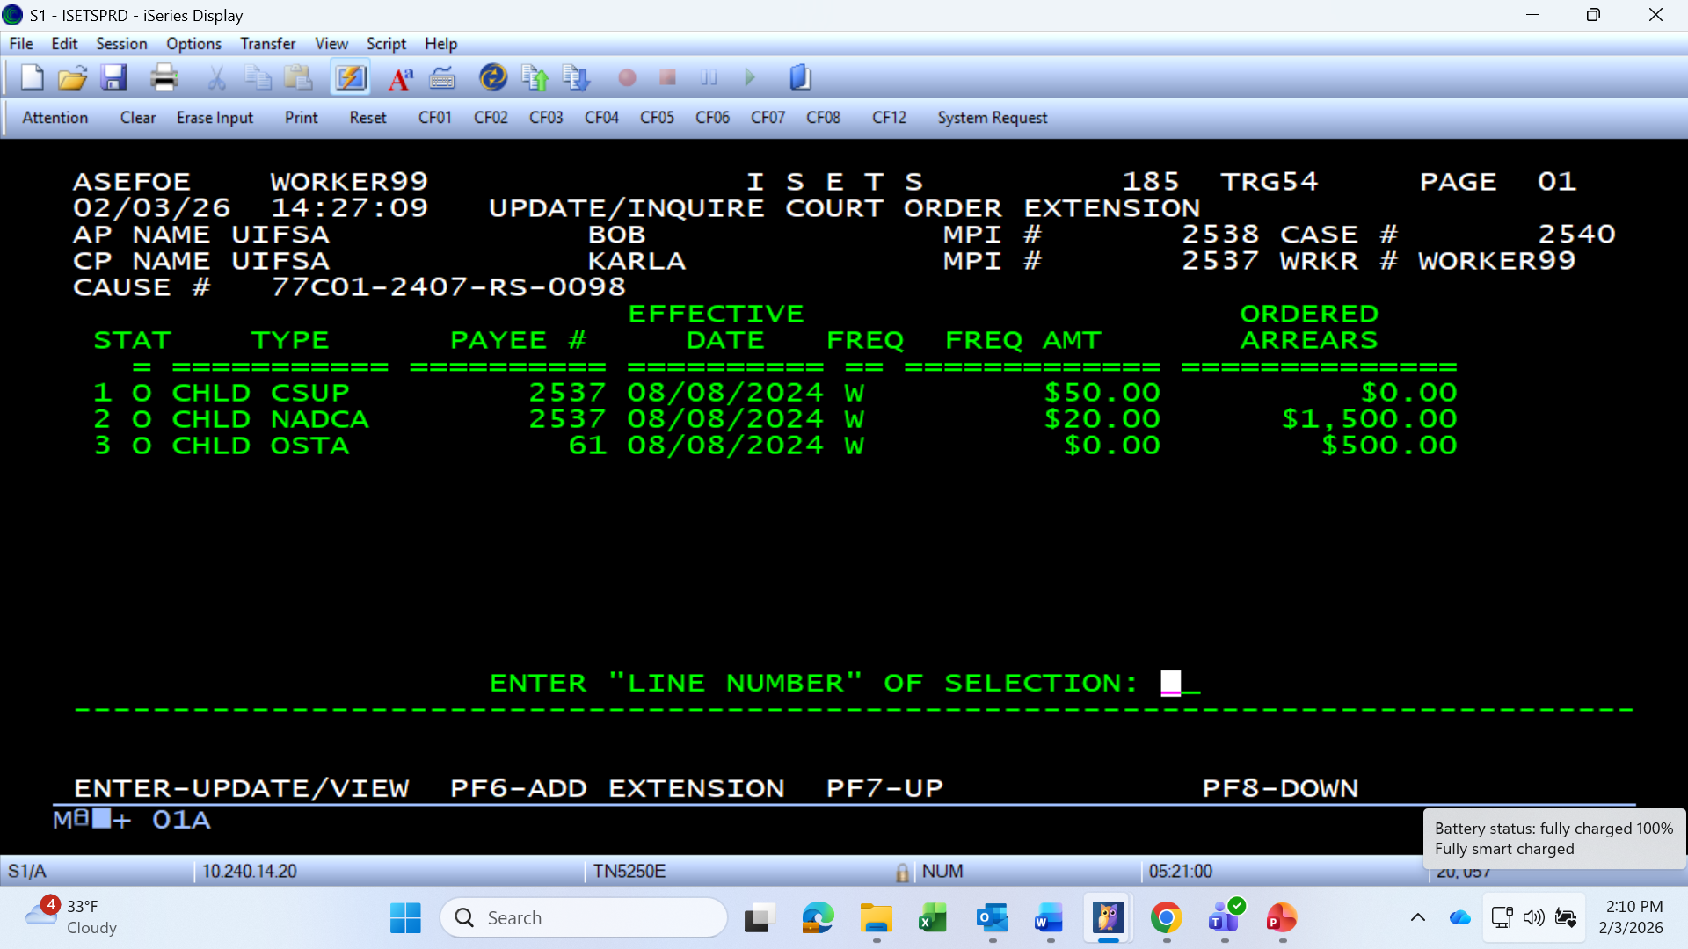
When to Use OSTA Subaccounts
Notes:
Screenshot showing the OSTA subaccount set up correctly for the case in ISETS.

Slide 23
