Slide 1
Appeals Case Processing
Kyle Gillaspie
Chief Staff Attorney, Court of Appeals of Indiana

Slide 2
Where an Appeal Begins
An appeal begins with the entry of an appealable order.
Typically, it is a final judgment that disposes of all claims as to all parties.
But it could be an interlocutory order.

Slide 3
The Notice of Appeal
Filed with Appellate Clerk
30 days after final judgment

Slide 4
Service of the Notice of Appeal
Appellate Clerk serves Notice of Appeal on:
Trial Clerk
Trial Judge
Court Reporter

Slide 5
Pass On What You Have Learned
Trial Clerk must give immediate notice to Court Reporter of the filing of the Notice of Appeal

Slide 6
Why the Notice of Appeal is Important
For Clerks – triggers 30-day deadline to file Notice of Completion of Clerk’s Record.
For Court Reporters – (1) triggers 45-day deadline to file transcript; and (2) IDs hearings to be transcribed.

Slide 7
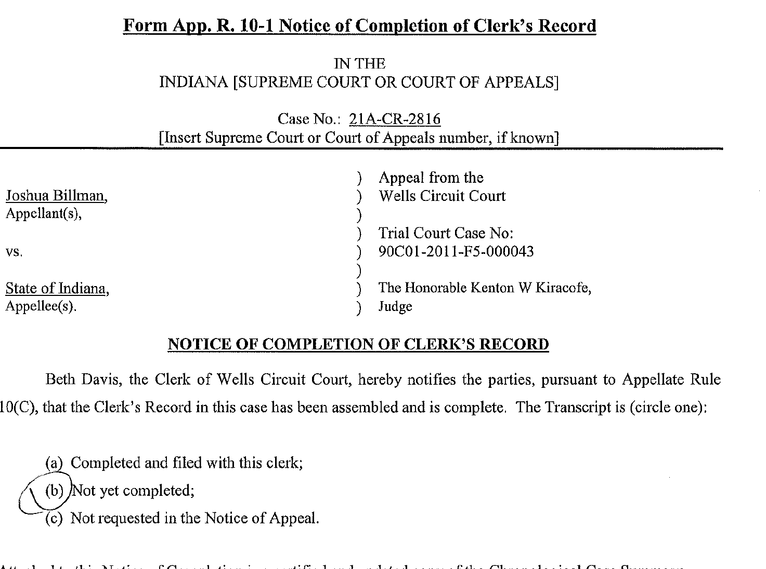
The Notice of Completion of Clerk’s Record

Slide 8
The Notice of Completion of Clerk’s Record
E-File with Appellate Clerk 30 days after Notice of Appeal filed.
Should include a certified copy of the CCS.
States record is assembled and complete.

Slide 9
The Notice of Completion of Clerk’s Record
Should indicate status of Transcript:
Completed
Not Completed
Not Requested

Slide 10
The Notice of Completion of Clerk’s Record
Accurately reporting the status of the transcript is important because it may trigger the deadline for a party to file their brief.
If the transcript status is inaccurate, appeals can stall.

Slide 11
The Transcript
The filing of the Notice of Appeal triggers the 45-day deadline to file the transcript.

Slide 12
Filing the Transcript with the Trial Clerk
If e-filing is required in the trial court . . .
Then Court Reporter must e-file transcript and documentary exhibits with trial clerk through the IEFS.
Appellate Rule 28(C)(1)(a)

Slide 13
E-Filing the Transcript
If e-filing is required . . .
Then the Transcript should not be submitted on CD, DVD, or flash drive.

Slide 14
Audio and Video Exhibits
Cannot be e-filed.
☹

Slide 15
Audio and Video Exhibits
Submit on CD, DVD, or flash drive in an envelope stapled into a conventional physical exhibit binder.
Filed with trial clerk the same day the transcript and documentary exhibits are e-filed.

Slide 16
Non-Documentary and Oversized Exhibits
Remain in custody of the trial court.
Do not send Non-Documentary and Oversized Exhibits to Appellate Clerk.

Slide 17
Notice of Filing of Transcript
Court Reporter serves on the parties.
Informs parties transcript has been filed with trial clerk.
Does not trigger any deadlines.

Slide 18
The Notice of Completion of Transcript
Trial Clerk e-files with Appellate Clerk 5 days after Court Reporter files Transcript.
Triggers 30-day deadline for Appellant to file brief.

Slide 19
Access to the Record
The record includes both the Clerk’s Record and the transcript.
Parties need access to the record to prepare their briefs and appendices.

Slide 20
The Clerk’s Record
What is it?
The CCS and . . .
All papers, pleadings, documents, orders, judgments, and other materials filed in the trial court

Slide 21
The Clerk’s Record
Trial Clerk retains Clerk’s Record throughout the appeal.
Unless limited by the trial court, any party can copy any document from the Clerk’s Record and any portion of the transcript.

Slide 22
The Clerk’s Record
A party may request Trial Clerk provide a copy of Clerk’s Record.
*Copies should be provided within 7 days
*Party must pay for copies
** Exception: Pro se Post-Conviction appeals

Slide 23
The Transcript
In general, Trial Clerk retains Transcript until requested by Appellate Clerk

Slide 24
Access to the Transcript
Before transmittal to Appellate Clerk . . .
Any party may withdraw Transcript or a copy at no extra cost while preparing their appellate brief.

Slide 25
Benefits of E-Filing Transcript
Compliance with Appellate Rules
No need to mail transcript to appellate counsel
Easier for COA to review

Slide 26
Transmittal of the Transcript
Trial Clerk must transmit Transcript and documentary exhibits to Appellate Clerk in electronic format.
E-File through IEFS

Slide 27
Audio and Video Exhibits
Court Reporter should submit on CD, DVD, or flash drive in an envelope stapled into a conventional physical exhibit binder

Slide 28
Audio and Video Exhibits
Trial Clerk mails to Appellate Clerk at the same time the transcript and documentary exhibits are e-filed.
Do not retain!

Slide 29
Non-Documentary Exhibits
Remember!
Do not send Non-Documentary or Oversized Exhibits.
Those remain in custody of trial court.

