Slide 1

ABC’s of the
CEB 9’s
Presented by:
David Shelton
Knox County Clerk
1

Slide 2
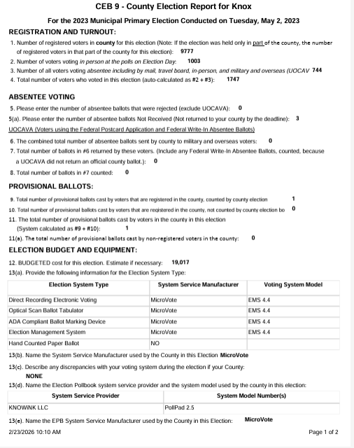
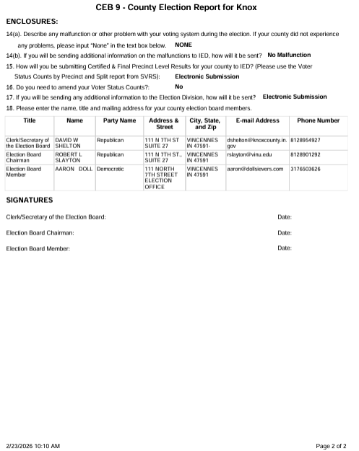
2222

Slide 3
CEB-9 Section I
HOW TO FIND THE STEP-BY-STEP IN SVRS
SVRS- MAIN SCREEN
STEP BY STEP INSTRUCTIONS
3

Slide 4
CEB -9 Section I
Where to find step-by-step instructions, continued:
ELECTION
CEB FORM GENERATION
A 49 STEP-BY-STEP DOCUMENT IS AVAILABLE TO PRINT.
4

Slide 5
CEB 9 Section I
Where to find the correct reporting information for each step.
Registration and Turnout, questions 1-4.
This information can be found at the top of the FINAL Election Night Summary report.
Absentee Voting
5). Reports/Absentee/ABS Rejected by Reason
5 (a). Reports/ABS Ballot Activity Report
6). Reports/ABS Ballot Activity Report
7). Reports/ABS Ballot Activity Report
8). Total number counted in #7.
5

Slide 6
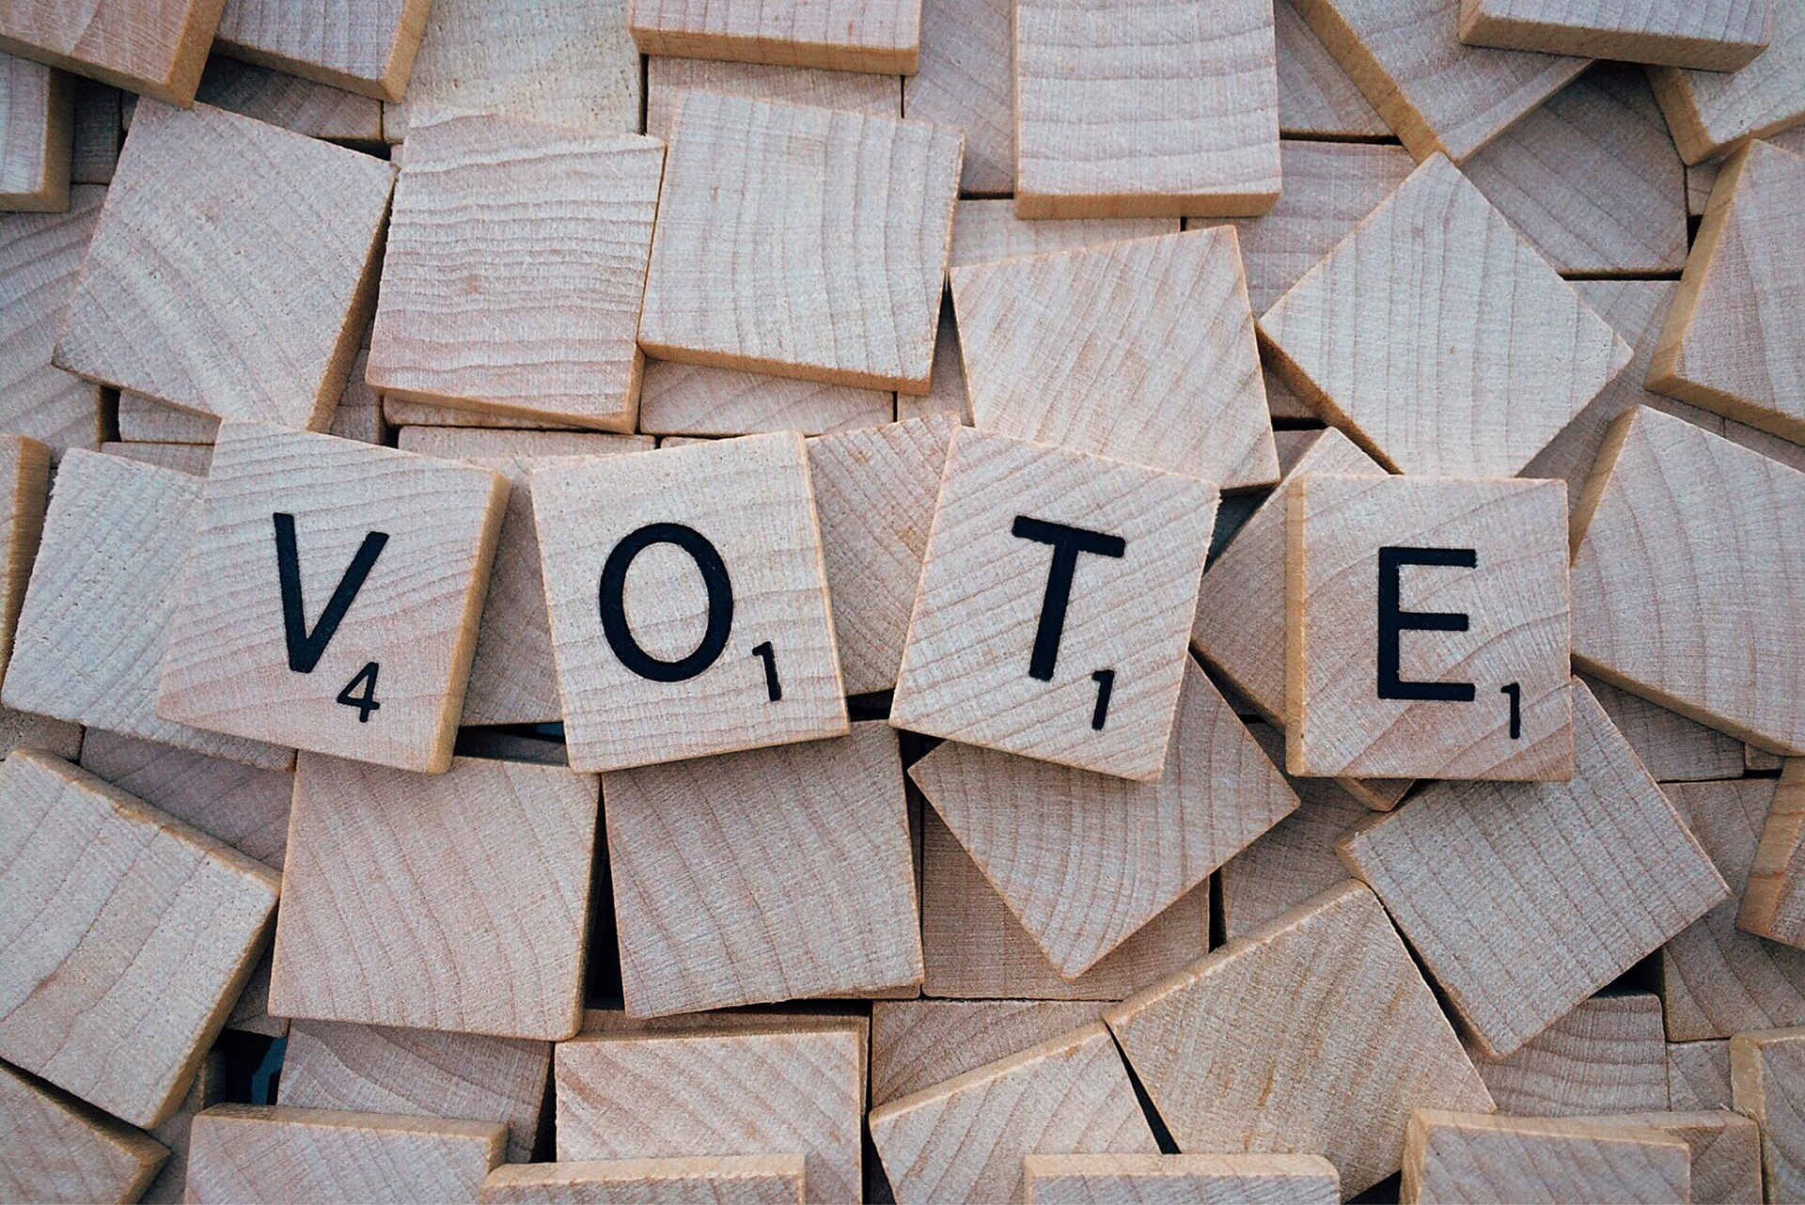
CEB-9, Section I
Provisional Ballots:
9). Final Election Night Summary report
10). Reports/Absentee/ABS Ballot Activity Report
11). Add lines 9 & 10 to get the answer
11 (a). The will be determined after the CEB Hearing for Provisional Ballots cast.
6

Slide 7

Election Budget and Equipment:
12. Estimated or actual Amount Spent on this Election.
What can you bill for:
Absentee Voter Board/Poll Worker Pay
Advertising/Legal Notices
Election Day Meals
Paper supplies
Poll workers
Postage/ Absentee Applications/Ballots
Mechanics
Security/Vote Centers/ Internet Security to Poll Pads
Vendor/Equipment Programming/Ballot Creation
7
This Photo by Unknown Author is licensed under CC BY-SA

Slide 8
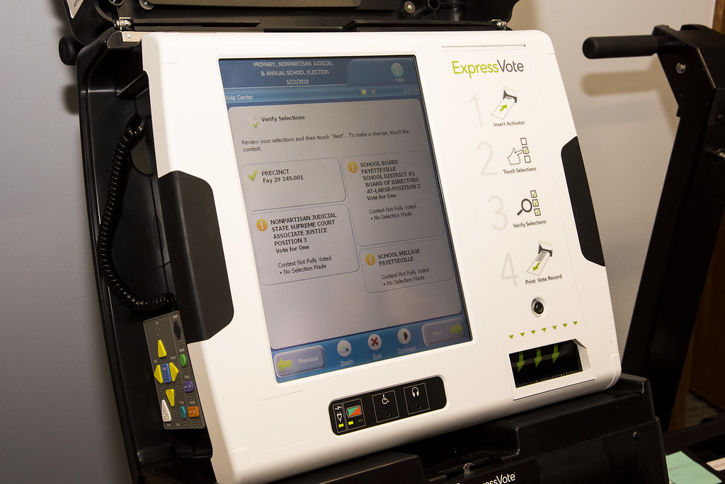
CEB-9 Section I
Equipment:
13(a),(b),(d), (e)
If you cannot locate this information on your equipment. You should reach out to your Vendor. They will be happy to assist you.
Exception for (c)
You should keep a list of discrepancies and contact your Vendor to discuss them.
14 (a.) Again, keep track of discrepancies and malfunctions. They are reported here.
14(b). If discrepancies are found, how will you send the information to the IED?
8

Slide 9

CEB-9, Section I
15.) Submitting Certified & Final Results to the IED
You need to submit Final Precinct Level Results
You need Voter Status Counts by Precinct and Split report from SVRS
You can submit these electronically through an SVRS upload, save them to a file, and attach them to the CEB form found in SVRS/Election/Election Results/Execute CEB Forms / Paperclip Icon by the CEB-9 Section I, link.
16). ONCE YOU MARK IT FINAL YOU CANNOT CHANGE IT WITHOUT AN AMENDMENT.
17). How will you send additional information to the IED if needed?
18). You need to enter your Election Board Members’ contact information. They will also need to certify the results with their signatures before you submit to the IED.
9

