Slide 1

A Deep Dive
Into the ESI
Wednesday, March 4, 2026
Presented By: Lisa Gray & Duncan Klemm

Slide 2


The VSTOP Team
Duncan Klemm, BA
VSTOP IT Specialist
dklemm@bsu.edu
Alisa Gray, MPA
Training & Assessment Specialist
Asgray2@bsu.edu

Slide 3
Objectives
What is an Election System Inventory?
How does the ESI get updated?
How can the ESI support and improve the administration of elections?
Who has access to the ESI and how to create an account?
How to navigate the ESI?
Discuss new ESI Platform.

Slide 4
What is ESI?
Election System Inventory
Managed by the Voting System Technical Oversight Program
A detailed list of all election-related equipment and systems used to support and conduct an election
Tracks specific information for each item (make, model, serial number, storage location)
Purpose: Keep Indiana and federal stakeholders updated on election equipment across Indiana

Slide 5
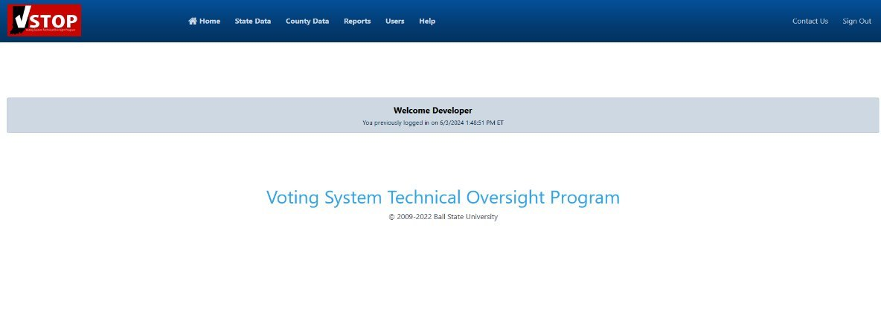
Election System Inventory
What data is stored within VSTOP -ESI?
State-level Data:
Certified Vendor Details
Election System Certifications & Components
County-level Data:
Election Equipment Details
Contracts/Purchase Agreements & Expenses
Storage Locations
Disposal Plans
What does VSTOP use VSTOP-ESI for?
System Certification History
Public Test Lists
Random Audit Lists
Report Generation
Stakeholder Updates
Clerks/Election Officials
SOS/BakerTilly/Civix
Federal Government

Slide 6


Updating the ESI
Forms related to Updating the ESI:
IEC- 22 (IC 3-11-16-5): Update of Voting System Inventory; certification
Due each year, no later than January 31
Inventory should be accurate
VSTOP will confirm with the ESI that it is up-to-date.
IEC-6 (IC 3-11-15-59): Disposition of voting system unit of electronic poll book unit; county election board plan; filing and approval of plan
Disposal plan
Must be completed each time an equipment is being disposed of
Complete form, update ESI, and send to VSTOP
VSTOP will confirm both align

Slide 7
Benefits of the ESI
Enhance accuracy and accountability
Aids in planning and logistics
Improves maintenance and lifecycle management
Informs stakeholders and decision-makers

Slide 8
New ESI Platform
Inventory will be transferred automatically
New accounts will need to be made
Current County Admins will have an account created; they will need to create accounts for subordinates
How to Create an Account:
Admin > Manage Users > Create New
Expected Launch Date: Mid 2026

Slide 9

Live Demonstration
Encourage you to take notes during this time
Will be a time at the end for questions

Slide 10
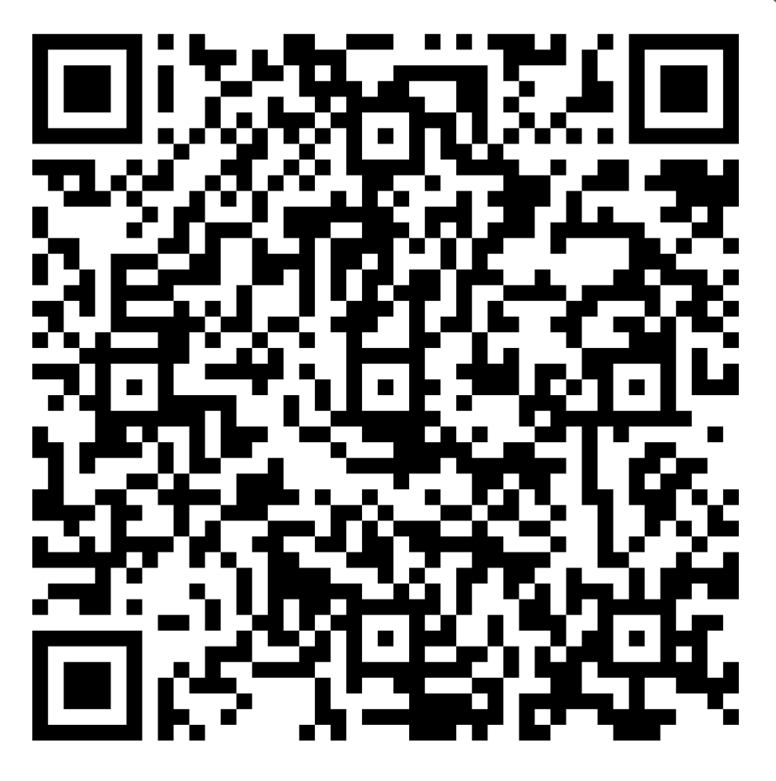

The Certificate in Election Administration, Technology, and Security Program
Connect with fellow Hoosier Election Administrators
Enhance your understanding and management of Indiana Elections​
​
Network with technical experts in the election industry
Establish rapport with the VSTOP Team
Cohort 8 Applications Now Open!

Slide 11

Questions
VSTOP ESI: vstopsupport@bsu.edu
VRAPSA: vrapsa@bsu.edu
CEATS: CEATS@bsu.edu
Any other inquiries: vstop@bsu.edu
Office number: (765) 285 -8784

